Slide 1
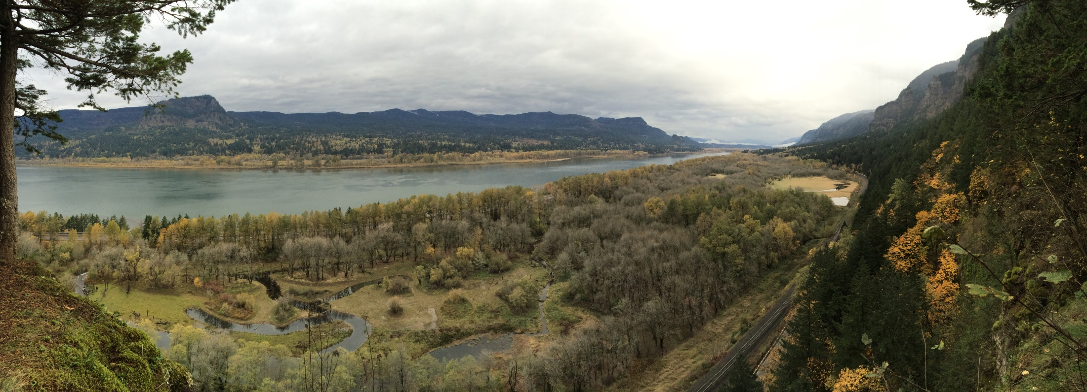
Cold Water Refuges in the lower
Columbia River
Catherine Corbett, Chris Collins, Keith Marcoe,
Paul Kolp, Matthew Schwartz

Slide 2
Predicted Changes with Climate Change
Climate change impacts:
Sea level rise –
Further loss of estuarine and coastal habitat through submersion, conversion and erosion
More intense storms, increased wave energy, increased erosion
Changes in upwelling patterns off coast -
Increased intrusion of hypoxia and acidification into estuaries
Increased influence with lower summer flows w/precipitation changes
Warmer temperatures–
Less habitat for cold water species (salmon, steelhead, trout)
Species shifts, migration, mortality, increased competition
Changing precipitation patterns –
More precipitation falling as rain, lower snow packs in mountains
Higher winter flows, lower summer flows
Altered timing and rates of change in flow events
More and more severe droughts
Increased pest invasions of forests
Larger, more severe forest fires
Vast changes to native habitat conditions and flora/fauna

Slide 3
Paradigm Shift
Mitigating for Climate Change:
To maintain floodplain wetlands, will need to allow wetlands to migrate inland
Assess sea level rise, marsh erosion, submersion
Identify areas - urban, productive agricultural - that will be protected
Protect more inland, upland areas behind current habitats
Strategic levee and dike modification
Identify ways to support species ability to adapt
Provide diversity of habitats to support resiliency of species using them
Protect, restore base flow, groundwater inputs to tributaries, alluvial fans to provide cold water refugia
Understand likely changes in habitat structure with increasing temperatures, changing precipitation and inundation, flow patterns
Understand likely species shifts, migration, mortality, competition
Adapt management strategies – focus on restoring historic conditions will not be protective of native species in the long term

Slide 4
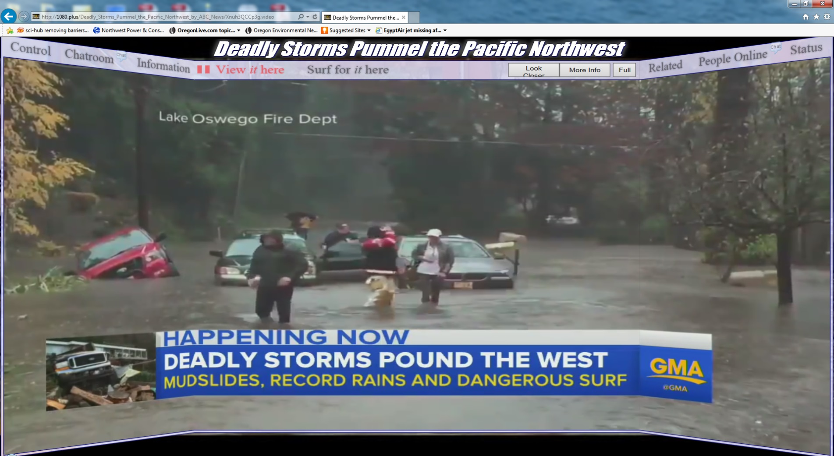
Orderly Proactive Transition vs Abrupt Reactive Change
Knowledge and leadership is key

Slide 5
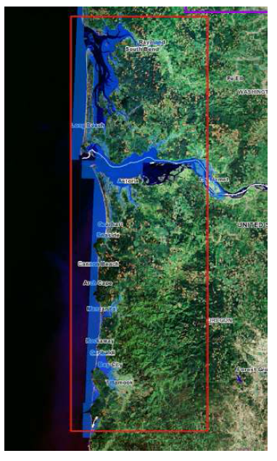
Mitigating for Climate Change– Sea Level Rise
NWF 2007 - Modeled SLR for Puget Sound to Tillamook Bay
Demonstrates likelihood of significant loss of floodplain habitats
Inundation, conversion and erosion
Flooding of urban areas in Astoria, Ilwaco, etc
Good first step BUT need more site specific, detailed information
Lower Columbia composited with Willapa down to Tillamook Bay (1.4 million acres)
Covered only up to Cathlamet
Local planners, officials, funders, restoration practitioners, cannot make significant investment decisions based on these data alone

Slide 6
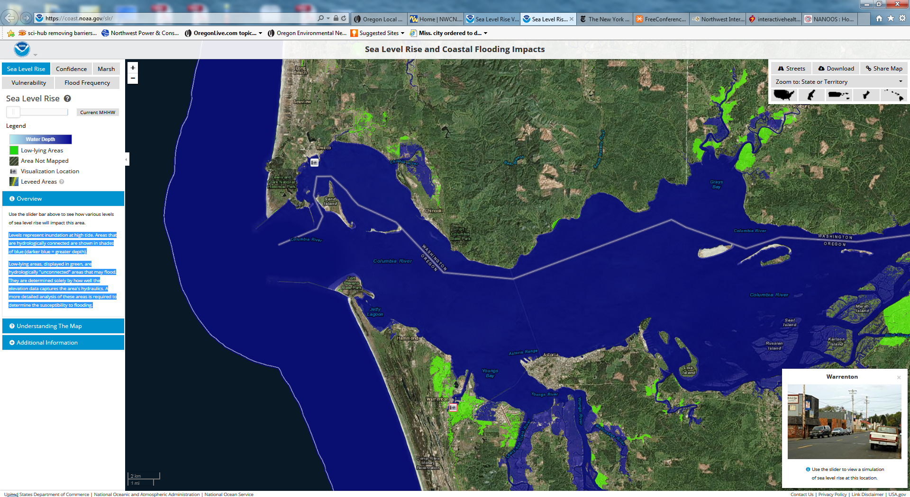
Current MHHW
Levels represent inundation at high tide. Areas that are hydrologically connected are shown in shades of blue (darker blue = greater depth).
Low-lying areas, displayed in green, are hydrologically "unconnected" areas that may flood. They are determined solely by how well the elevation data captures the area's hydraulics. A more detailed analysis of these areas is required to determine the susceptibility to flooding.
https://coast.noaa.gov/slr/

Slide 7
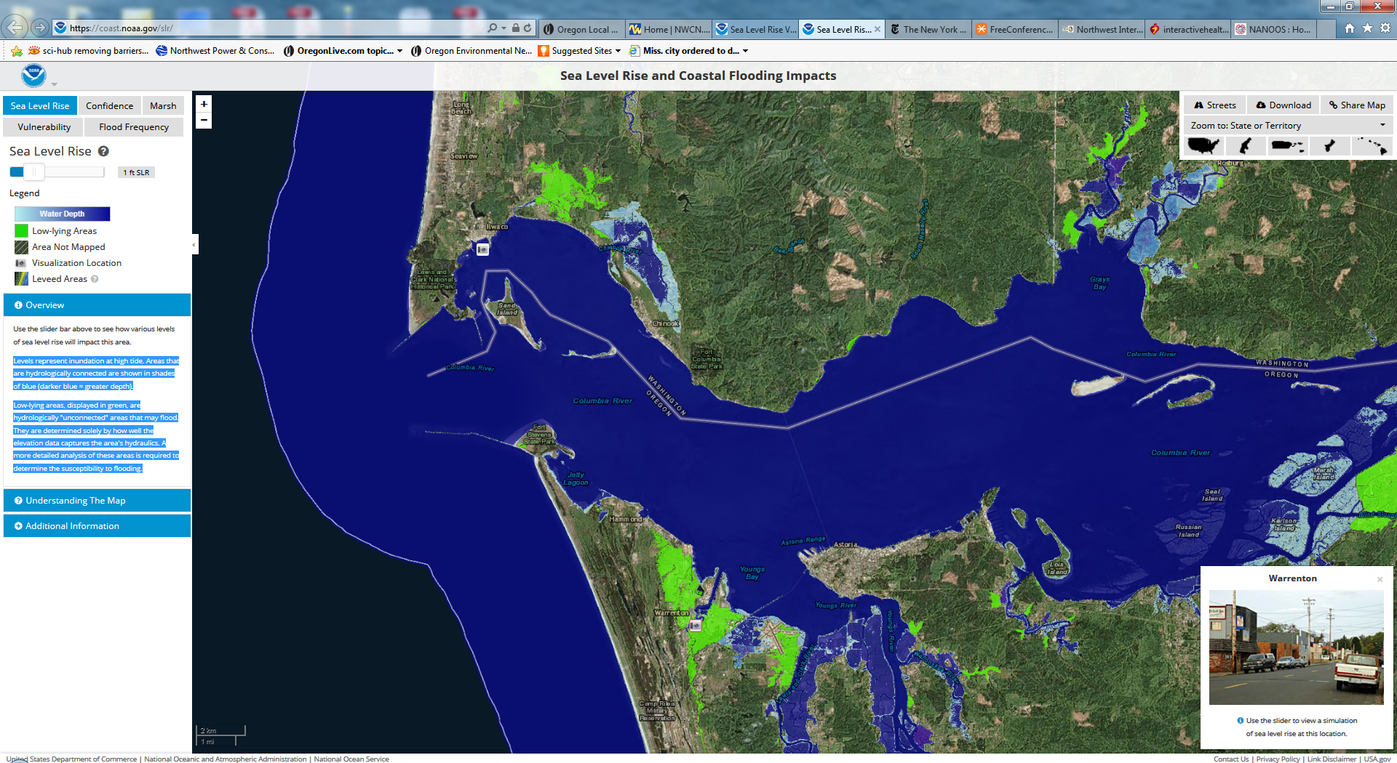
1ft Sea Level Rise
Levels represent inundation at high tide. Areas that are hydrologically connected are shown in shades of blue (darker blue = greater depth).
Low-lying areas, displayed in green, are hydrologically "unconnected" areas that may flood. They are determined solely by how well the elevation data captures the area's hydraulics. A more detailed analysis of these areas is required to determine the susceptibility to flooding.
https://coast.noaa.gov/slr/

Slide 8
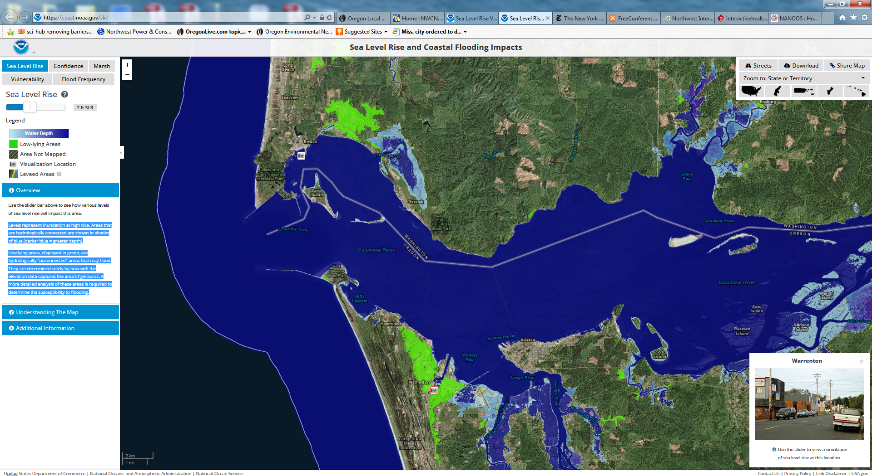
2ft Sea Level Rise
Levels represent inundation at high tide. Areas that are hydrologically connected are shown in shades of blue (darker blue = greater depth).
Low-lying areas, displayed in green, are hydrologically "unconnected" areas that may flood. They are determined solely by how well the elevation data captures the area's hydraulics. A more detailed analysis of these areas is required to determine the susceptibility to flooding.
https://coast.noaa.gov/slr/

Slide 9
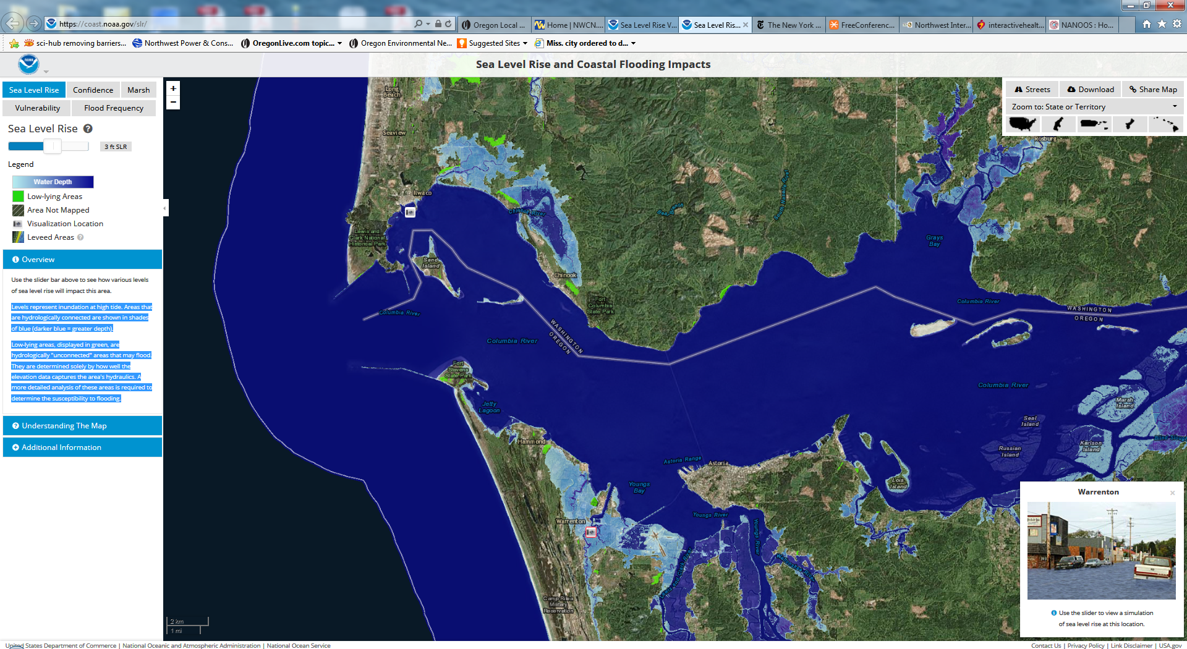
3ft Sea Level Rise
Levels represent inundation at high tide. Areas that are hydrologically connected are shown in shades of blue (darker blue = greater depth).
Low-lying areas, displayed in green, are hydrologically "unconnected" areas that may flood. They are determined solely by how well the elevation data captures the area's hydraulics. A more detailed analysis of these areas is required to determine the susceptibility to flooding.
https://coast.noaa.gov/slr/

Slide 10
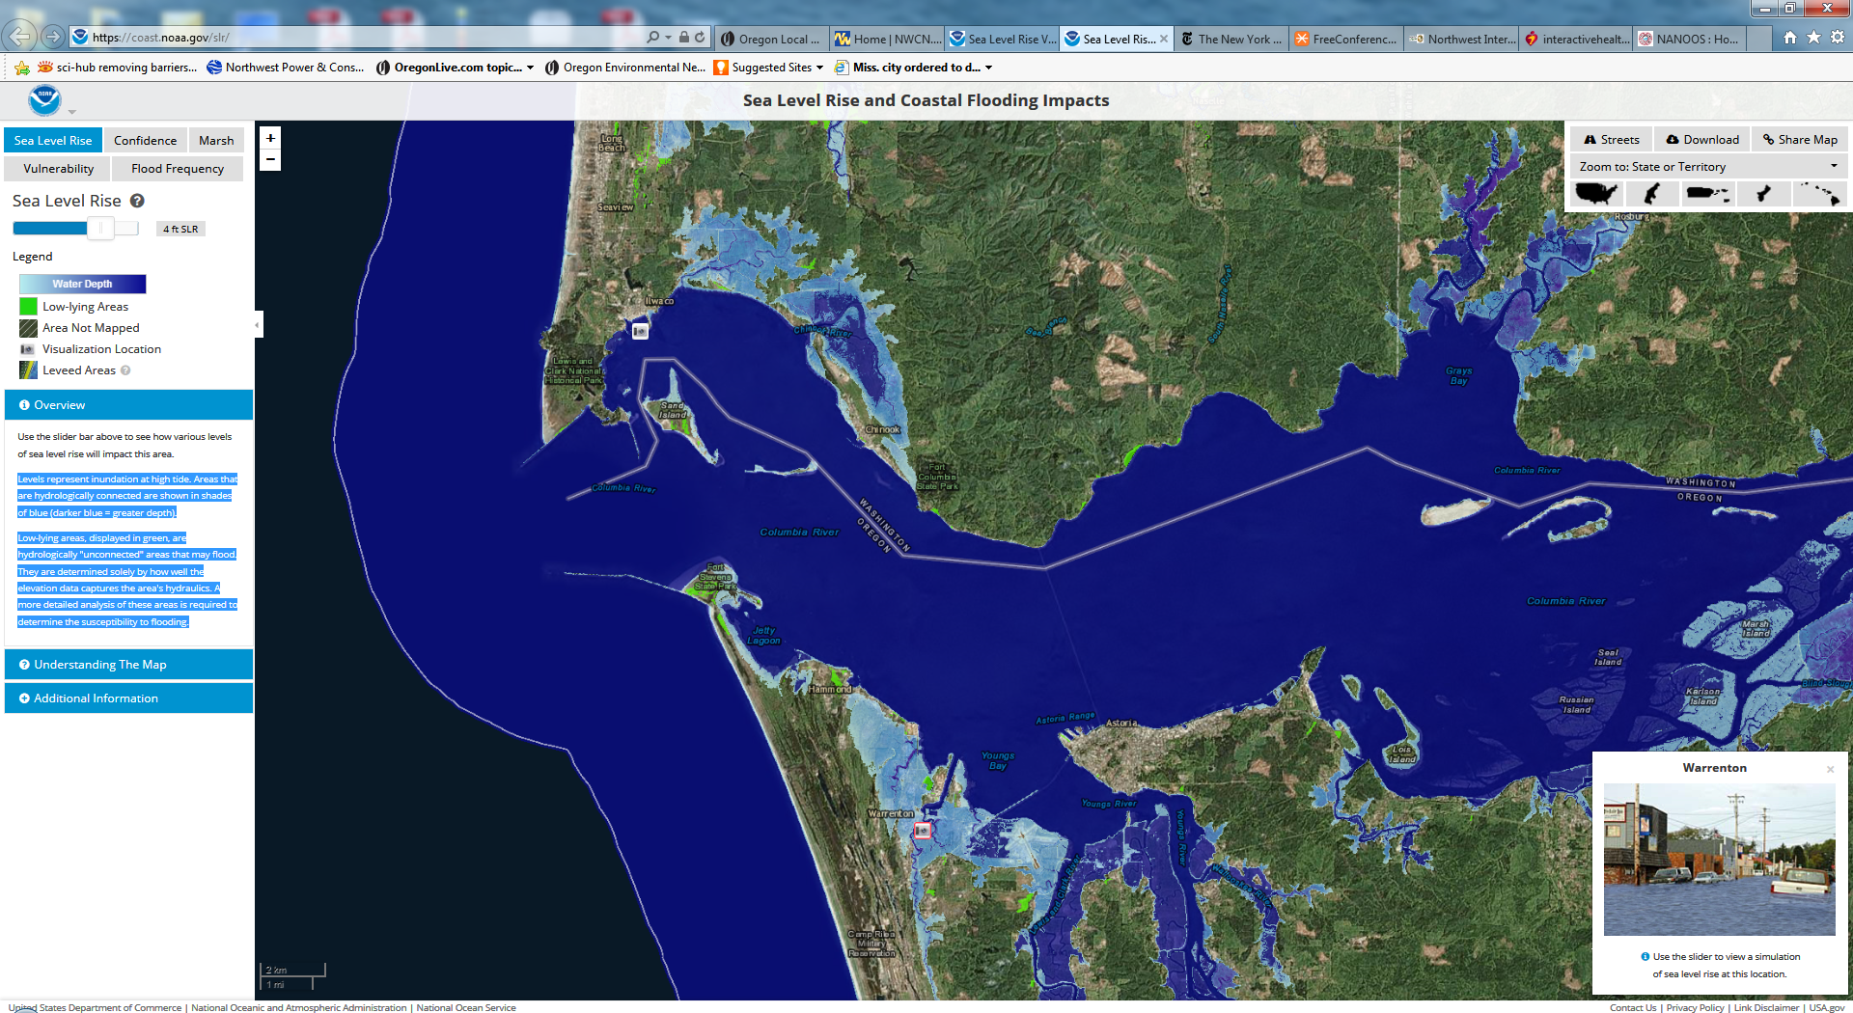
4ft Sea Level Rise
Levels represent inundation at high tide. Areas that are hydrologically connected are shown in shades of blue (darker blue = greater depth).
Low-lying areas, displayed in green, are hydrologically "unconnected" areas that may flood. They are determined solely by how well the elevation data captures the area's hydraulics. A more detailed analysis of these areas is required to determine the susceptibility to flooding.
https://coast.noaa.gov/slr/

Slide 11
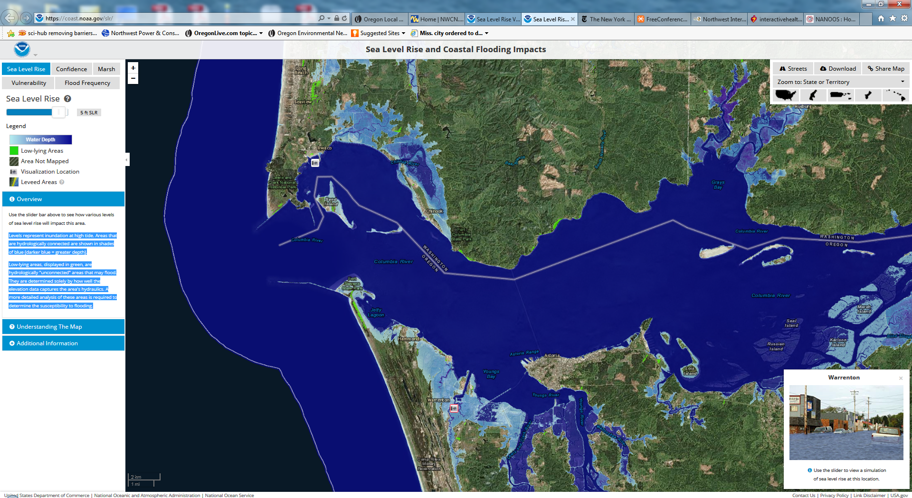
5ft Sea Level Rise
Levels represent inundation at high tide. Areas that are hydrologically connected are shown in shades of blue (darker blue = greater depth).
Low-lying areas, displayed in green, are hydrologically "unconnected" areas that may flood. They are determined solely by how well the elevation data captures the area's hydraulics. A more detailed analysis of these areas is required to determine the susceptibility to flooding.
https://coast.noaa.gov/slr/

Slide 12
6ft Sea Level Rise
Levels represent inundation at high tide. Areas that are hydrologically connected are shown in shades of blue (darker blue = greater depth).
Low-lying areas, displayed in green, are hydrologically "unconnected" areas that may flood. They are determined solely by how well the elevation data captures the area's hydraulics. A more detailed analysis of these areas is required to determine the susceptibility to flooding.
https://coast.noaa.gov/slr/

Slide 13
CMOP Stations – operated and maintained by OHSU
Provided by Joe Needoba

Slide 14
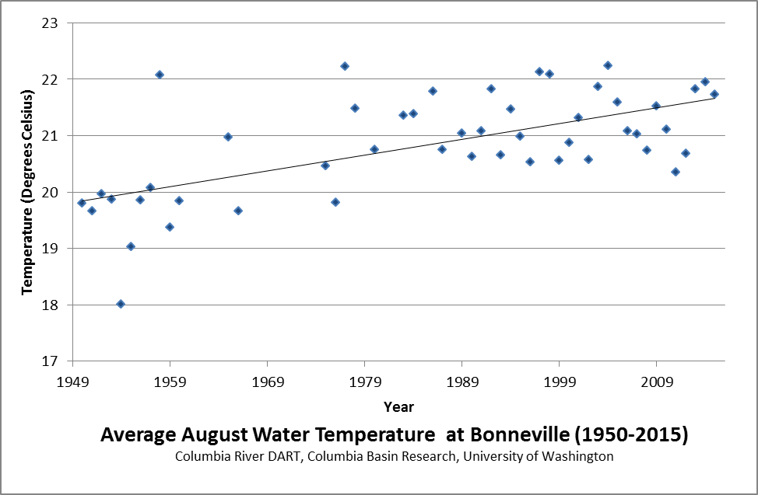
Mitigating for Climate Change– Thermal Refuges
Most natural systems have spatially variable thermal profiles, i.e., not homogenous and not linear (Fullerton et al. 2015)
Mainstem temperatures have increased over the last 70 years
Mainstem temperatures predicted to continue to increase, and extend in duration

Slide 15
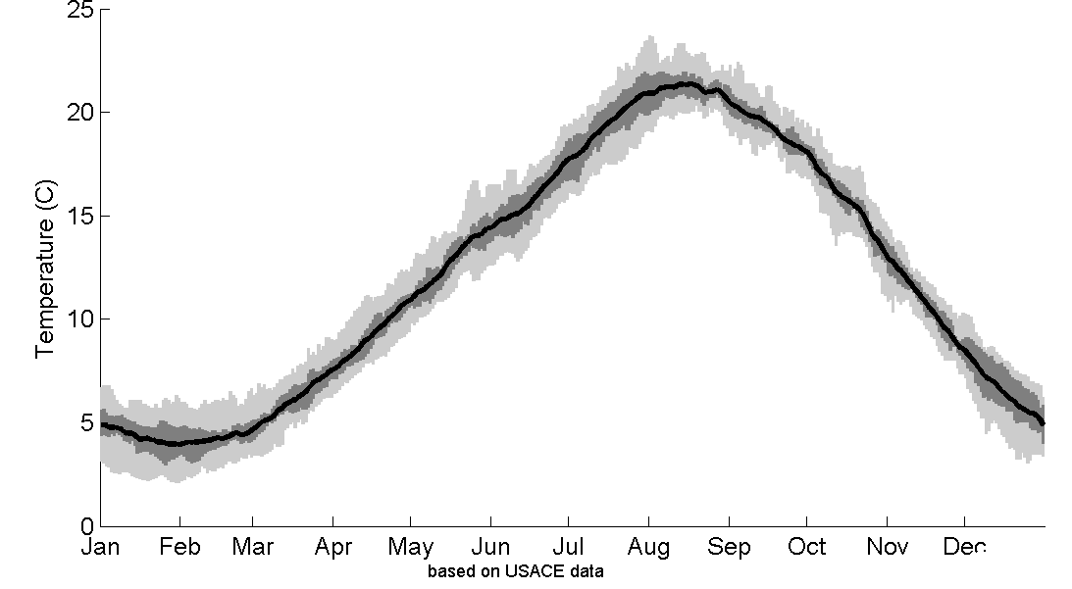
Mainstem thermal regime during juvenile salmon outmigration
UZNG (24˚C)
(Beechie et al. 2012)
2015 Mainstem Temps
Regulatory (18˚C)
Ideal (16˚C)
(Beechie et al. 2012)
Subyearling
Chinook Pass
Bonn. Dam

Slide 16
Mainstem thermal regime during adult returns
~50% of steelhead used thermal refugia when temperatures were 19-21°C.
>70% used tributaries when temperatures were > 21°C.
Duration of use extended to weeks during the warmest times.
0
2015 Temps
Graph and text copied from Keefer et al. 2011.

Slide 17
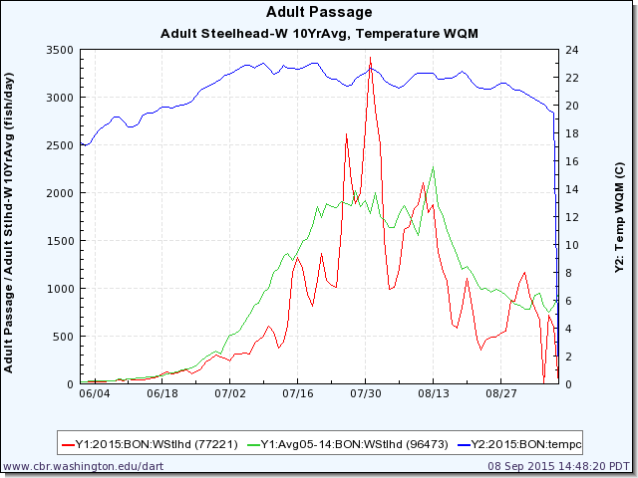
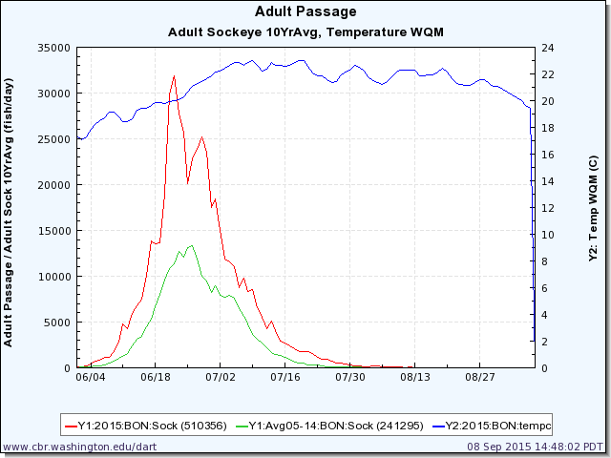
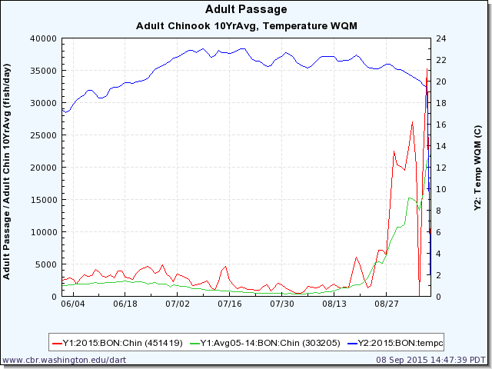
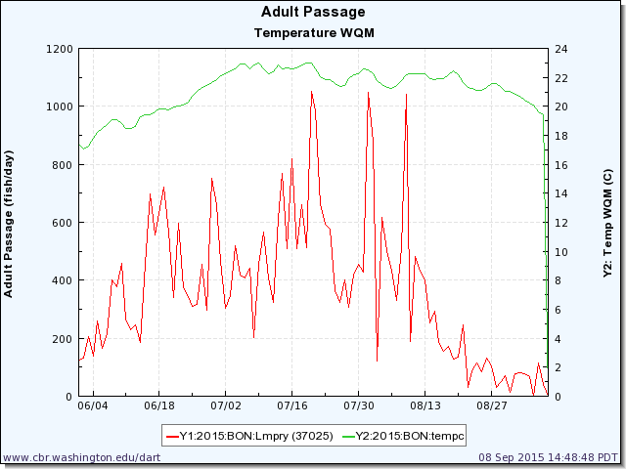
Wild Steelhead
23˚C vs. 21˚C at peak
Sockeye salmon
20˚C vs. 16˚C at peak
Lamprey
23˚C at peak
Summer Chinook salmon
21˚C vs. 18˚C at peak
USGS video
“These conditions profoundly impacted sockeye passage, travel time and survival. The 2009 to 2014 migration years saw survival of adult sockeye from Bonneville Dam to Lower Granite Dam of 44 percent to 77 percent. In 2015, survival was just 4 percent.” http://www.cbbulletin.com/435505.aspx

Slide 18
Mainstem thermal regime during adult returns
Steelhead returns – run timing by population
Graph and text copied from Keefer et al. 2011

Slide 19
Received EPA grant for cold water refuges assessment for 15 Gorge tributaries in 2015-2016 (mostly below Bonneville)
Assess mouths of tributaries, extent of plumes, temperature differential with mainstem
Are conditions at mouths sufficient to cue fish to use tributaries?

Slide 20
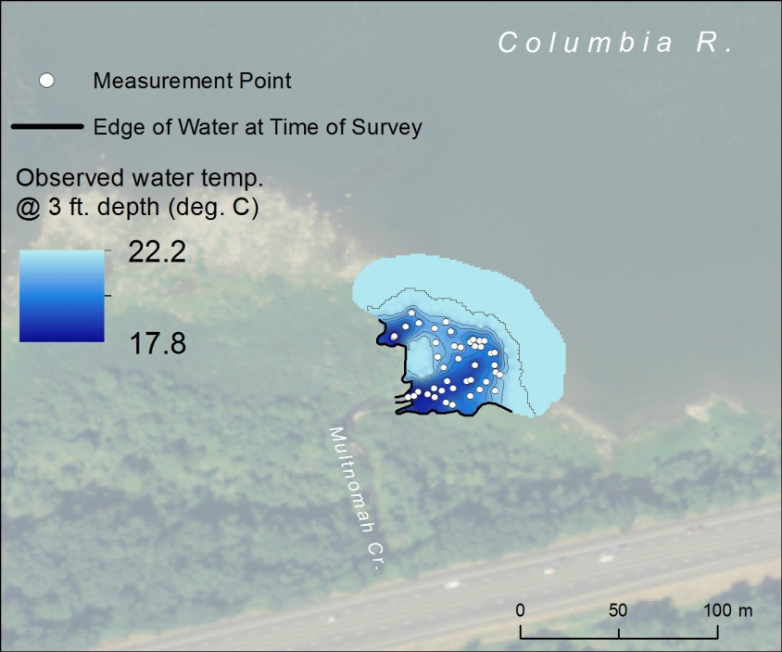
Question 1: What are the characteristics of thermal refuges?
Organized by attributes presented in Ecological Assessment Criteria for Restoring Anadromous Salmonid Habitat in Pacific Northwest Estuaries (Simenstad and Cordell, 2000)
Opportunity/Access:
Adjacent to mainstem
Detection: - Plume must extend into the migratory corridor
- Temperature differential (2 ˚C differential from mainstem (EPA, ODEQ);
2-7˚C cued adults above Bonneville) (Keefer et al. 2011)
Capacity:
Temperature: - physiological: <19˚C (Bottom et al. 2011) - protection from predators: <19˚C (Moyle 2002)
Depth: minimum of ~0.5m for juveniles (Bottom et al. 2005)
Horizontal extent: uncertain
Our Criteria: >- 2°C temperature difference
- 19°C max. tributary temperature
- >0.5m depth
- max. spatial extent practical

Slide 21
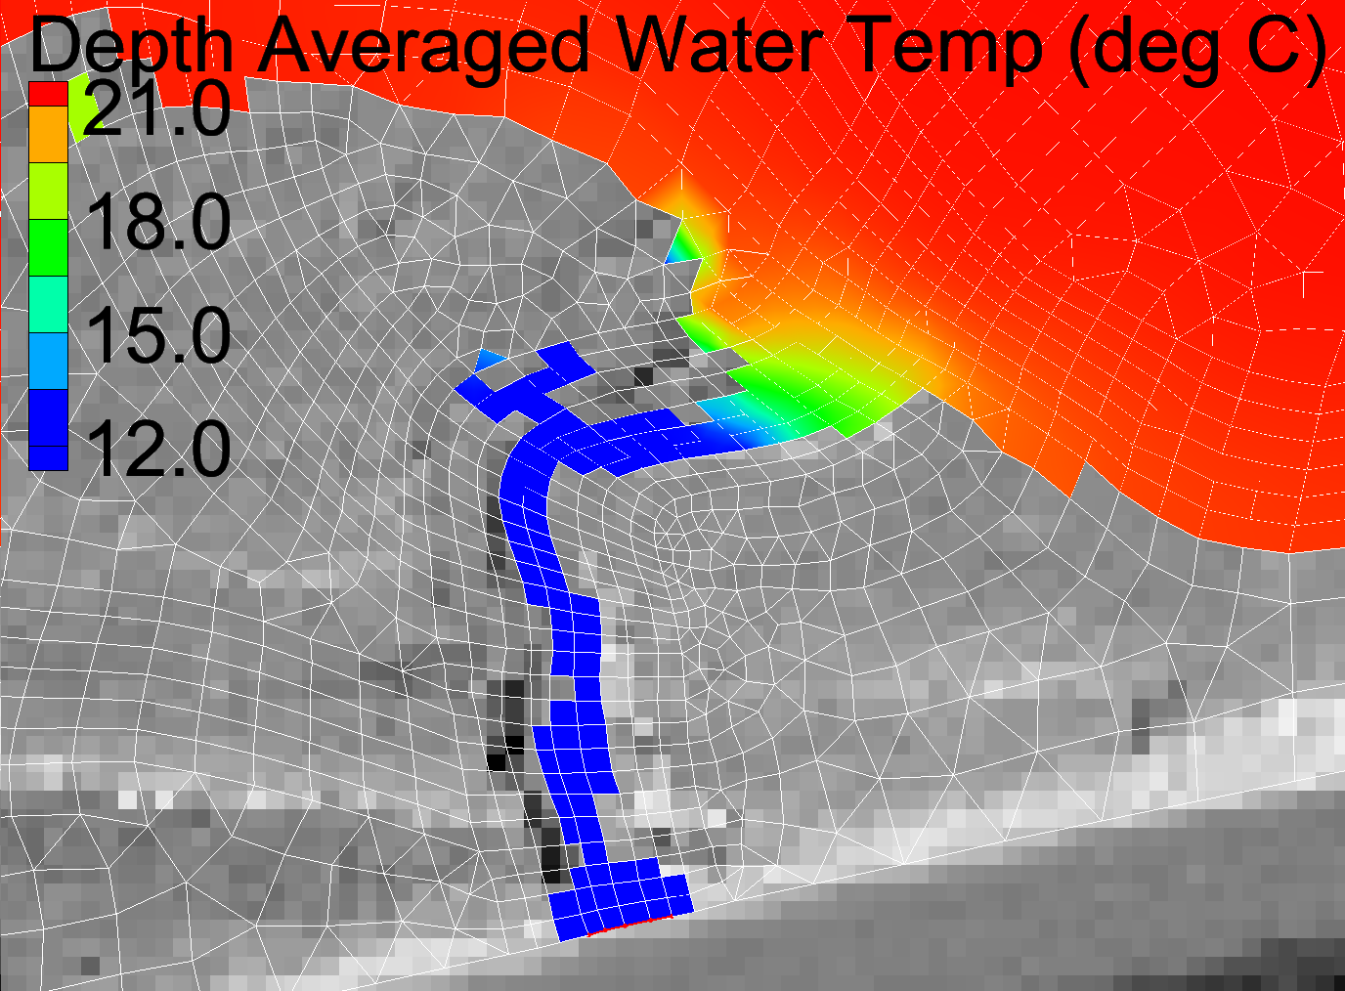
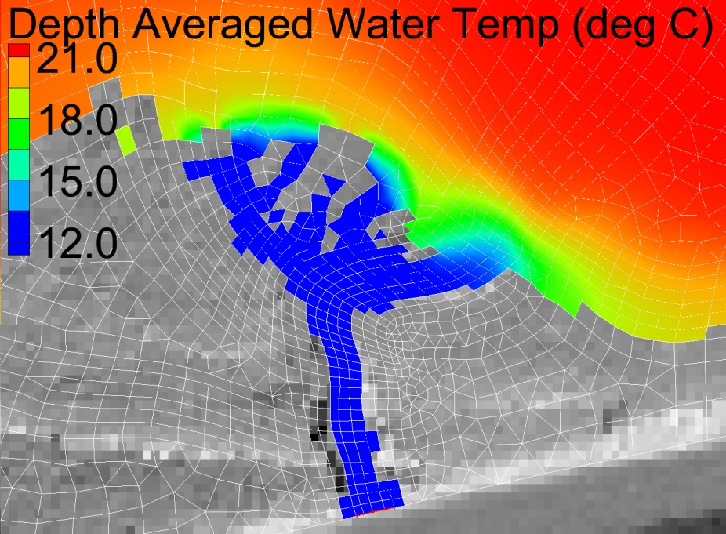
Question 2: What factors influence formation of thermal refuges?
The likelihood of a plume to form at a tributary confluence is influenced by:
Discharge (tributary and mainstem lower Columbia)
Columbia River = 100,000 – 150,000 cfs
Gorge tributaries = 1 – 50 cfs
Water temperature (tributary and mainstem Columbia R.)
Temperature differential b/t Columbia River and tributaries varies from 2 to 11˚C
Q_{TRIB} = 10 cfs
Q_{TRIB} = 50 cfs

Slide 22
Question 2: What factors influence formation of thermal refuges?
The likelihood of a plume to form at a tributary confluence is influenced by:
Discharge (tributary and mainstem Columbia R.)
Columbia River = 100,000 – 150,000 cfs
Gorge tributary = 1 – 50 cfs
Water temperature (tributary and mainstem Columbia R.)
Temp. differential b/t Columbia River and tributary varies from 2 to 11 ˚C
Bathymetric profile (eddy formation)
Atmospheric effects (solar radiation, wind)

Slide 23
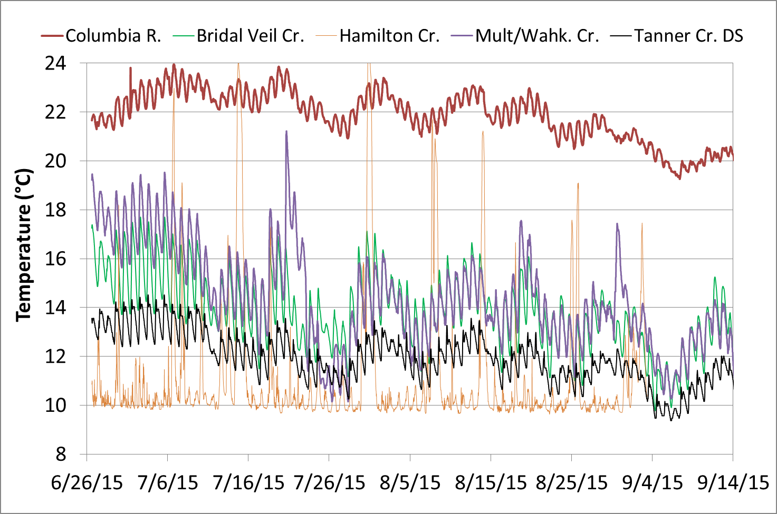
Assessment Results - Stream Temperatures Summer 2015

Slide 24
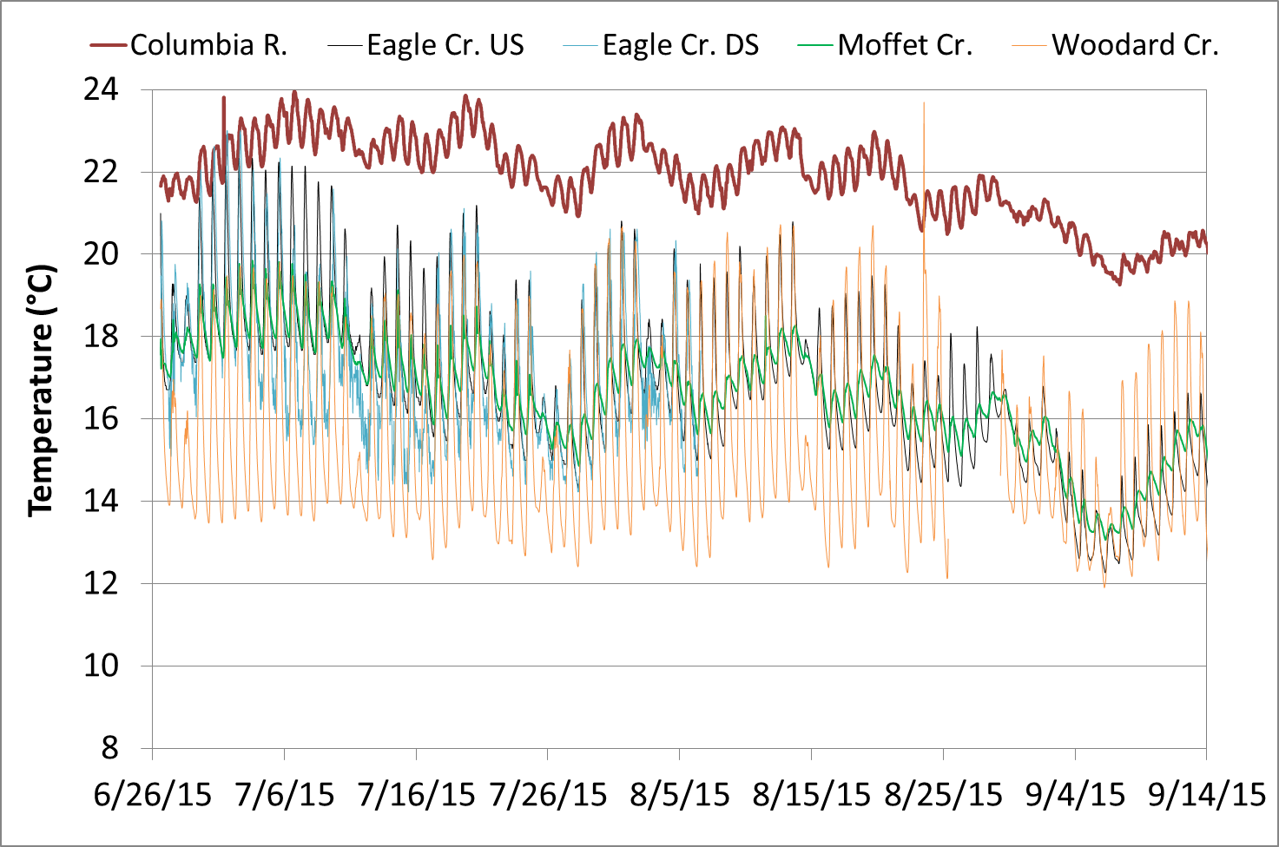
Assessment Results - Stream Temperatures Summer 2015

Slide 25
Assessment Results - Stream Temperatures Summer 2015
Met temperature differential standard
Temperatures for all tributaries were 2 – 10 degrees Celsius less than the mainstem
Plume formation observed at 5 of 15 tributary complexes
Bridal Veil, Multnomah, Horsetail, Tanner, Eagle Creeks
All had discharges > 6 cfs
Plumes were dynamic, varying with time and water depth
Adult salmonids observed using creeks, with and without plumes
Tanner, Eagle Creeks
Lawton Creek confluence, which didn’t have a sign. plume
Could signify cold water refuge use
Some tributaries lost flow at downstream areas
Upstream reaches may still provide cold water refuge for salmonids (observed at McCord Creek).
Further study planned in 2016, working with USEPA

Slide 26
On-Going Cold Water Refuges Work
US EPA under a 2015 NOAA BiOp
Partnering with WA Ecology, OR Department of Environmental Quality, Estuary Partnership
Tasks:
Characterize current spatial and temporal cold water refuges –collecting data at tributary confluences in summer 2016
Characterize current salmon and steelhead use of cold water refuges
Identify potential locations to restore cold water refuges
Assess whether current cold water refuges is sufficient to meet Oregon’s narrative temperature criteria
Characterize additional cold water refuges needed
Identify and prioritize actions to protect, restore or enhance cold water refuges

Slide 27
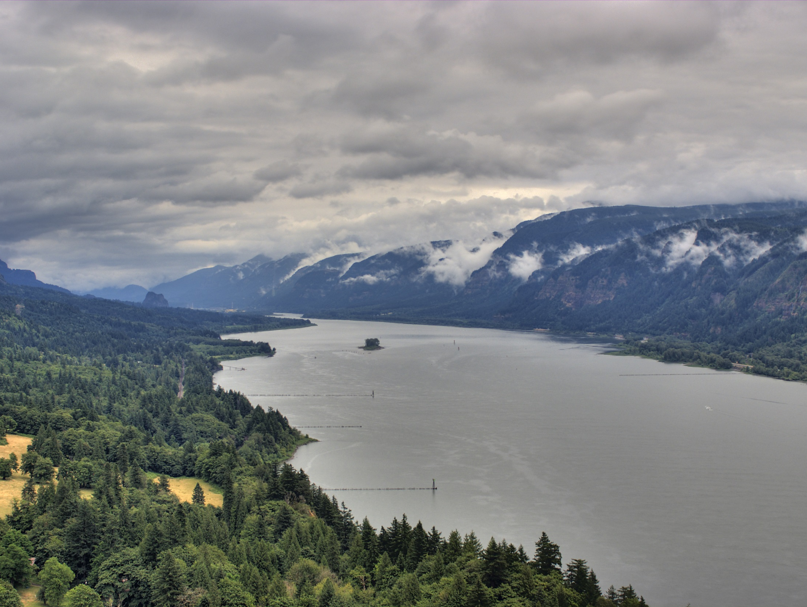
Science to Policy Summit
Climate Change: How vulnerable is the
lower Columbia River?
Questions?

