Slide 1
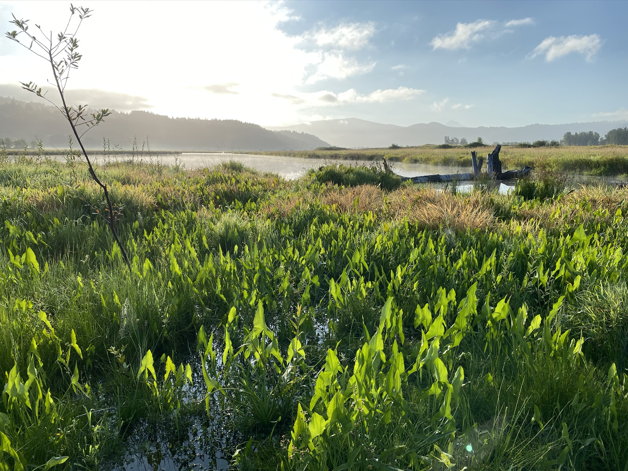


Assessing Effectiveness of Tidal Freshwater Restoration Sites as Natural Climate Solutions
Zoie Brauser and Catherine Corbett

Slide 2
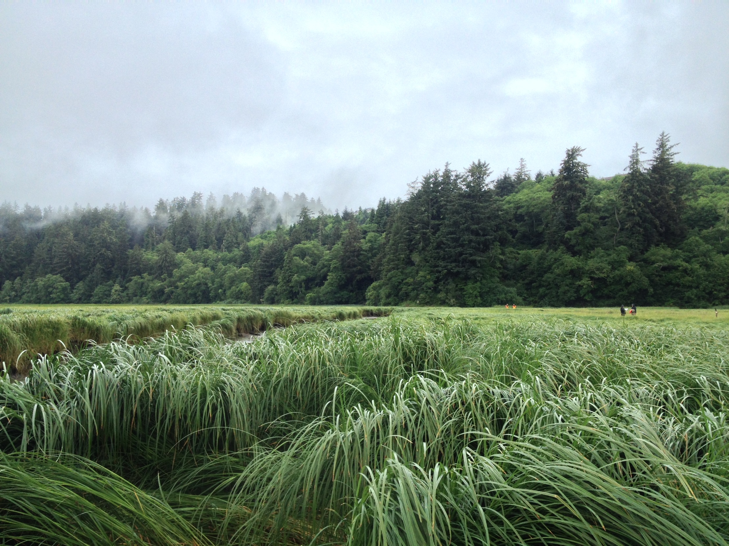
Presentation Overview
Background
Monitoring design and methods
Preliminary data
Takeaways
Next steps
Project significance

Slide 3
Background

Slide 4
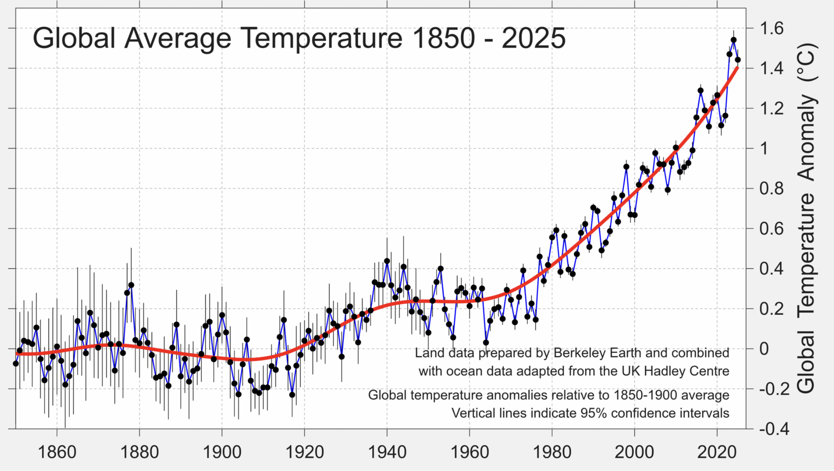
Global climate context
Average global temperature will soon regularly exceed 1.5°C
Source: Berkeley Earth

Slide 5
Global climate context
Need to minimize magnitude and duration of overshoot to avoid destabilizing climate tipping points
(Lenton et al. 2025, IPCC, etc.)
Source: Berkeley Earth

Slide 6
Greenhouse gas reduction goals
Halve emissions by 2030 (from 2010 levels)
Net zero emissions by 2050

Slide 7
Greenhouse gas reduction goals
Halve emissions by 2030 (from 2010 levels)
Net zero emissions by 2050
Scale up renewables
Electrify sectors
Sustainable land management
Improve energy efficiency

Slide 8
Greenhouse gas reduction goals
Halve emissions by 2030 (from 2010 levels)
Net zero emissions by 2050
Scale up renewables
Electrify sectors
Sustainable land management
Improve energy efficiency
Upscale GHG sequestration using natural and working lands

Slide 9
Greenhouse gas reduction goals
Halve emissions by 2030 (from 2010 levels)
Net zero by 2050
Scale up renewables
Electrify sectors
Sustainable land management
Improve energy efficiency
Oregon E.O. 25-26
Washington Climate Commitment Act
Upscale GHG sequestration using natural and working lands
Notes:
Middle line of actions modified from Rosia 2026 (“Strategic frameworks for carbon emission mitigation”)

Slide 10
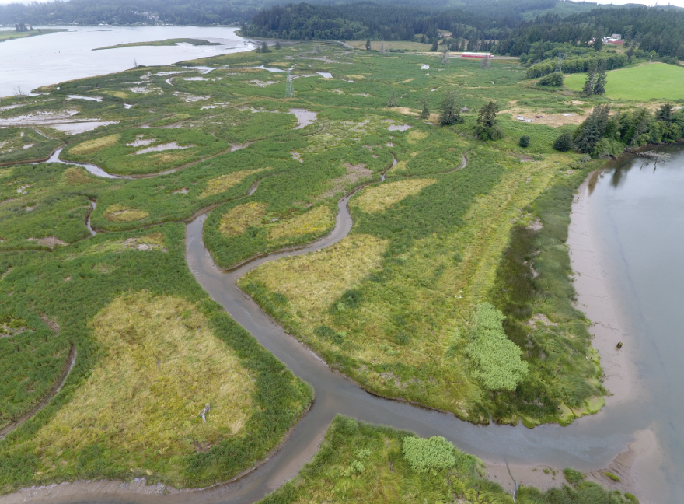
Natural climate solutions
Actions that protect, restore, and manage natural areas to reduce greenhouse gas emissions and store carbon
(e.g., wetland restoration and conservation)
Wallooskee-Youngs Marsh, OR

Slide 11
How can LCEP and other restoration practitioners integrate natural climate solutions at a program scale?

Slide 12
Existing tool: Blue Carbon Calculator
Created by the PNW Blue Carbon Working Group
Estimates GHG emissions and removals over 1-100 year timeframes in coastal habitats
Great tool for practitioners to inform coastal restoration and conservation projects from the perspective of GHG sequestration potential

Slide 13
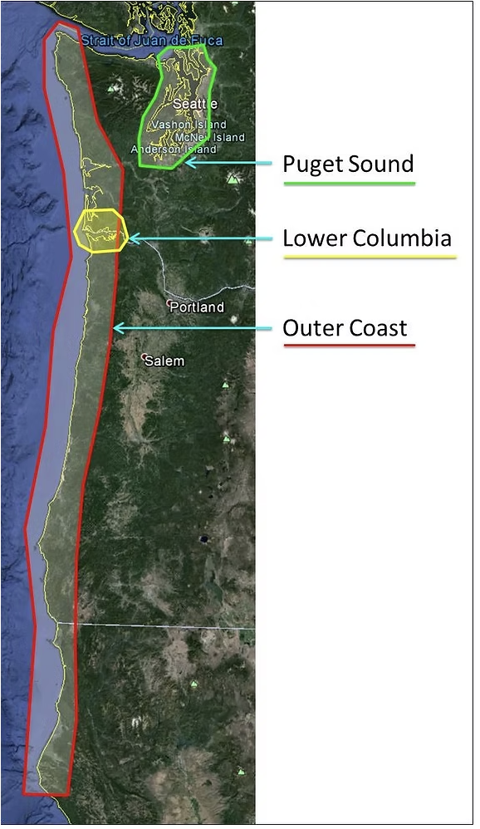
Gaps in the Blue Carbon Calculator for LCEP’s needs
Puget sound
Lower Columbia
Data focus on saline and brackish coastal habitats
Relies primarily on global literature for tidal freshwater
Doesn’t have data for tidally influenced or riparian areas (teal carbon)
Outer coast
Blue Carbon Working Group study area
Source: PNW Blue Carbon WG

Slide 14


Gaps in the Blue Carbon Calculator for LCEP’s needs
Puget sound
Lower Columbia
Data focus on saline and brackish coastal habitats
Relies primarily on global literature for tidal freshwater
Doesn’t have data for tidally influenced or riparian areas (teal carbon)
May not be accurate for most of the lower Columbia estuary
Outer coast
LCEP area of work
Blue Carbon Working Group study area
Source: PNW Blue Carbon WG

Slide 15
Saline and freshwater wetlands have different GHG dynamics
Freshwater wetlands produce more methane due to different microbial communities
Methane emissions can offset CO2 uptake
We need to monitor methane emissions to determine if it’s feasible for our restoration projects to be natural climate solutions

Slide 16
CCMP Habitat Restoration Action 1
Expand and refine regional carbon calculators to:
Include riparian and riverine restoration and conservation actions...
so that these areas can be used as natural mitigation solutions and ultimately within carbon programs

Slide 17
CCMP Habitat Restoration Action 1
Develop an inventory of greenhouse gas sequestration potential by habitats across the lower river

Slide 18
Summary of project goals
Collect data on CO2 and methane emissions in restored freshwater wetlands to fill critical data gaps

Slide 19
Summary of project goals
Collect data on CO2 and methane emissions in restored freshwater wetlands to fill critical data gaps
Evaluate whether certain restoration practices can reduce methane emissions

Slide 20
Summary of project goals
Collect data on CO2 and methane emissions in restored freshwater wetlands to fill critical data gaps
Evaluate whether certain restoration practices can reduce methane emissions
Use the data we collect to
  Map GHG sequestration potential across the Lower Columbia estuary
  Inform restoration practices

Slide 21
Monitoring Methodology

Slide 22
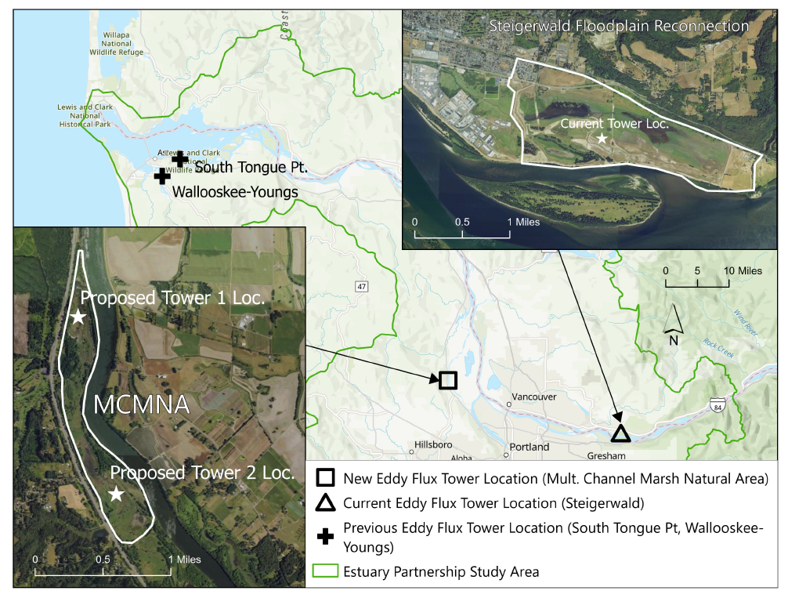
Monitoring Design
Install Eddy Covariance Flux Tower
Install Soil Chambers
Rotate Instruments to a new Site after a Full Year/Growing Season
Capture Estuarine-Tidal Freshwater Gradient Conditions
Assess Site Conditions and Restoration Techniques e.g., Mounding, Inundation Frequency/Timing, Groundwater, and Plant Communities

Slide 23
Monitoring Design
Install Eddy Covariance Flux Tower
Install Soil Chambers
Rotate Instruments to a new Site after a Full Year/Growing Season
Capture Estuarine-Tidal Freshwater Gradient Conditions
Assess Site Conditions and Restoration Techniques e.g., Mounding, Inundation Frequency/Timing, Groundwater, and Plant Communities

Slide 24
Monitoring Design
Install Eddy Covariance Flux Tower
Install Soil Chambers
Rotate Instruments to a new Site after a Full Year/Growing Season
Capture Estuarine-Tidal Freshwater Gradient Conditions
Assess Site Conditions and Restoration Techniques e.g., Mounding, Inundation Frequency/Timing, Groundwater, and Plant Communities

Slide 25
Monitoring Design
Install Eddy Covariance Flux Tower
Install Soil Chambers
Rotate Instruments to a new Site after a Full Year/Growing Season
Capture Estuarine-Tidal Freshwater Gradient Conditions
Assess Site Conditions and Restoration Techniques e.g., Mounding, Inundation Frequency/Timing, Groundwater, and Plant Communities

Slide 26
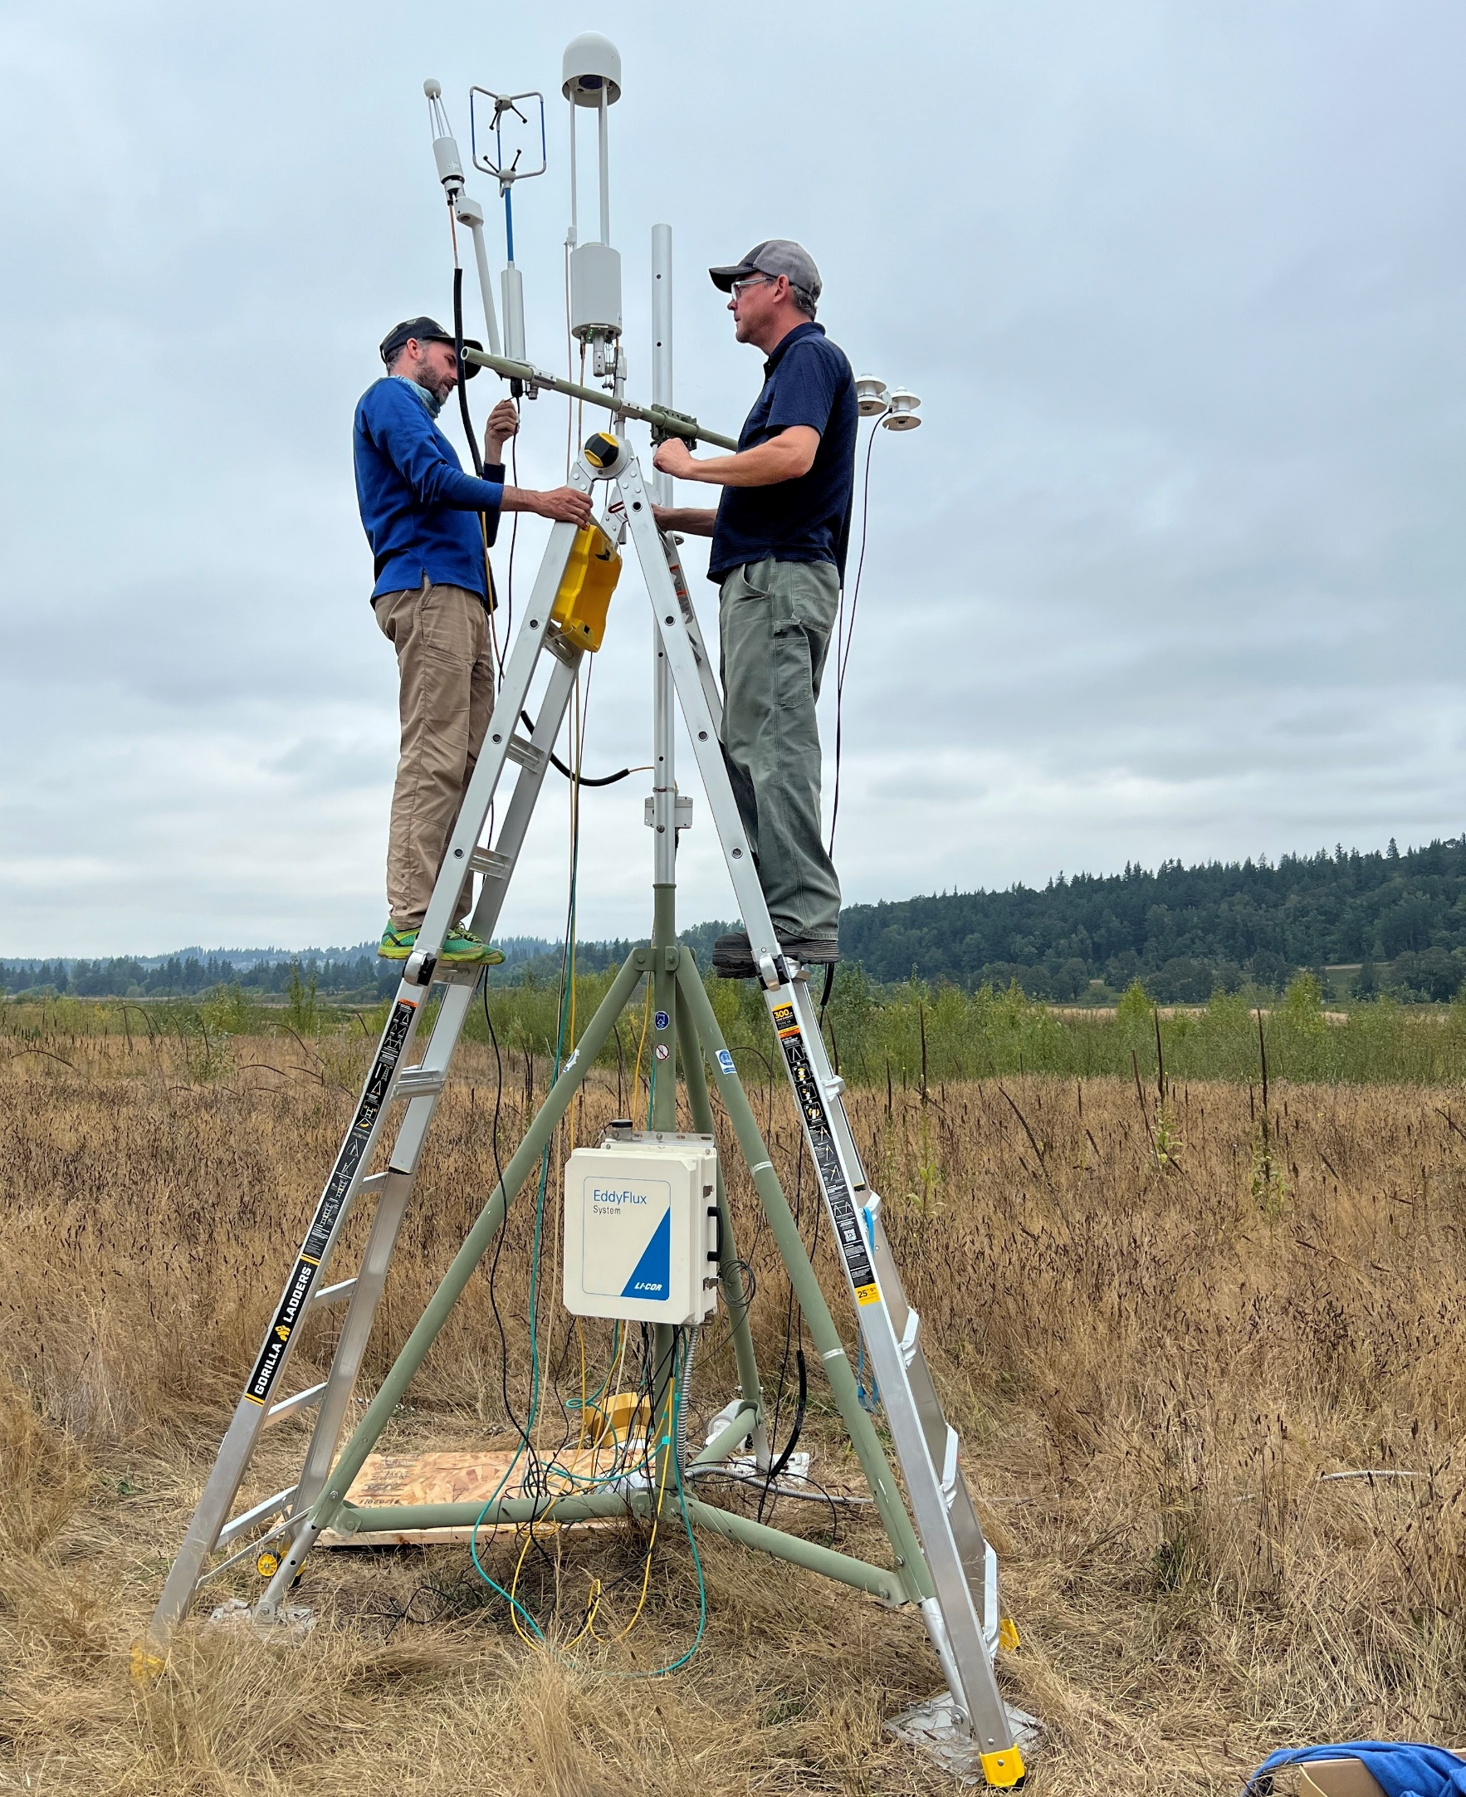
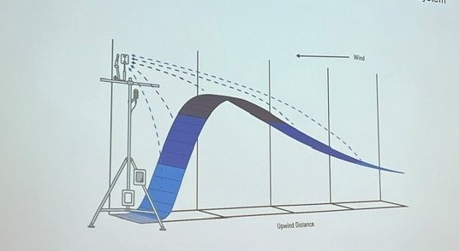
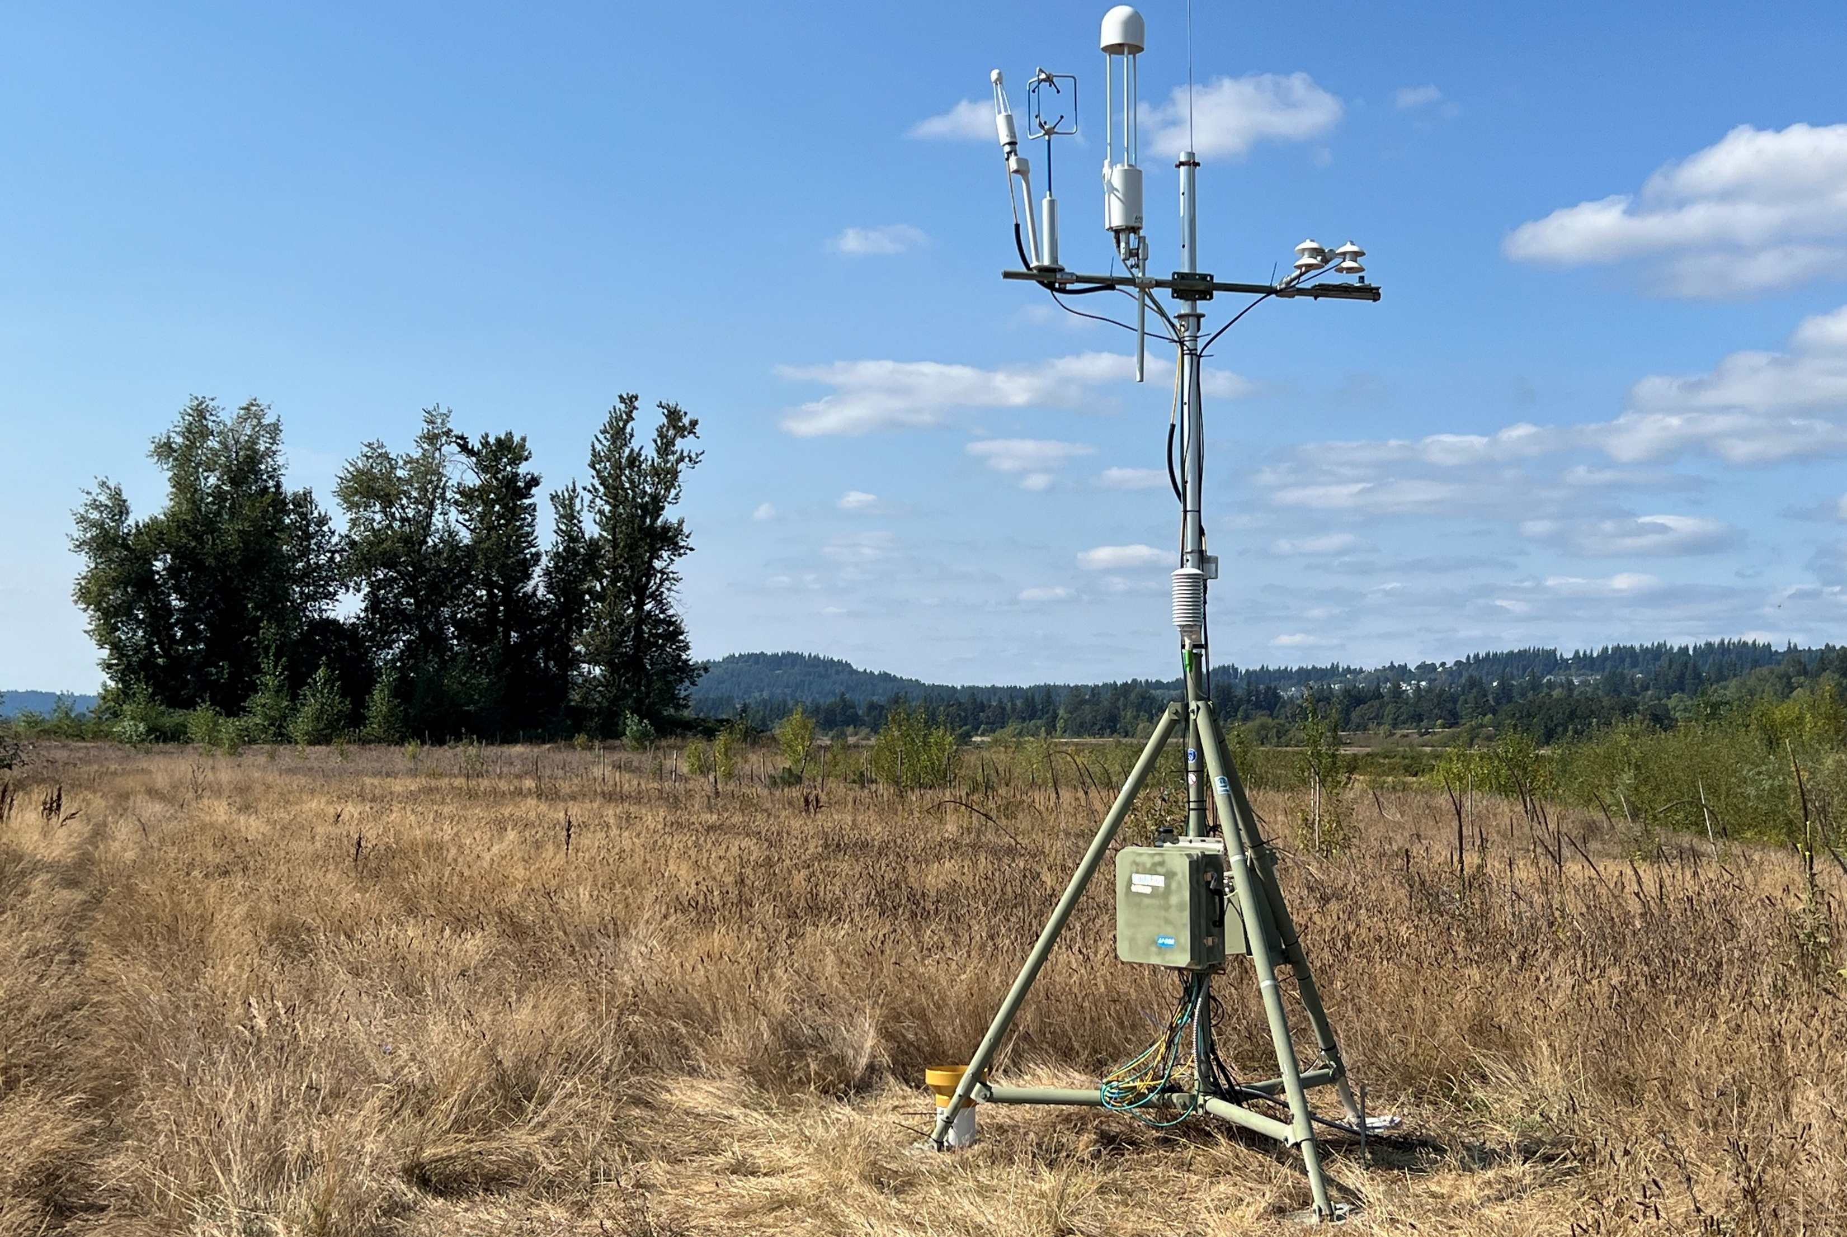
Method 1: Eddy Covariance
Supports our objective to estimate site-level carbon sequestration rates at restoration sites
2-D Profile of Flux Contributions at Distances from the system

Slide 27
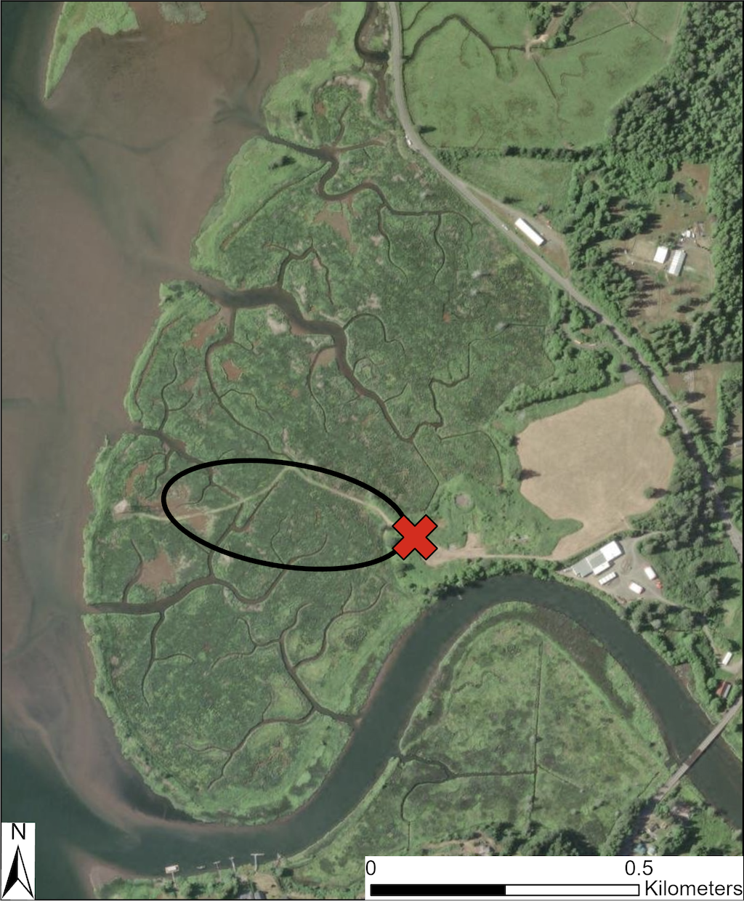
Method 1: Eddy Covariance
Wallooskee-Youngs Marsh, OR
Measures the covariance of wind speed and gas concentrations
Calculate 30 min averages of CO2 and methane fluxes
Approx. 500 m radius
High temporal resolution, aggregates over a large area

Slide 28
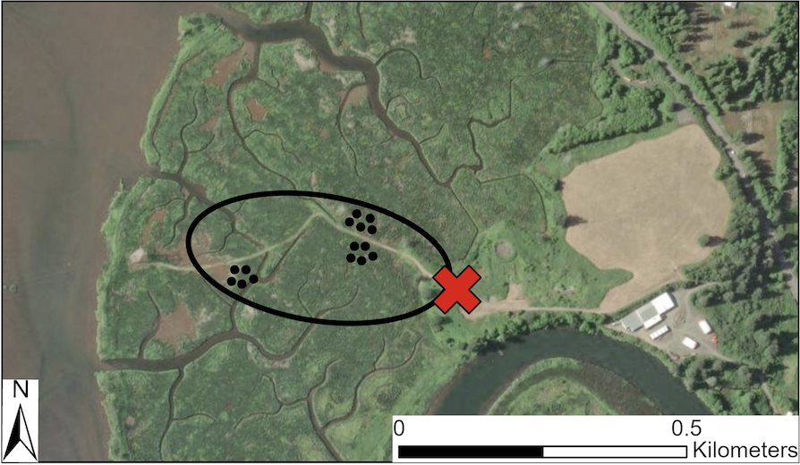
Method 2: Soil chambers
Wallooskee-Youngs Marsh, OR
Supports our objective of assessing fine scale spatial variability and the effects of different restoration actions
Wallooskee-Youngs Marsh, OR

Slide 29
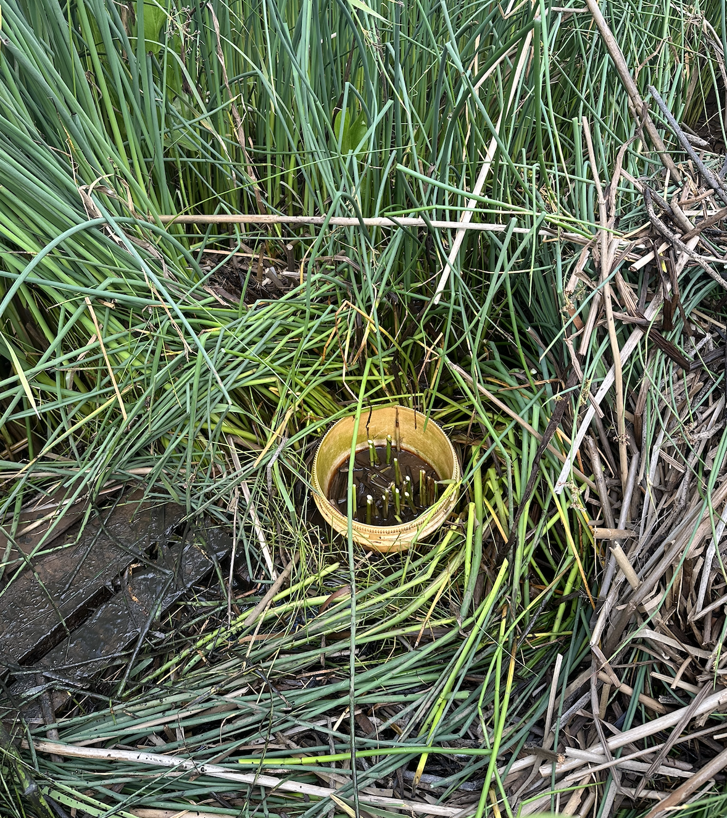
Method 2: Soil chambers
~15 PVC collars permanently installed in the soil
Placed in areas with different elevation, vegetation, etc.
Point measurements of CO2, CH4 flux every 1-2 weeks
Soil sensors monitor temp., electrical conductivity, soil moisture

Slide 30
Monitoring Data Examples
Wallooskee-Youngs (Spring/Summer 2024)

Slide 31
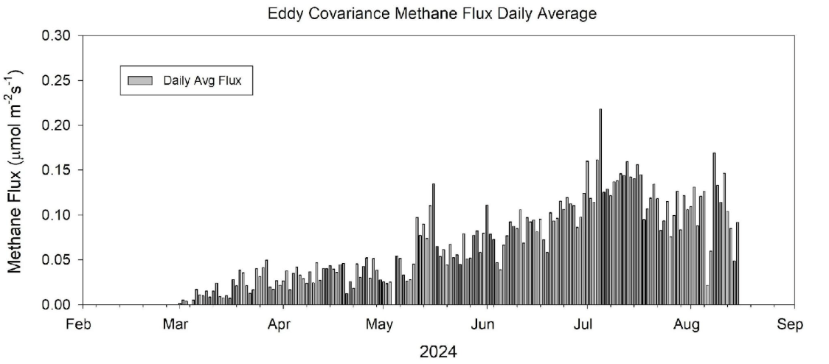
Eddy covariance: Methane fluxes as daily averages
Wallooskee-Youngs | ~ 0.00 to 0.23 μmol m⁻² s⁻¹
Other low salinity marshes (Poffenbarger et al. 2011) | 0.009 to 1.04 μmol m⁻² s⁻¹
Mar
Apr
May
Jun
Jul
Aug
2024

Slide 32
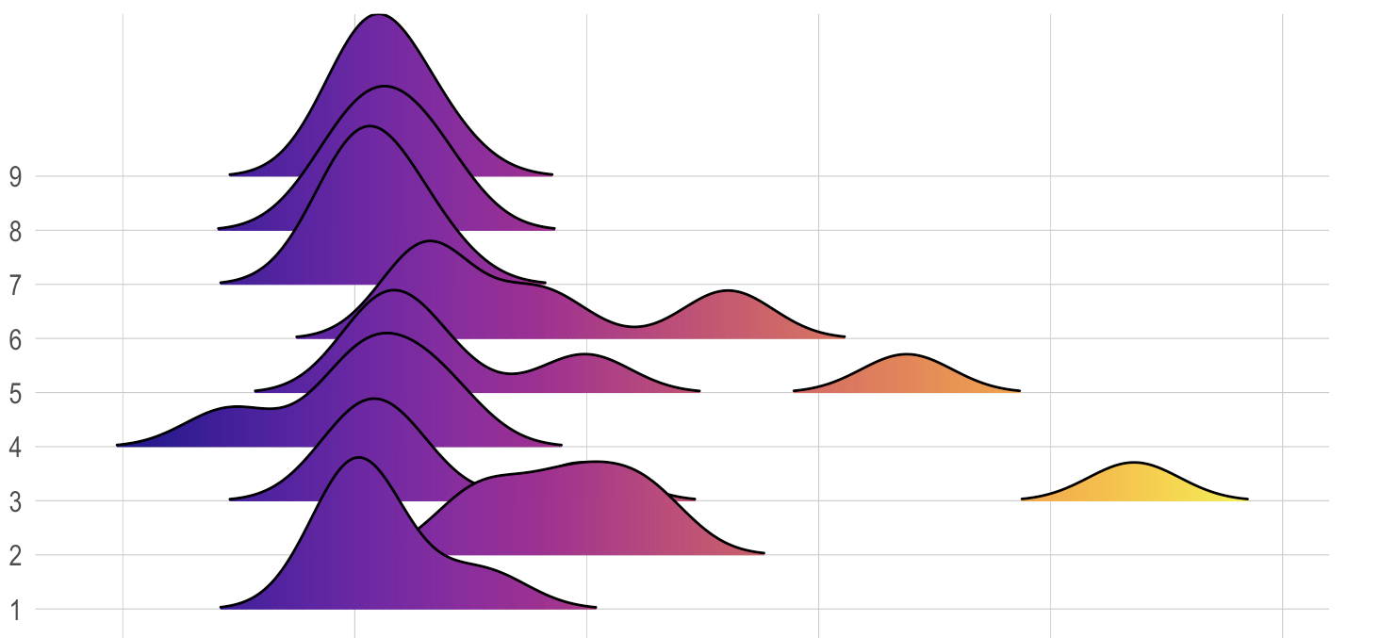
Soil chambers: Point measurements of methane fluxes (n=6)
9
8
7
6
Chamber
5
4
3
2
1
-0.5
0.0
0.5
1.0
1.5
2.0
EC range
CH₄ flux (µmol m⁻² s⁻¹)
Notes:
Explain the plot: Shows distributions of summertime (2024) methane fluxes by chamber
Overall, the central tendency is similar to the range observed by the eddy covariance tower but there are hot moments where methane is higher at this finer scale
Chamber 2 had consistently higher methane emissions --> it was in an area that remained flooded even at low tide
Similarly, the other chambers that had more hot moments more consistently remained inundated at low tide
- Even tho it’s consistently higher, it is within the range of estimates from Poffenbarger et al 2011

Slide 33
Soil chambers: Point measurements of methane fluxes (n=6)
9
8
7
6
Higher CH4 from chambers in depressions
Chamber
5
4
3
2
1
-0.5
0.0
0.5
1.0
1.5
2.0
EC range
CH₄ flux (µmol m⁻² s⁻¹)

Slide 34
Takeaways from Wallooskee
Eddy data: Site-level methane emissions are relatively low compared to other low-salinity tidal marshes
Chamber data: Micro-scale topography may influence methane emissions → could adding elevation in some areas help reduce emissions?

Slide 35
Next Steps and Significance

Slide 36
Next steps
Finish analyzing the data we have collected so far and disseminate results
Secure more funding to support this work so we can:
Monitor more sites across the range of habitats in the estuary to accurately map carbon sequestration potential
Directly assess the effects of restoration actions such as mounding to inform future restoration practices

Slide 37
Project significance
Generate critical GHG emissions data for freshwater wetlands that don’t currently exist for the lower Columbia
Complement existing data in saline coastal wetlands from the PNW Blue Carbon Working Group
LCEP completes a lot of restoration projects!
Reducing our methane emissions & strategically planning restoration can meaningfully contribute to regional GHG reduction goals

Slide 38
Questions

