Slide 1
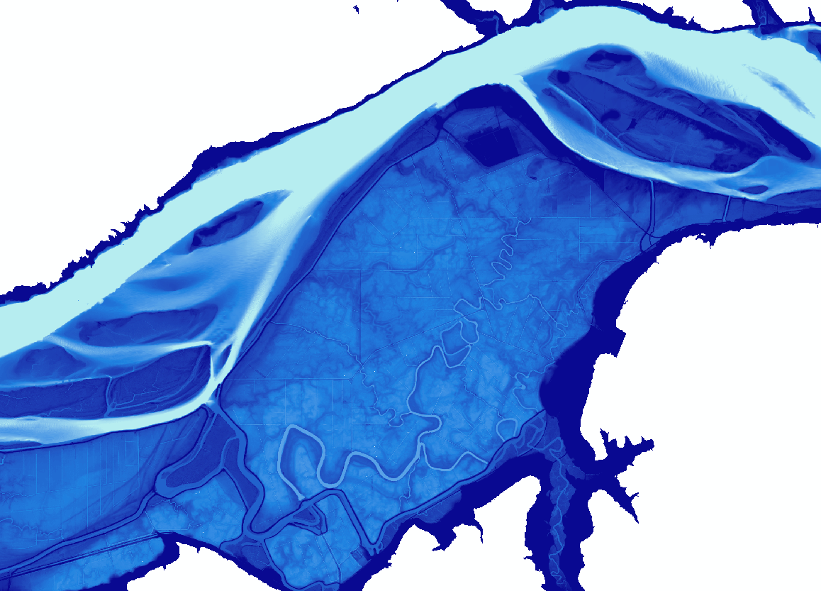

CCMP Action 1 Targets Review (#1,3,4)
Presentation to Estuary Partnership Board of Directors
Keith Marcoe – Physical Scientist
Catherine Corbett – Chief Scientist
September 17, 2026

Slide 2
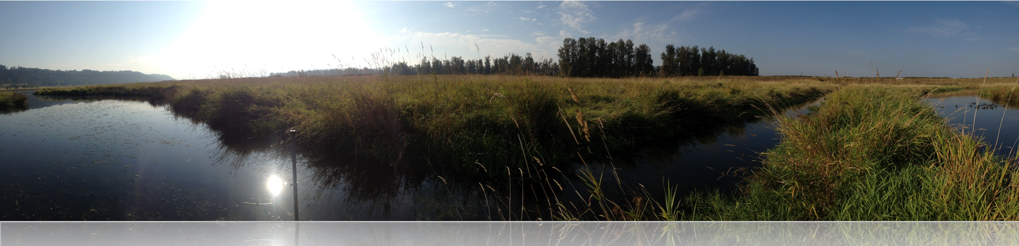
CCMP Action 1 Inventory habitat types and attributes in the lower Columbia River and estuary and prioritize those that need protection and conservation; identify habitats and environmentally sensitive lands that should not be altered. Update periodically to reflect emerging science and issues
Objectives
  Identify critical habitat types, and how much of them, to restore and protect
  Measure progress (mapping, etc.) as things change, and adaptively manage
Restoring the biological integrity of the lower Columbia and estuary is the ultimate goal of the Estuary Program

Slide 3
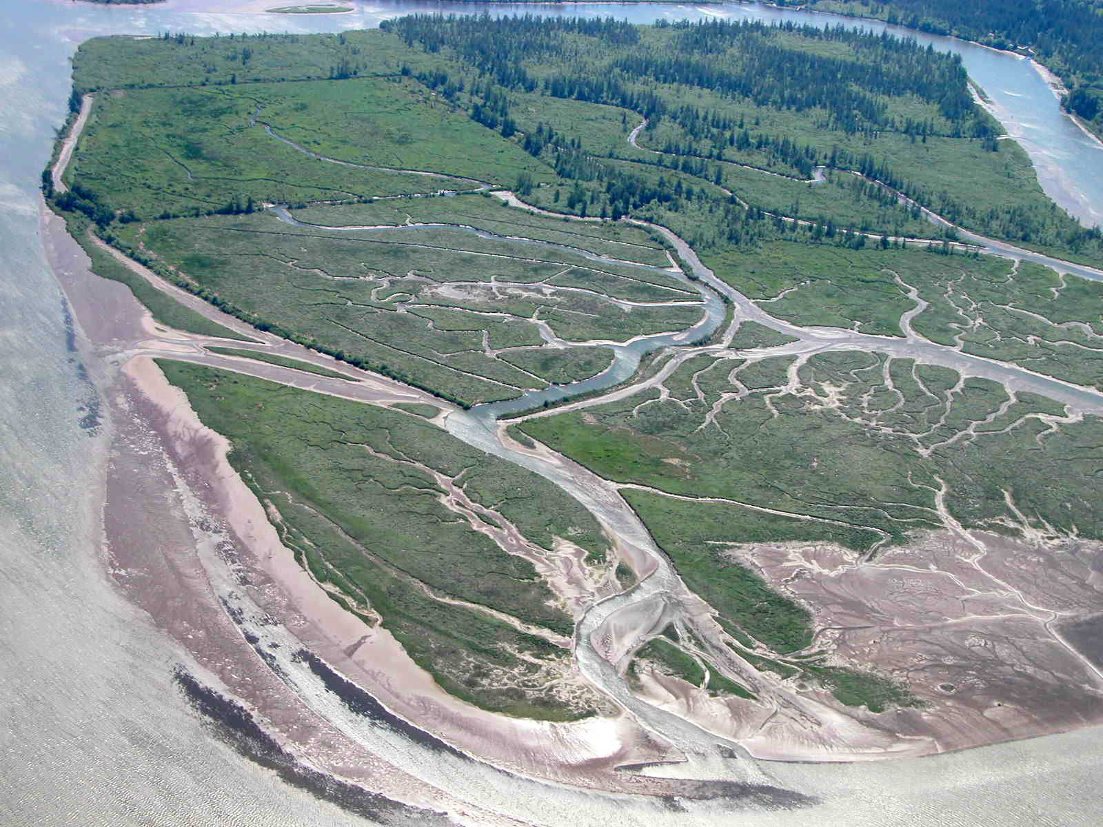
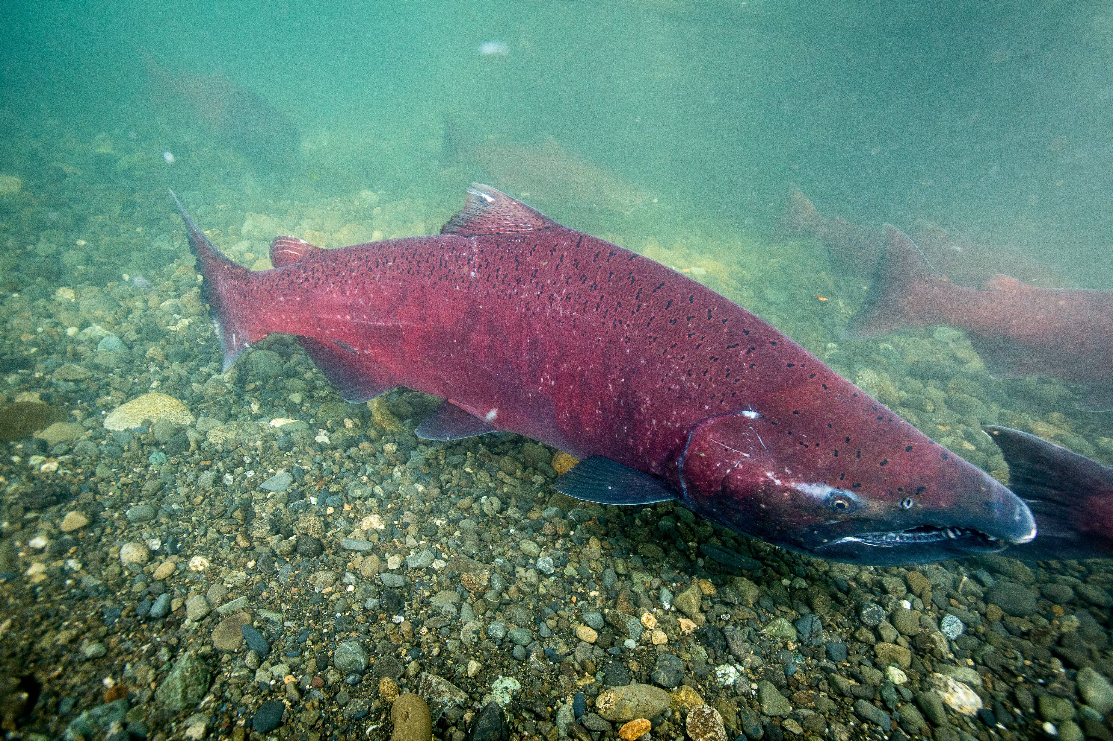
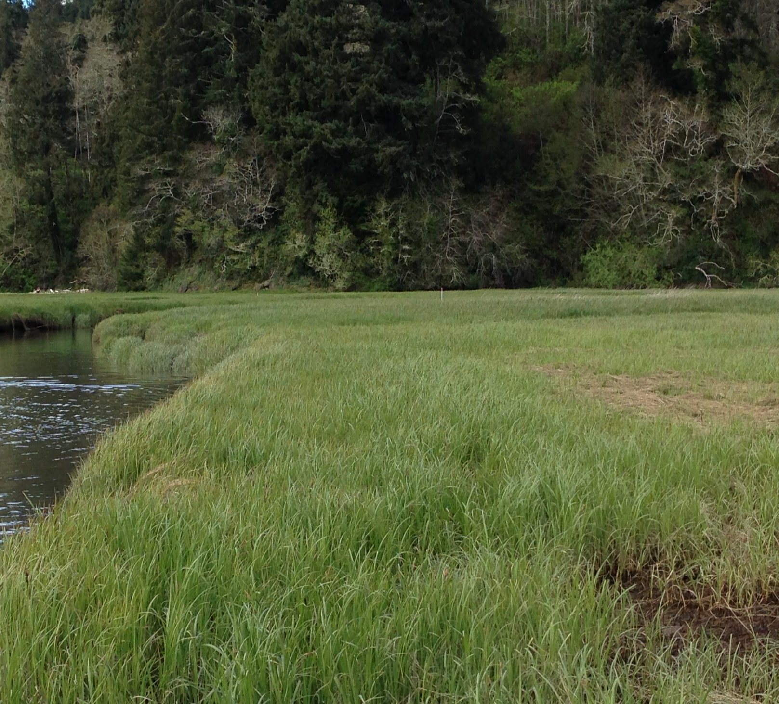
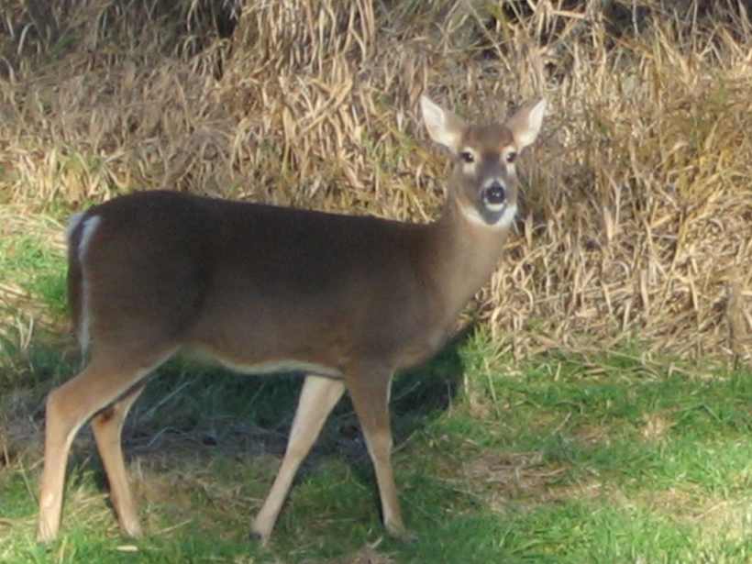
Preserve Native Habitat Diversity based on the Historic Habitat Mosaic
    - Assumption: historic habitat coverage is proxy for natural habitat diversity
CCMP Steps
Map historical habitats
Map current habitats
Quantify losses
Identify Priority habitats and species
Set quantifiable recovery goals
Measure progress

Slide 4
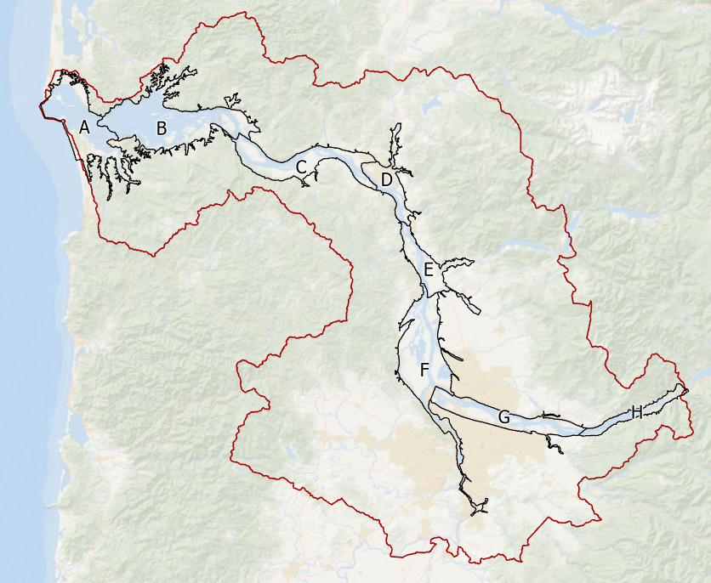
Lower Columbia Floodplain Focus
Reach-based analyses (A-H)
Available historic habitat data
EP Study Area
Reporting contemporary habitat change only (1996-Present)
No habitat prioritization or recovery goals
EP Study Area
Floodplain Hydrogeomorphic Reaches

Slide 5
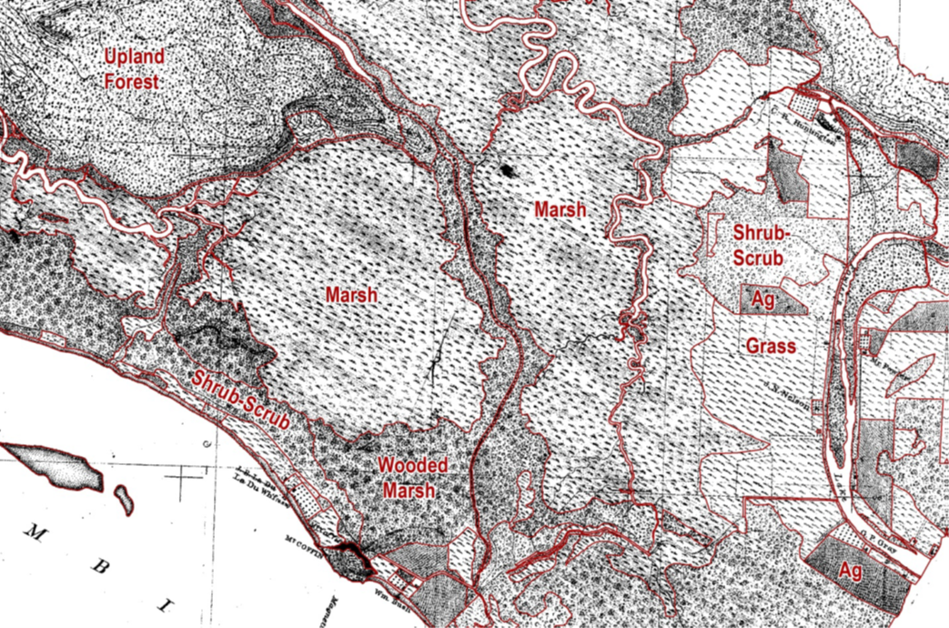




CCMP 1 Timeline
Map historical habitats (late 1800’s)
1800’s Office of Coast Survey topographic sheet
classified in GIS by UW Wetlands Ecosystem Team (Jen Burke)
2008
2009
2010
2011
2012
2013
2014
2015
2016
2017
2018
2019
2020
2021
2022
2023
2024
2025
2026

Slide 6
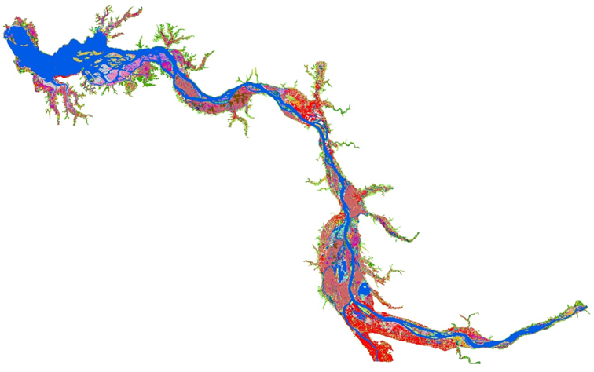
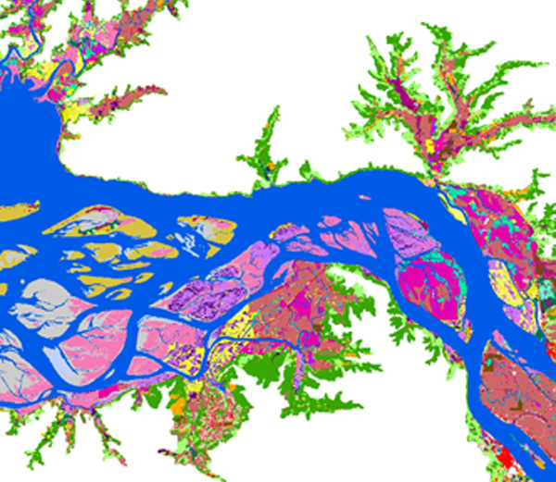
CCMP 1 Timeline
Map historical habitats (late 1800’s)
Map current habitats (2010)
Highly detailed data:
1-meter resolution
Object-based vs. pixel
2010 High-resolution landcover/land-use map.
Created for Columbia River Estuary Ecosystem Classification. BPA-funded.
2008
2009
2010
2011
2012
2013
2014
2015
2016
2017
2018
2019
2020
2021
2022
2023
2024
2025
2026

Slide 7
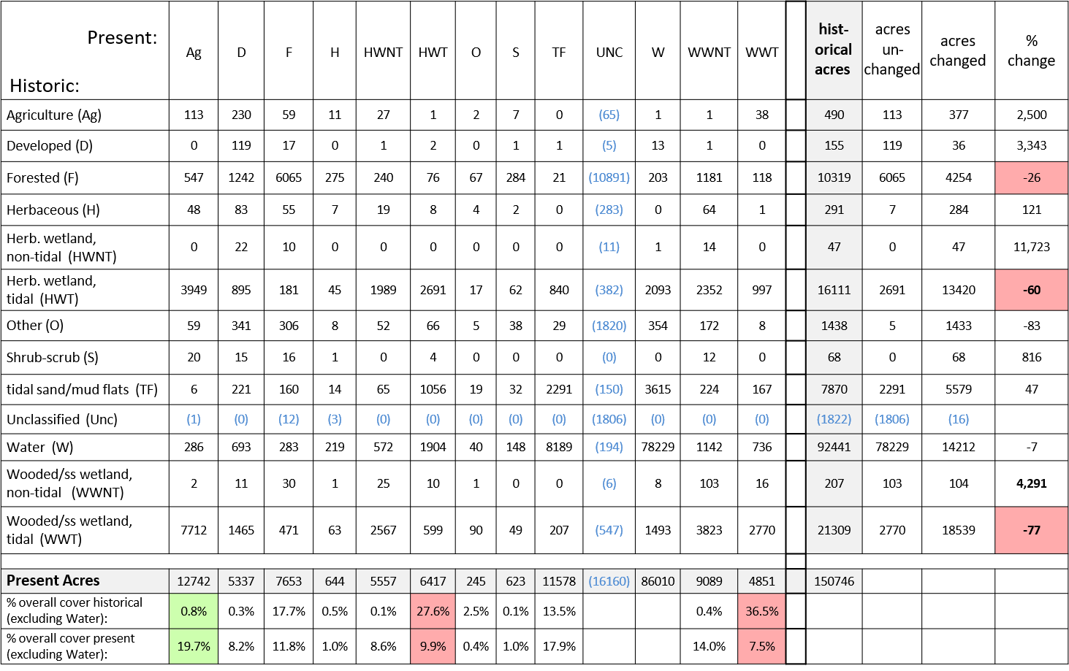
CCMP 1 Timeline
Map historical habitats (late 1800’s)
Map current habitats (2010)
Quantify losses
Cross-tabulation of generalized landcover change scenarios From Marcoe & Pilson, 2017 – Habitat change in the lower Columbia River estuary, 1870-2009
2008
2009
2010
2011
2012
2013
2014
2015
2016
2017
2018
2019
2020
2021
2022
2023
2024
2025
2026

Slide 8
Reach | Priority Habitats
 | 1 | 2 | 3 | 4
A | herbaceous tidal WL | wooded tidal WL
B | wooded tidal WL | herbaceous tidal WL
C | wooded tidal WL | herbaceous tidal WL
D | herbaceous tidal WL | wooded tidal WL | forested | herbaceous
E | herbaceous | forested | shrub-scrub | herbaceous tidal WL
F | forested | herbaceous | herbaceous WL | shrub-scrub
G | forested | herbaceous | herbaceous WL
H | wooded WL
CCMP 1 Timeline
Map historical habitats (late 1800’s)
Map current habitats (2009-10)
Quantify losses
Identify Priority Habitats
  Science Work Group Collaboration
  WL = wetland
  Representation of prevalent types, communities
  Representation of rare, vulnerable types, communities
  Ensure many examples of types, communities in each Reach for redundancy
2008
2009
2010
2011
2012
2013
2014
2015
2016
2017
2018
2019
2020
2021
2022
2023
2024
2025
2026

Slide 9

Species
Focal Species
Chinook, chum steelhead, coho
Pacific lamprey
Green and white sturgeon
Bald eagle
Columbia White-tailed deer
Ecologically Significant
N. Pikeminnow
Shad
Eluachon
Caspian tern
Osprey
Yellow warbler
Red-eyed vireo
Dusky Canada goose
Sandhill crane
River otter
Focal Species and Other Indicator Species Identified through NPCC Sub-basin Plan (2004)
No links to Priority Habitats

Slide 10
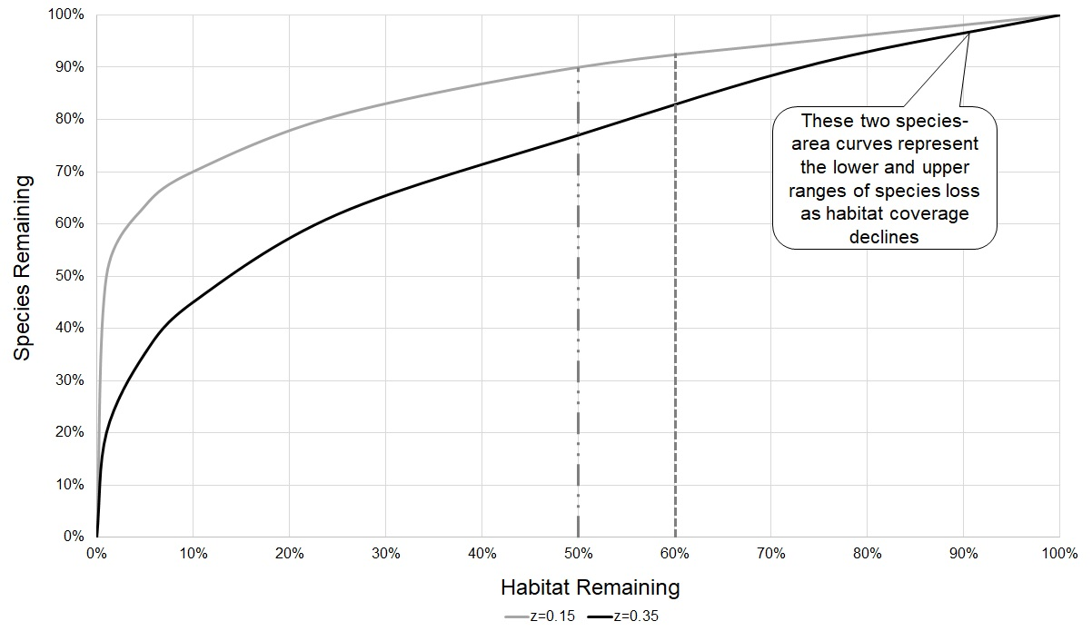
CCMP 1 Timeline
Map historical habitats (late 1800’s)
Map current habitats (2009-10)
Quantify losses
Identify Priority Habitats
Set Priority Habitat Goals
Adapted by A.P. Dobson, 1996
Species-area curves from conservation biology: Macarthur-Wilson (1967), Dobson (1996), Tear et al. (2005), Nature Conservancy.
Most research recommends 30% to preserve common species
50–60% not obtainable in LCRE
2008
2009
2010
2011
2012
2013
2014
2015
2016
2017
2018
2019
2020
2021
2022
2023
2024
2025
2026

Slide 11
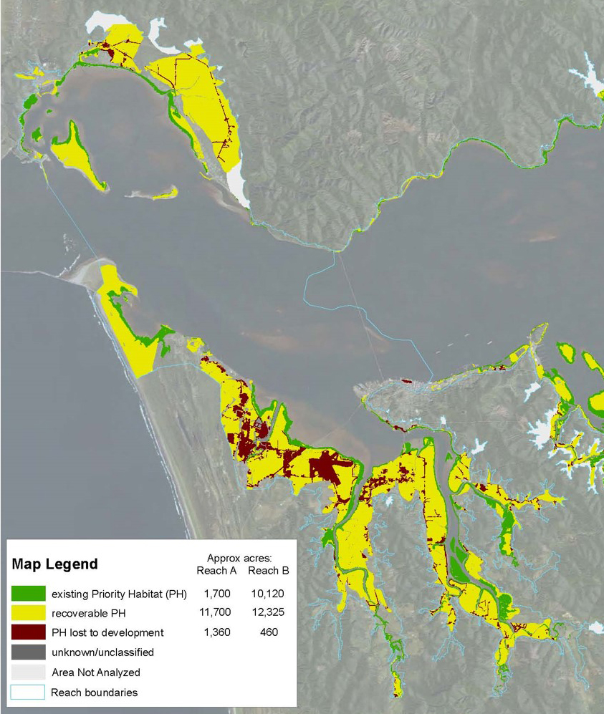
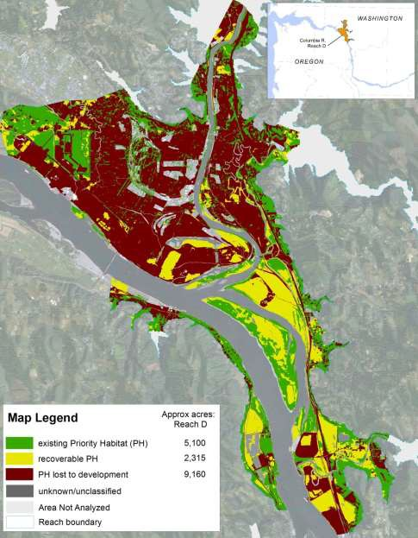
CCMP 1 Timeline
Map historical habitats (late 1800’s)
Map current habitats (2009-10)
Quantify losses
Identify Priority Habitats
Set Priority Habitat Goals
How much is available ? (‘recoverable habitat’)
Reach D
Reach A
Reach B
Recovery goal for Priority Habitats:
30% by 2030
40% by 2050
2008
2009
2010
2011
2012
2013
2014
2015
2016
2017
2018
2019
2020
2021
2022
2023
2024
2025
2026

Slide 12
CCMP 1 Timeline
Map historical habitats (late 1800’s)
Map current habitats (2009-10)
Quantify losses
Identify Priority Habitats
Set Priority Habitat Goals
  Create Habitat Restoration GIS Inventory
  Re-map current habitats (2020)
2020 High-resolution landcover/land-use map. Created by NV5 Geospatial through NOAA with BIL funding.
2008
2009
2010
2011
2012
2013
2014
2015
2016
2017
2018
2019
2020
2021
2022
2023
2024
2025
2026

Slide 13
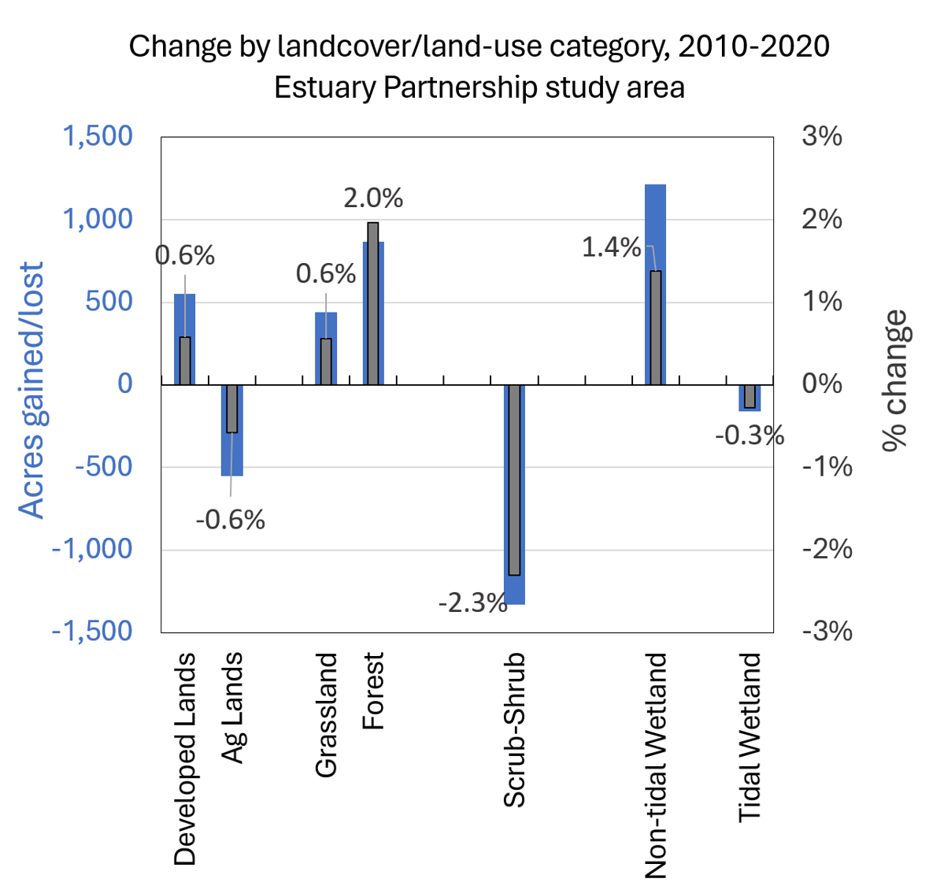
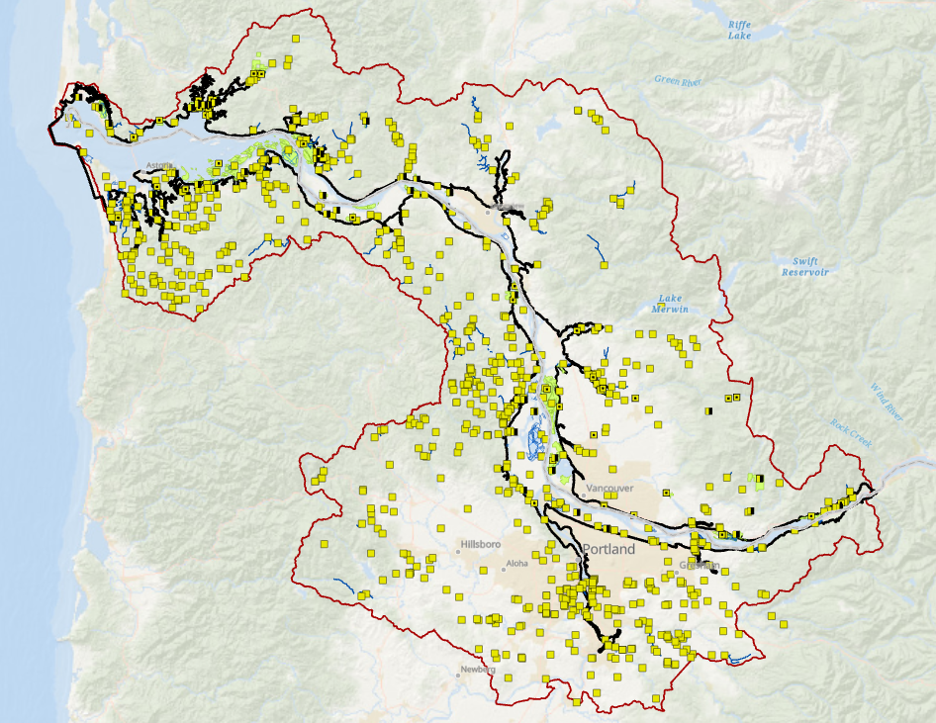
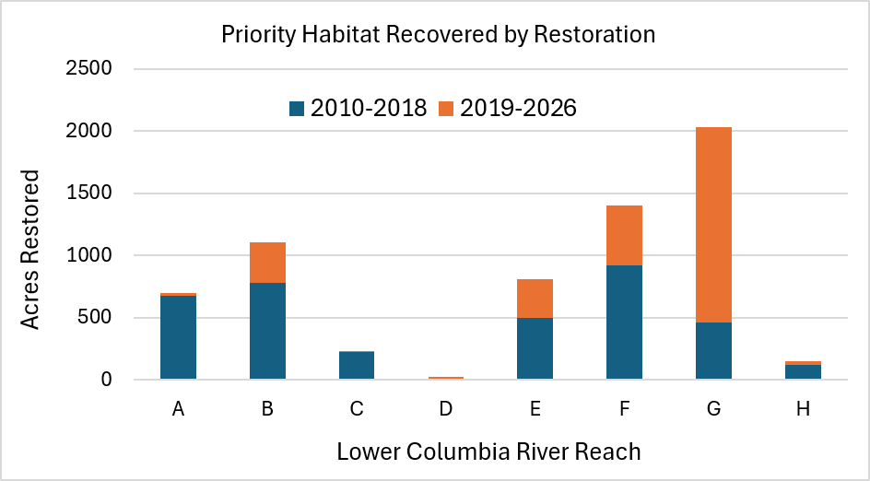
Tracking Habitat Recovery
  Compare landcover maps over time
    Frequency: 10 years
    Better at tracking losses
  Restoration Inventory
    Tracks gains/recovery
    Tracks protected lands
    Limited by reporting accuracy
    Combine results of both to measure progress

Slide 14
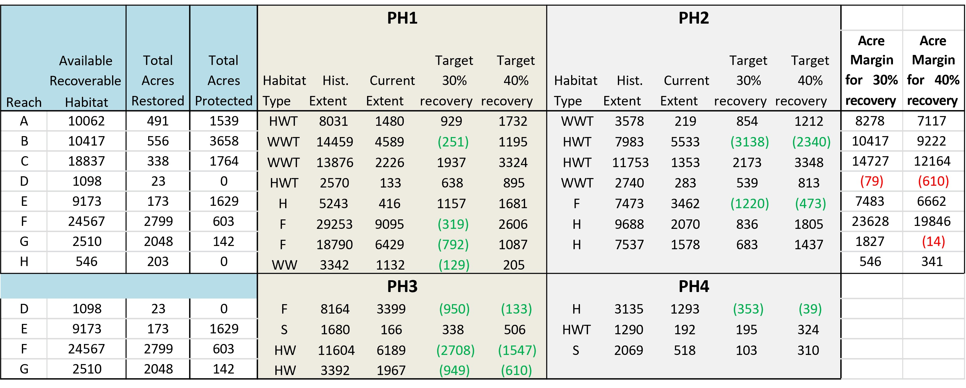
Habitat Recovered and Remaining Goals – 2015 Analysis
Goals met in 2015
Next update in progress
- Add recent restoration activity (2016-2026)
- Add landcover change results (habitat loss)

Slide 15
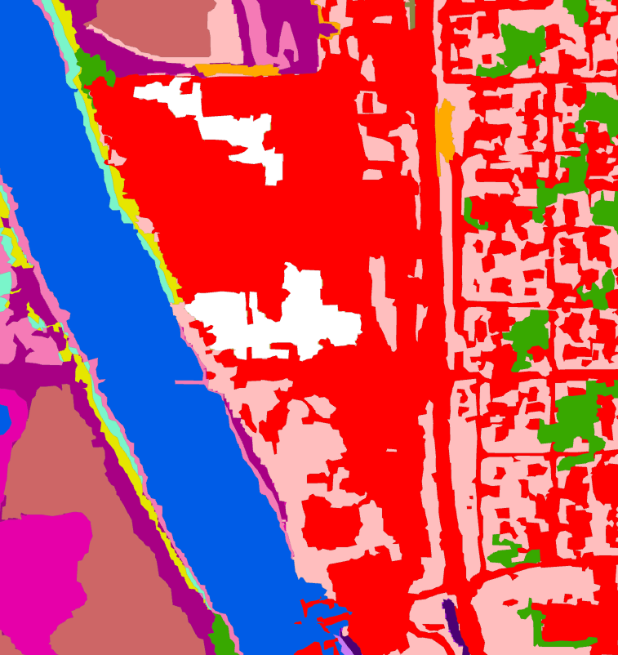
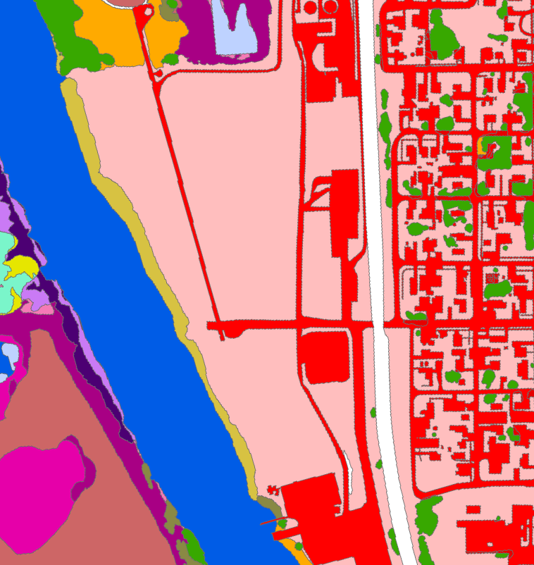
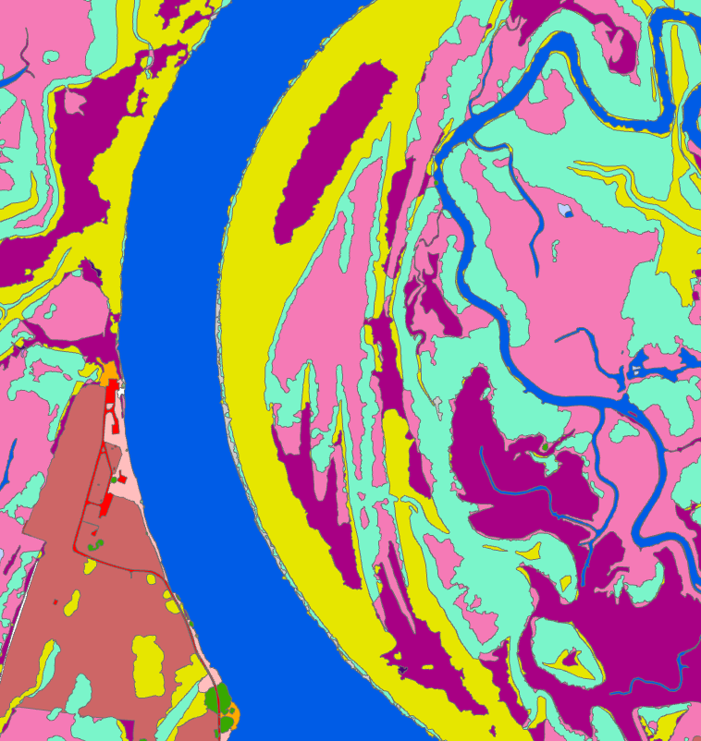
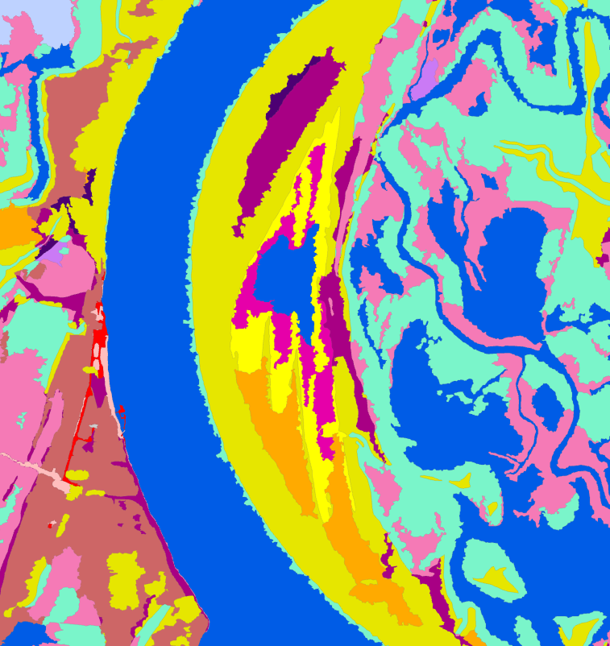
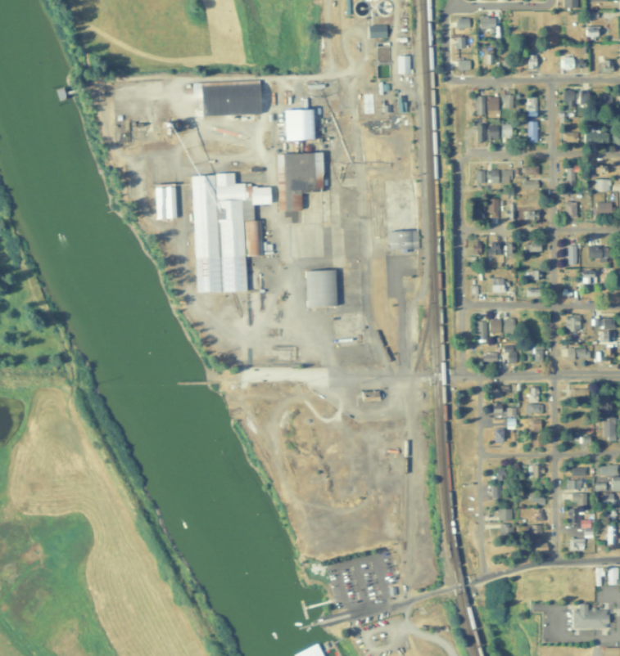
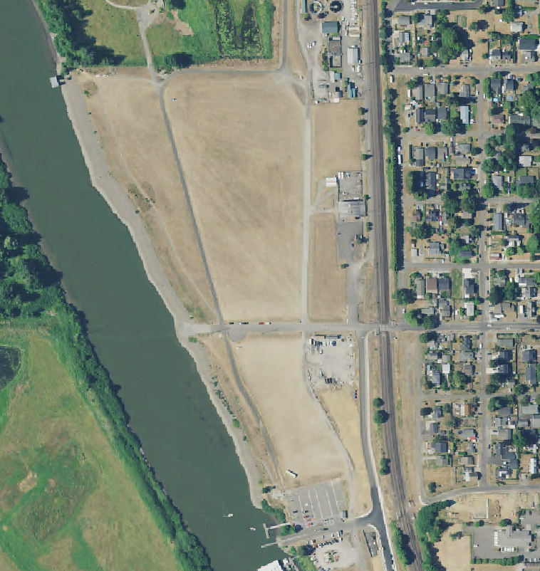
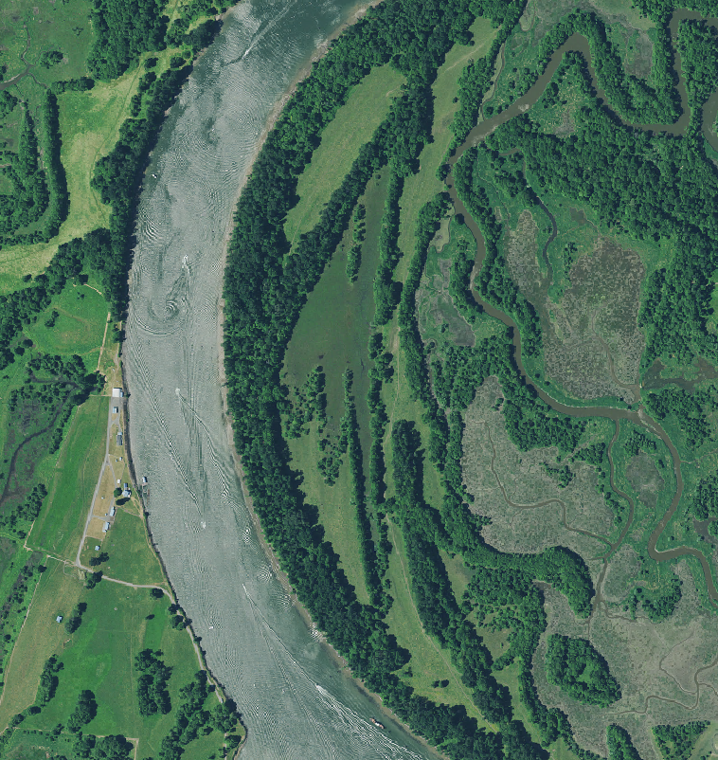
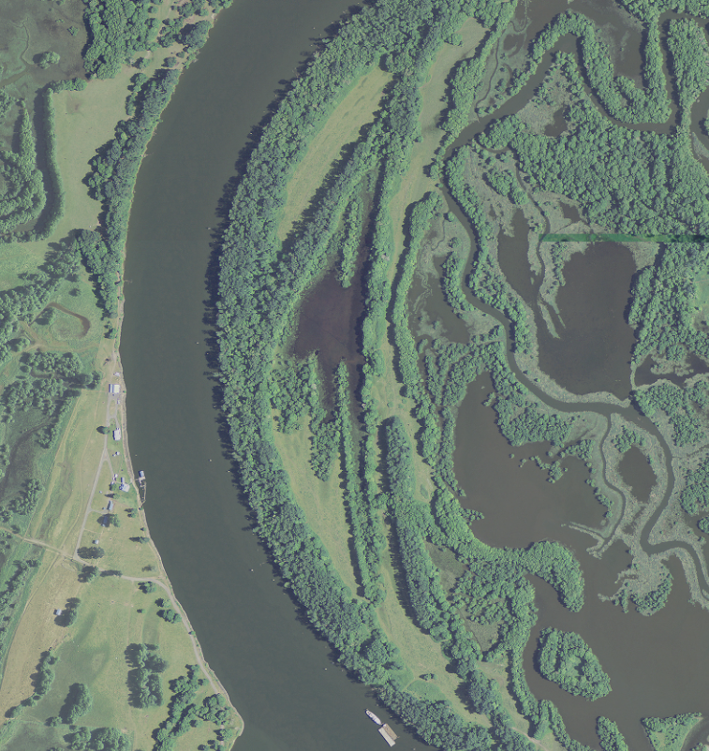
Landcover Maps Comparison Results
Real Change
Mapping Inconsistency (water level)
2010
2020
2010
2020

Slide 16
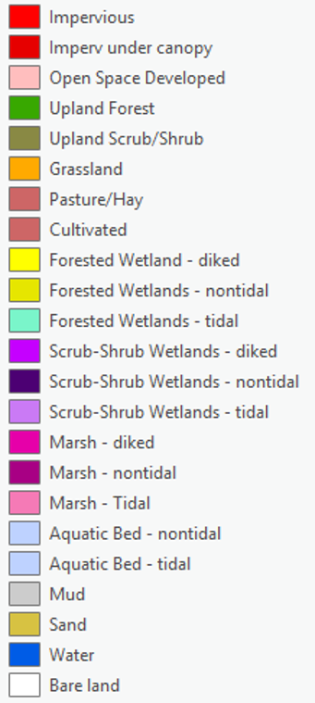
Landcover Maps Comparison Challenges
  Complex classification scheme (hard to separate classes)
  Technology changes
  Inconsistent image collection (date, time, tide cycle, etc.)
  Some can be overcome, but costly
    2010 Map: ~$175k.
    2020 Map: $70k. More errors.
  Alternate solutions
    Simplify classes
    Limit change scenarios (impervious-related, veg. height)
    Use lower resolution products

Slide 17
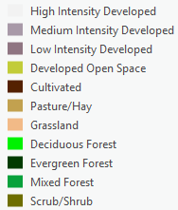
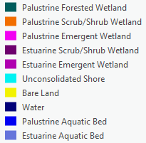
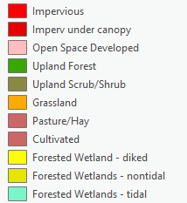
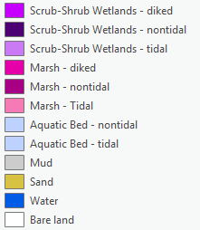

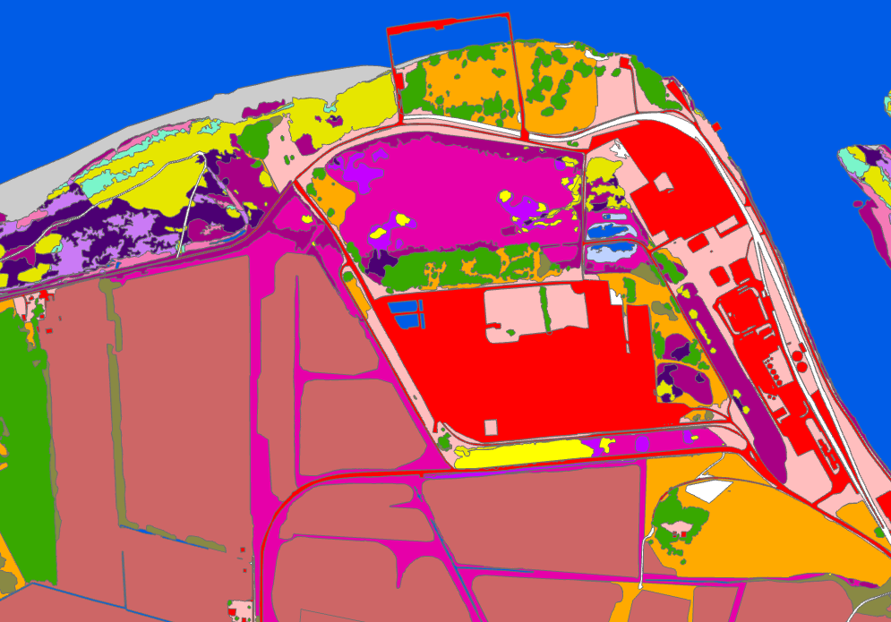
NOAA C-CAP Landcover
C-CAP 30-meter, pixel
LCEP 1-meter, object
Every 5 years
Consistent method
Public data, no cost
Already using for EPA reporting
Spatially limited (30-meter pixel vs. 1-meter object)
Classification scheme different but similar
Still error prone

Slide 18
Targets 1,4 - Discussion
4: Maintain and update criteria and tools to identify priority species and maps of their priority habitats
  Add language about tracking progress?
  Changes to priority habitats or species?
  Mapping source
    High-resolution worth the cost (~$75-$100k +) ?
  1: Update the map of habitats every ten years
  10-year timeline appropriate?
  Most gains can be measured annually
  Losses require landcover data

Slide 19
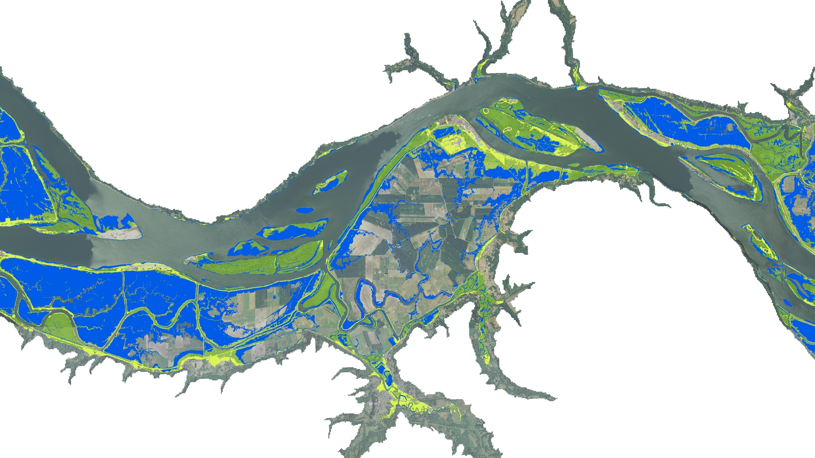
CCMP 1, Target #3
Update and maintain maps that provide information and tools related to vulnerabilities in the estuary due to recurring extreme weather events, accelerated land loss, and sea level rise
Extreme weather: No action
Accelerated land loss:
No action. What is this?

Slide 20
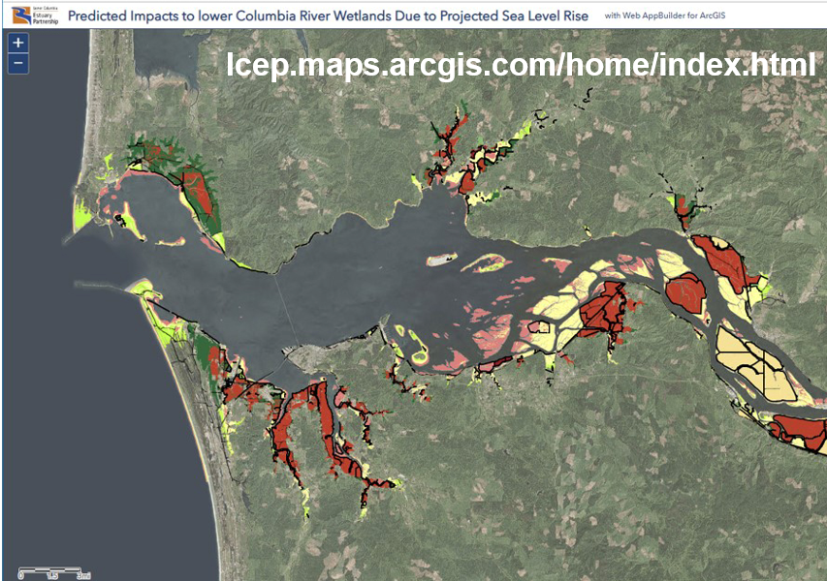
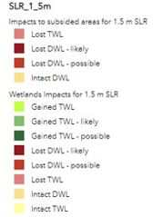
Sea Level Rise
Evaluated impacts of SLR on lower Columbia wetlands
EPA-funded, 2018 – 2020
0.5, 1.0, 1.5-meter SLR scenarios
Online results
Estuary Partnership Wetlands Impacts Study Online Planning Tool

Slide 21
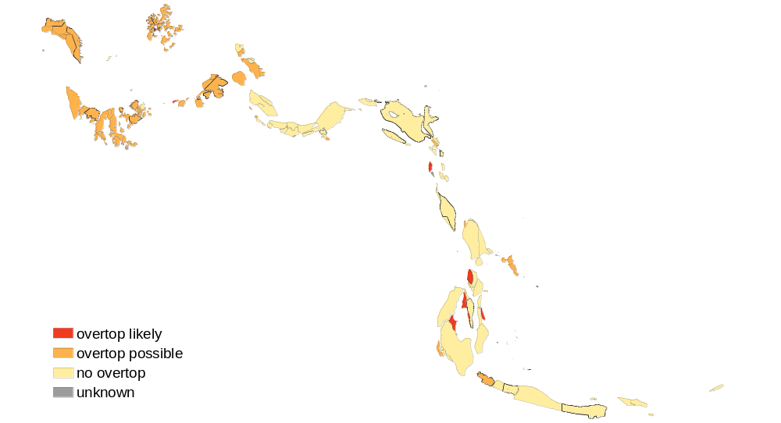
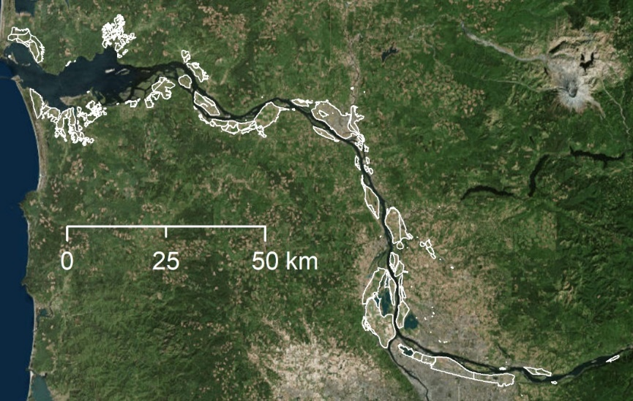
Levee overtopping with 1-meter sea level rise
Target 4 Adjustment – Revise PH Goals based on SLR analysis
Complicated
  SLR will create and eliminate wetlands
  Uncertainty behind levees
  Available Recoverable Habitat will change

Slide 22
Target 3 -Discussion
Extreme Weather Vulnerabilities
  Updated FEMA flood maps
  Proprietary risk maps?
Accelerated Land Loss Vulnerabilities
  Clarify definition or remove
Sea Level Rise
  Rise scenarios still apply
  Results would benefit from
    Better hydraulic modeling & levee assessment
Funding Sources?

