Slide 1
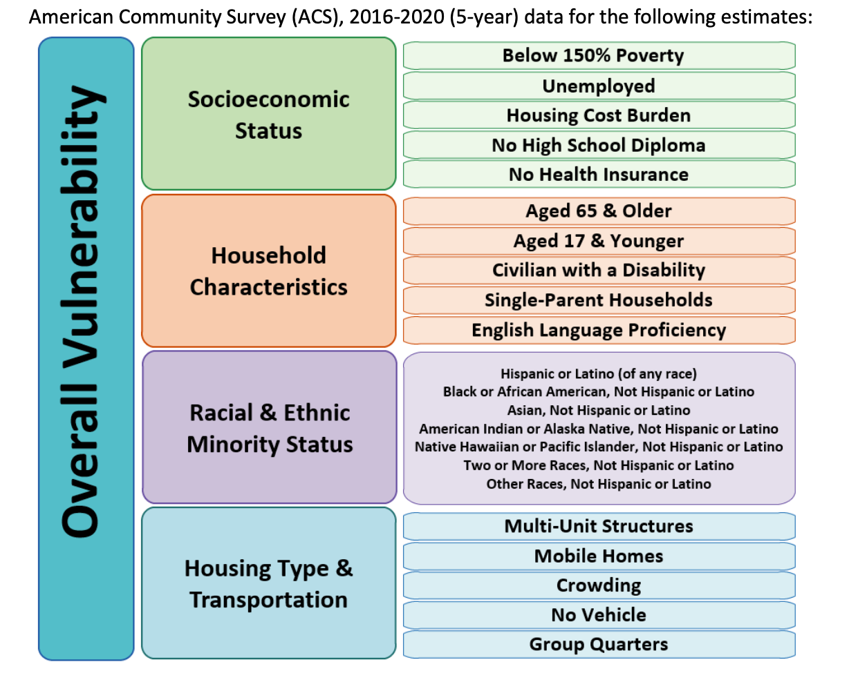
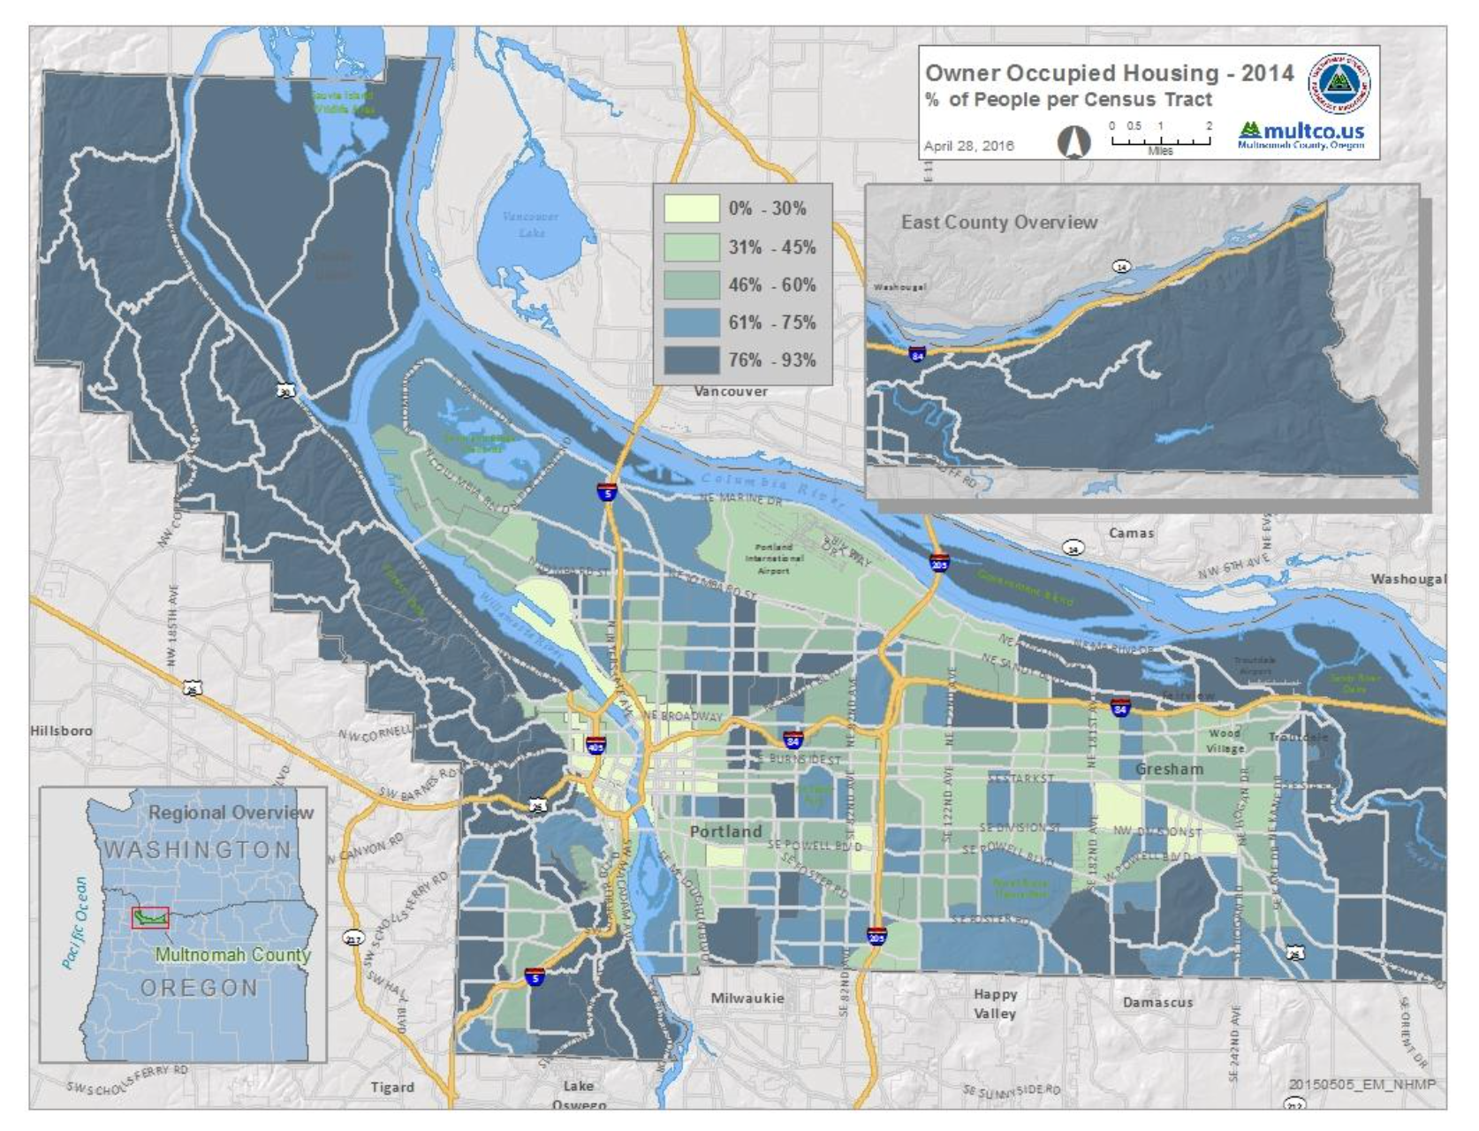
What is Social Vulnerability?

Slide 2
What is Social Vulnerability?
The degree to which a community exhibits certain social conditions may affect that community's ability to prevent human suffering and financial loss in the event of a disaster. These factors describe a community's social vulnerability or ATSDR/CDC Social Vulnerability Index (SVI)
U.S. Census tracts are subdivisions of counties containing statistical data, the SVI then ranks the relative vulnerability of every Census tract. The SVI ranks the tracts in decimals from 0 to 1 on sixteen (16) social factors grouped into four (4) themes:
Socioeconomic Status
Household Characteristics
Racial & Ethnic Minority Status
Housing Type & Transportation
Notes:
US Census TIGER/Line Files (Topologically Integrated Geographic Encoding & Referencing)
Geographic entity codes (shapefile) that can be used to link US Census demographic data

Slide 3
What is Social Vulnerability?
CDC (Centers for Disease Control)
ATSDR (Agency for Toxic Substance & Disease Registry)
GRASP (Geospatial Research, Analysis & Services Program)
SVI (Social Vulnerability Index)
U.S. Census TIGER/Lines
(Topologically Integrated Geographic Encoding & Referencing)

Slide 4
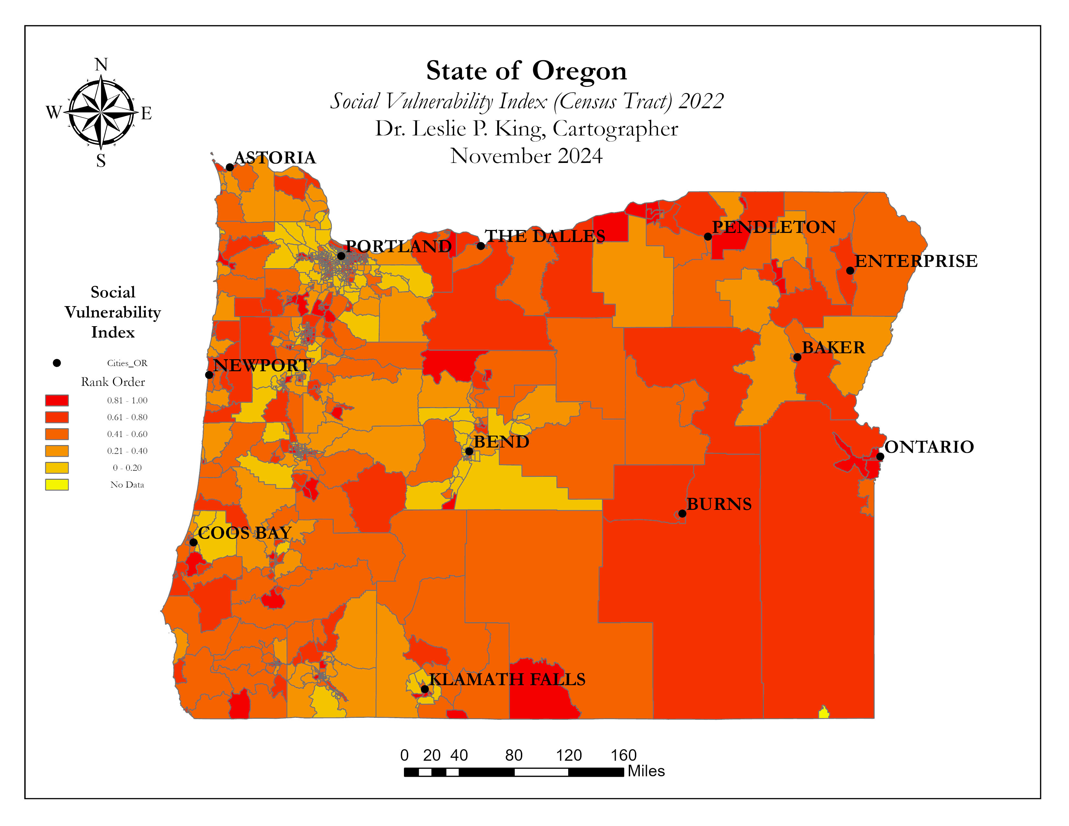

Slide 5
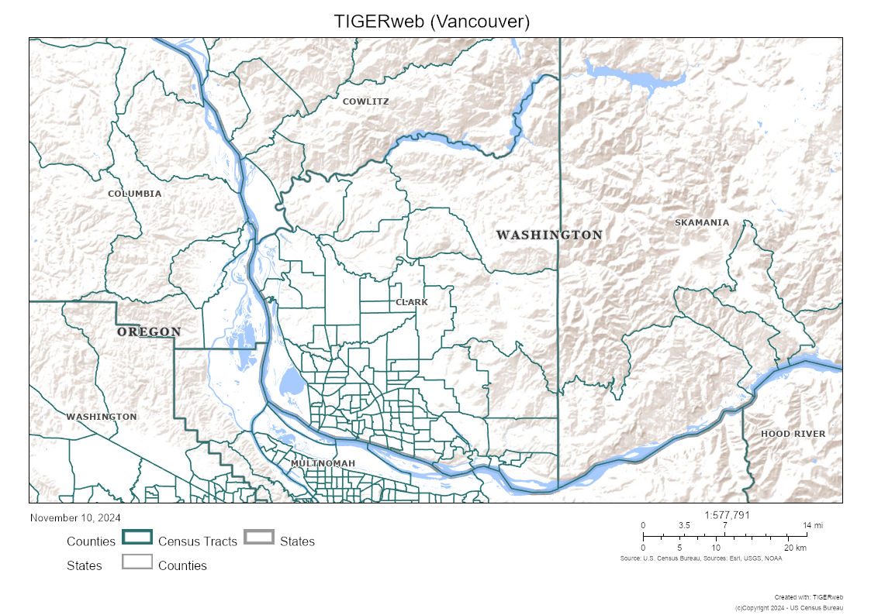
What is Social Vulnerability?

Slide 6
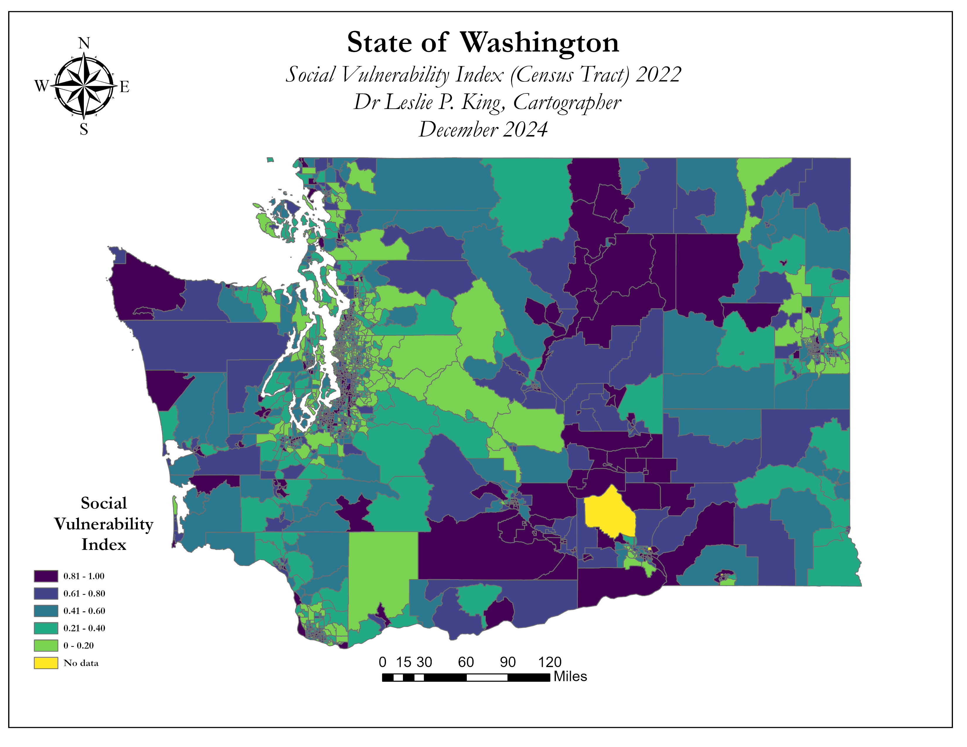

Slide 7
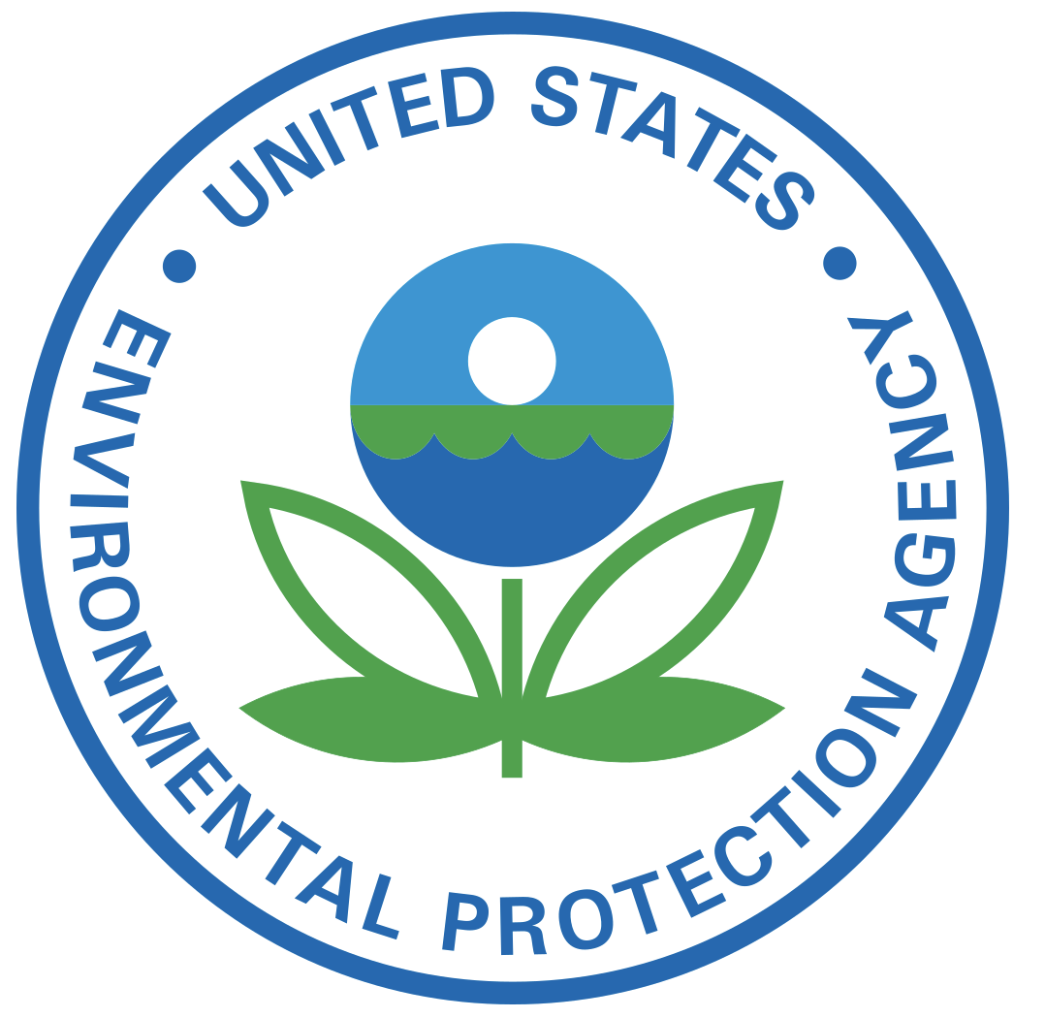
What is Environmental Justice?
EPA (Environmental Protection Agency), 1994
The fair treatment and meaningful involvement of all people regardless of race, color, national origin, or income with respect to the development, implementation, and enforcement of environmental laws, regulations, and policies.
Fair treatment means that no population, due to policy or economic disempowerment, is forced to bear a disproportionate share of the negative human health or environmental impacts of pollution or environmental consequences resulting from industrial, municipal, and commercial operations or the execution of federal, state, local and tribal programs and policies.

Slide 8
What is Environmental Justice?
EPA (Environmental Protection Agency), 1994
The fair treatment and meaningful involvement of all people regardless of race, color, national origin, or income with respect to the development, implementation, and enforcement of environmental laws, regulations, and policies.
Fair treatment means that no population, due to policy or economic disempowerment, is forced to bear a disproportionate share of the negative human health or environmental impacts of pollution or environmental consequences resulting from industrial, municipal, and commercial operations or the execution of federal, state, local and tribal programs and policies.

Slide 9
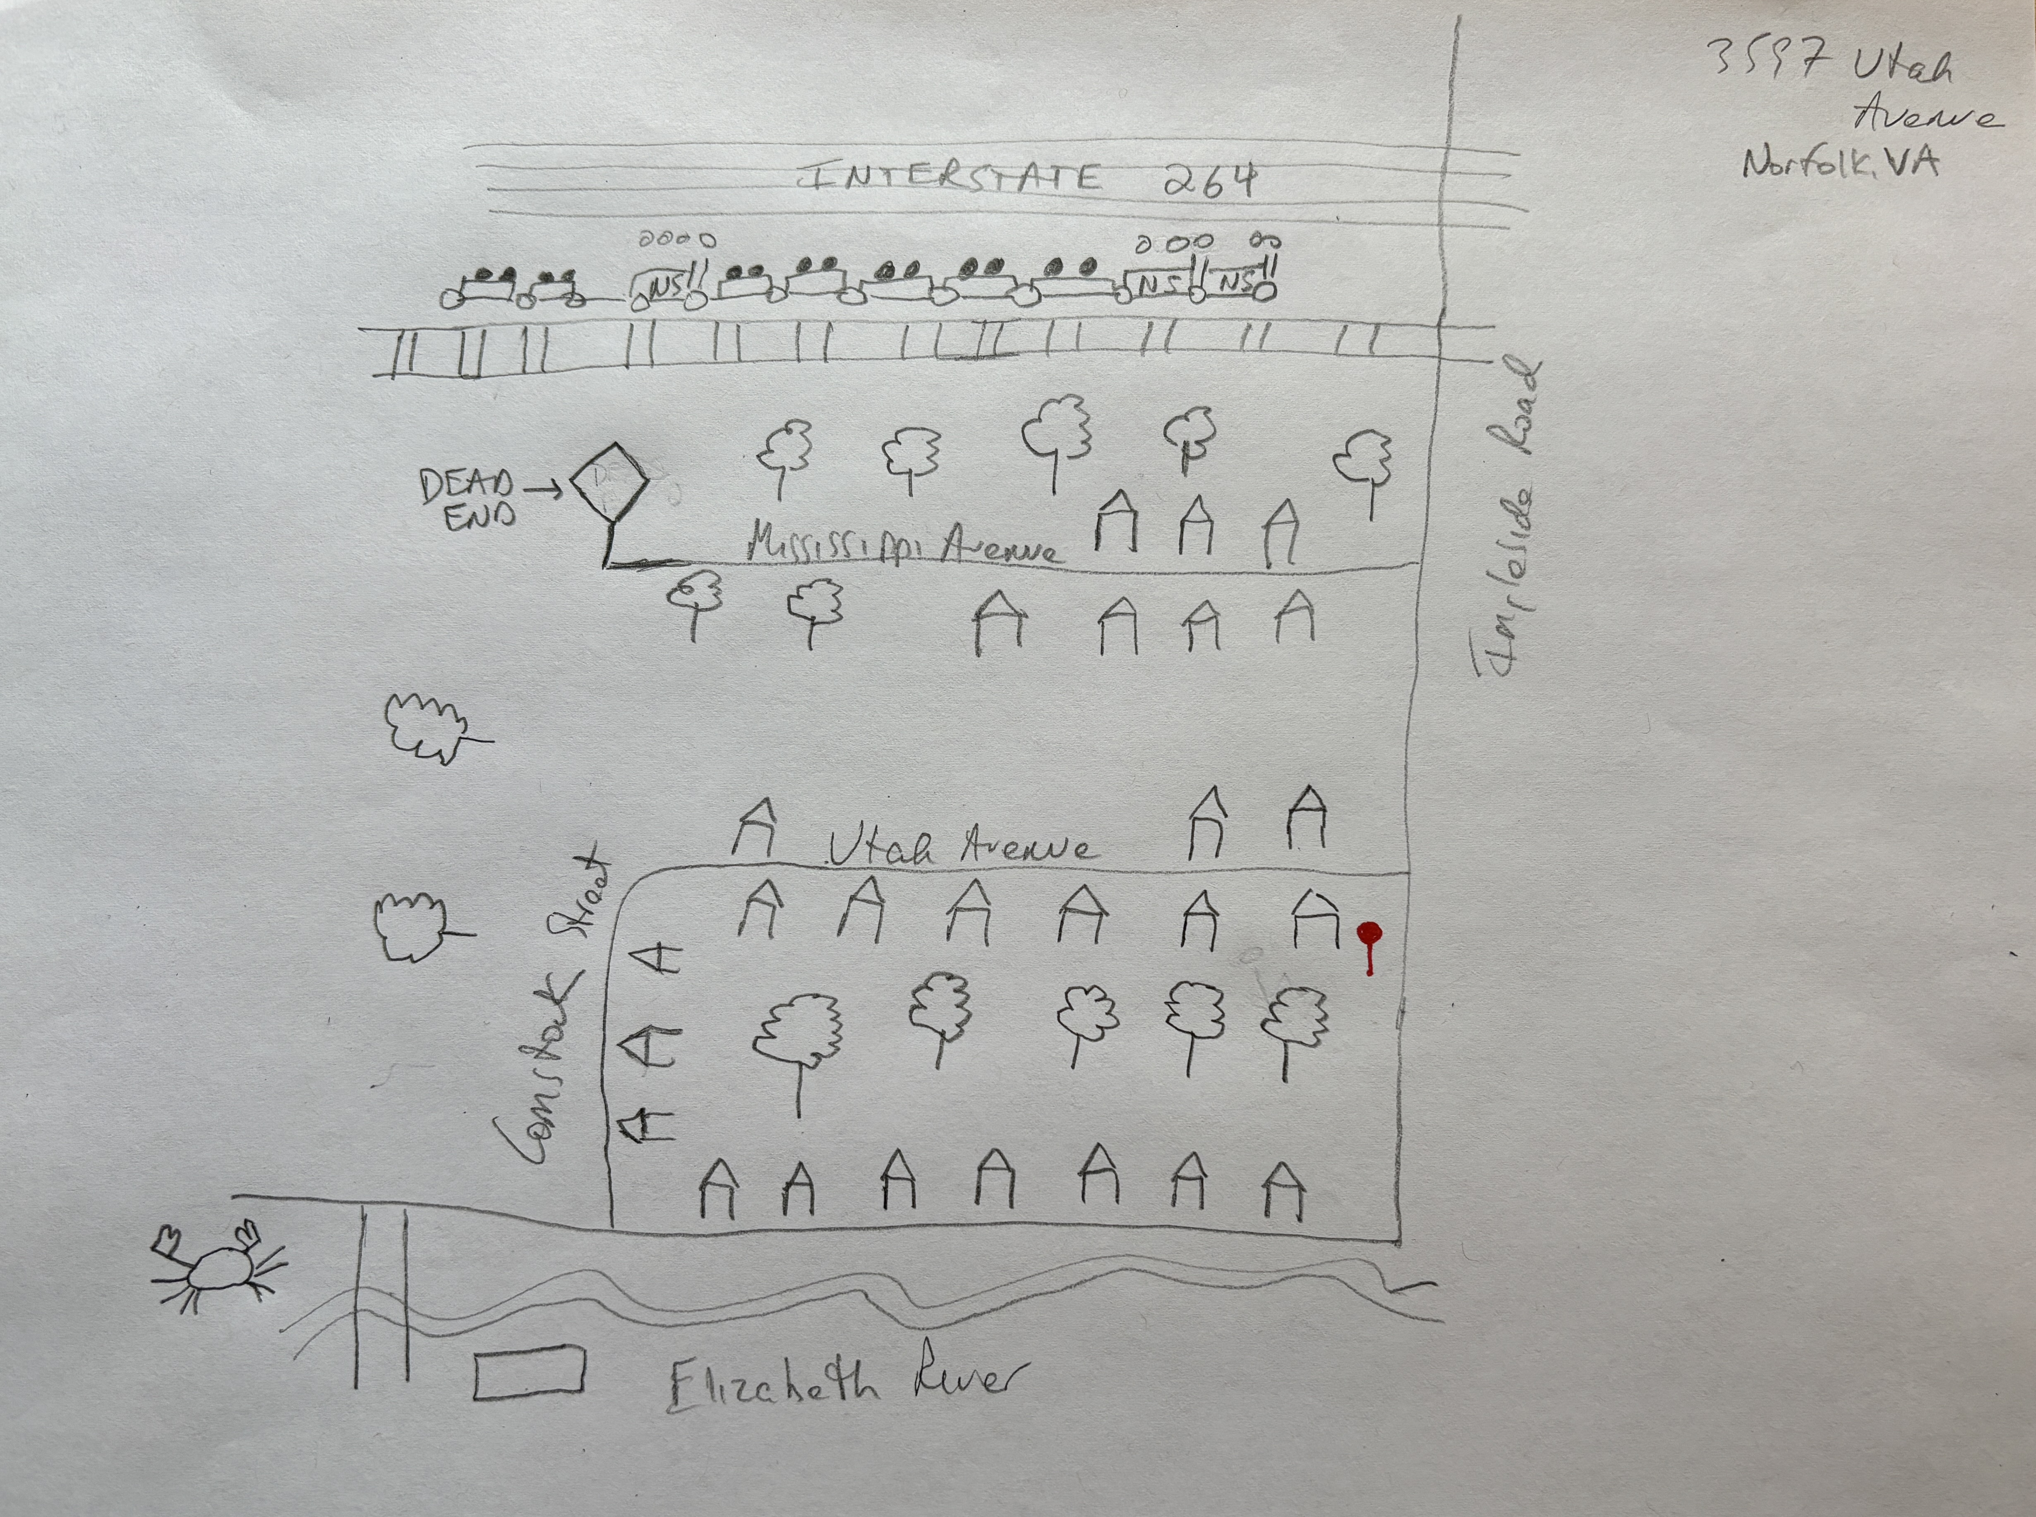
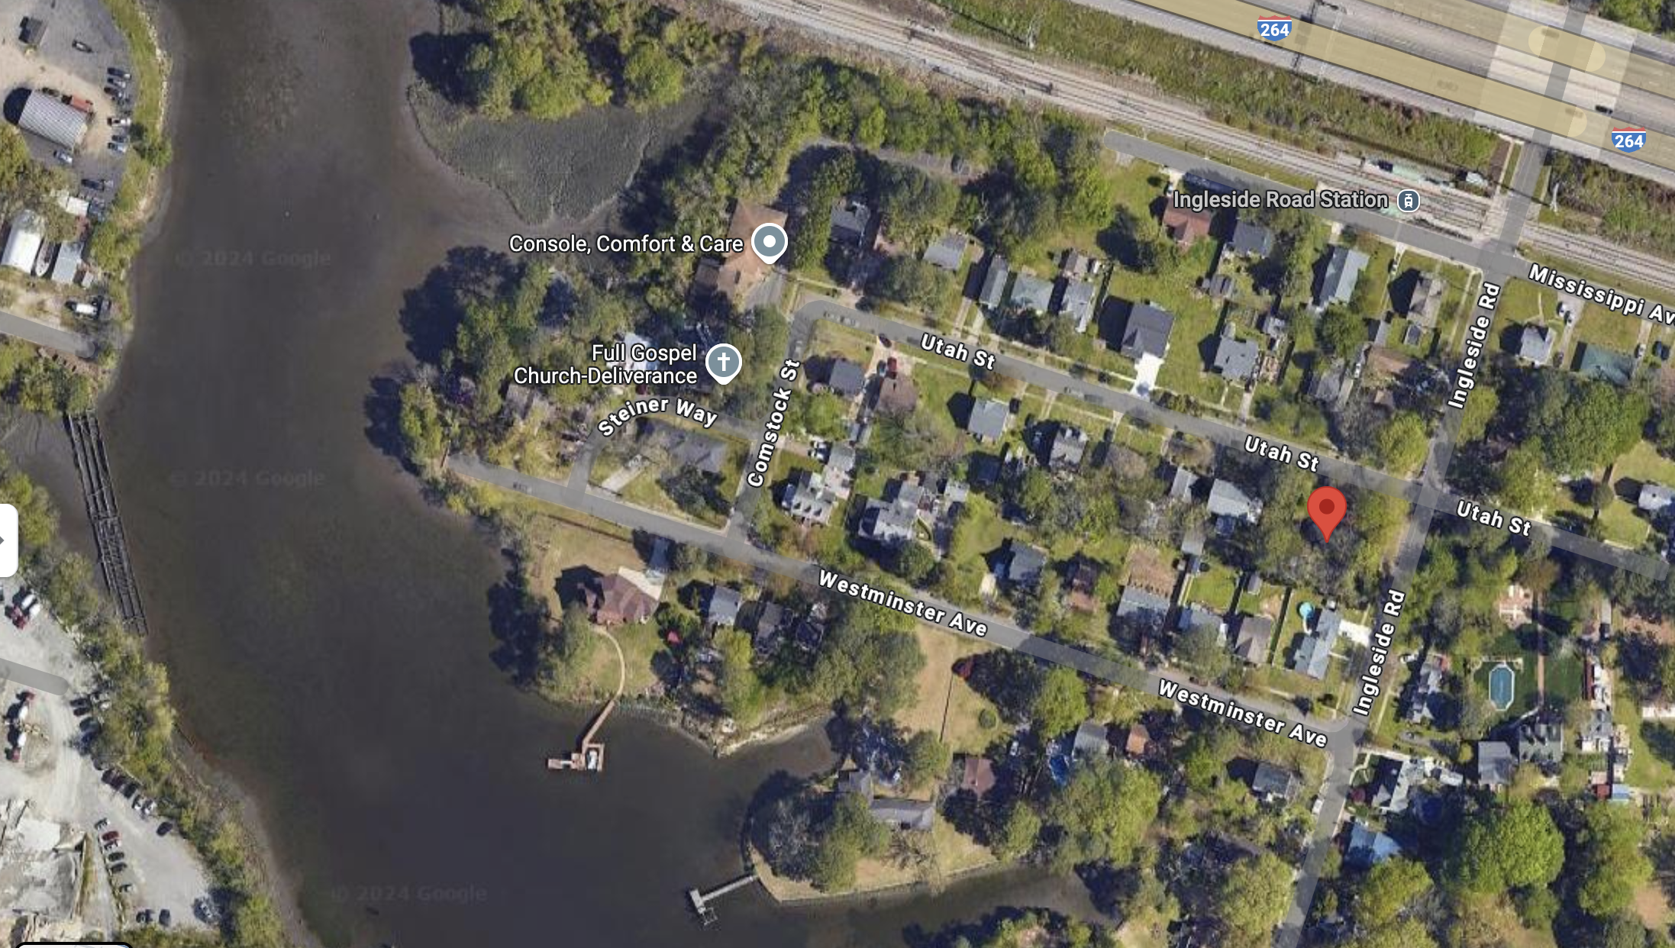
What is Environmental Justice?

Slide 10
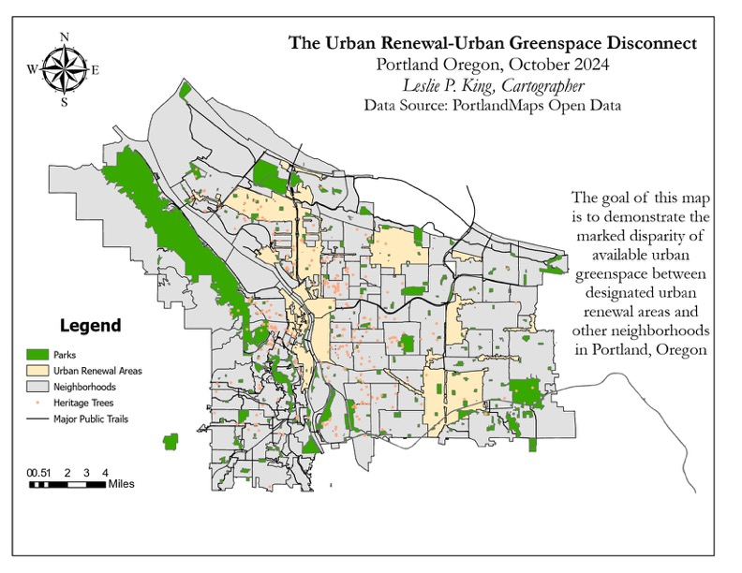
What is Environmental Justice?

