Slide 1
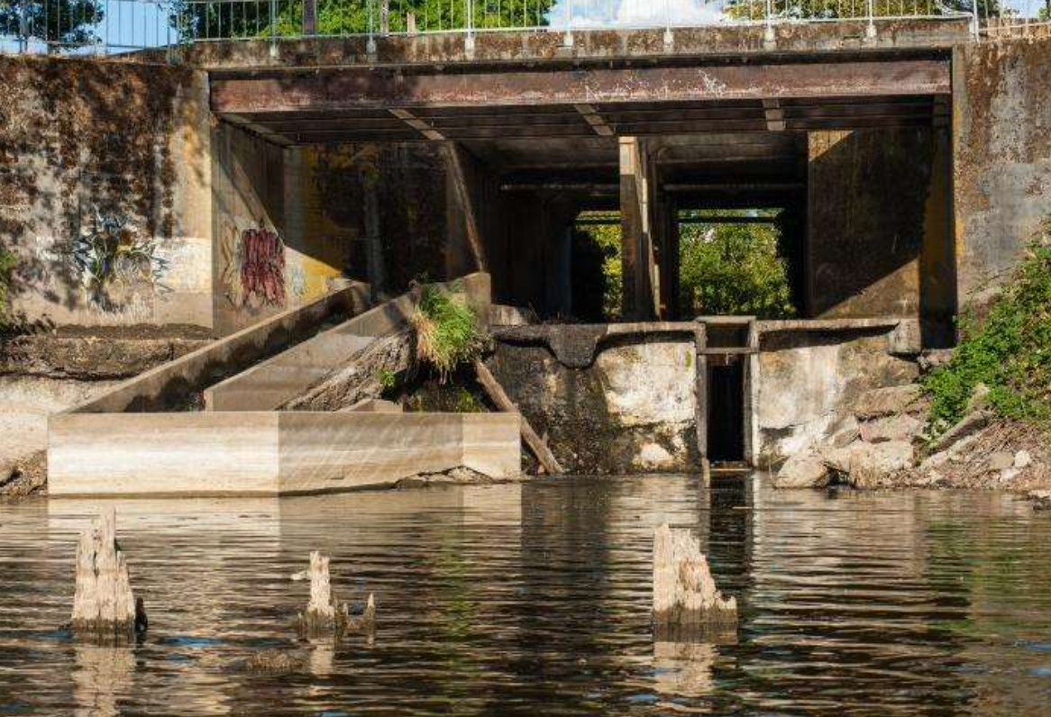
The Kellogg Dam
An Environmental Justice Example

Slide 2
Environmental Justice Definition
(Simplified)
Once more…with editing
The fair treatment and meaningful involvement of all people regardless of race, color, national origin, or income with respect to the development, implementation, and enforcement of environmental laws, regulations, and policies

Slide 3
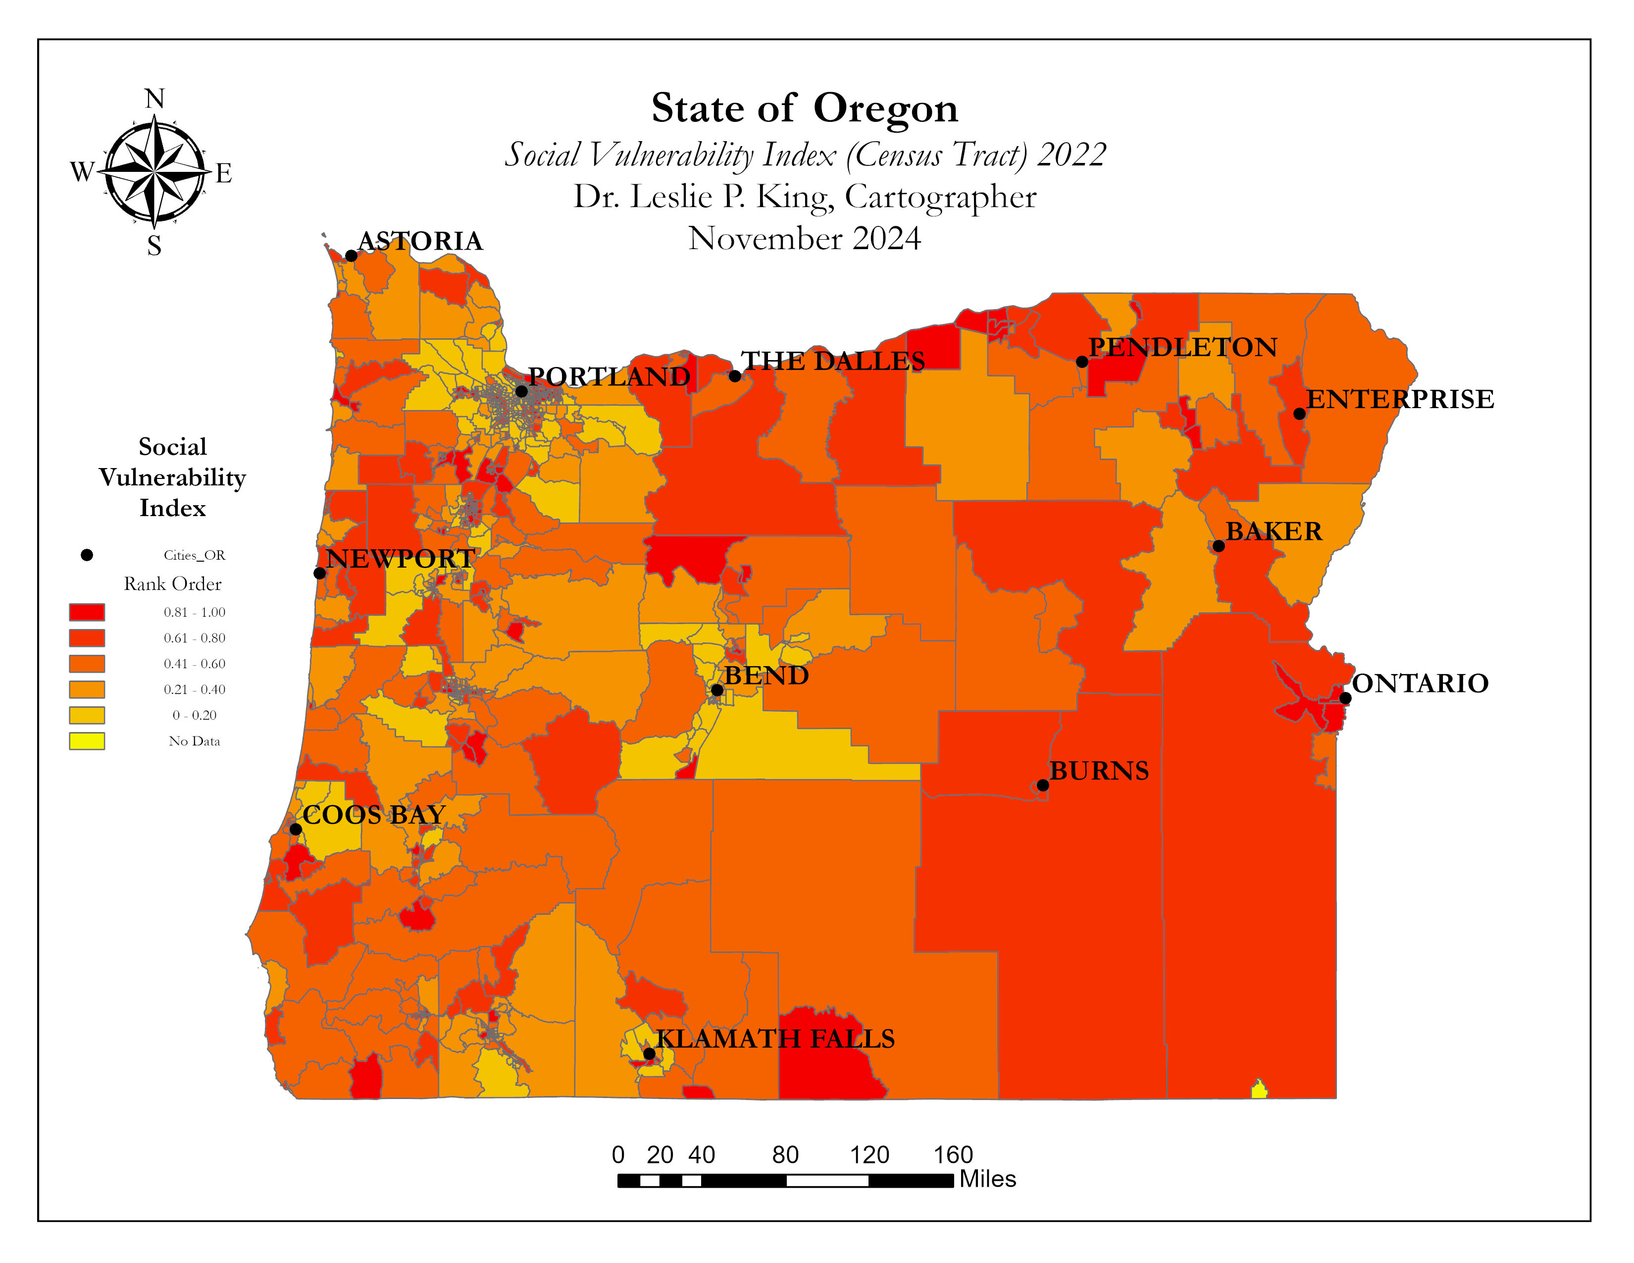

Slide 4
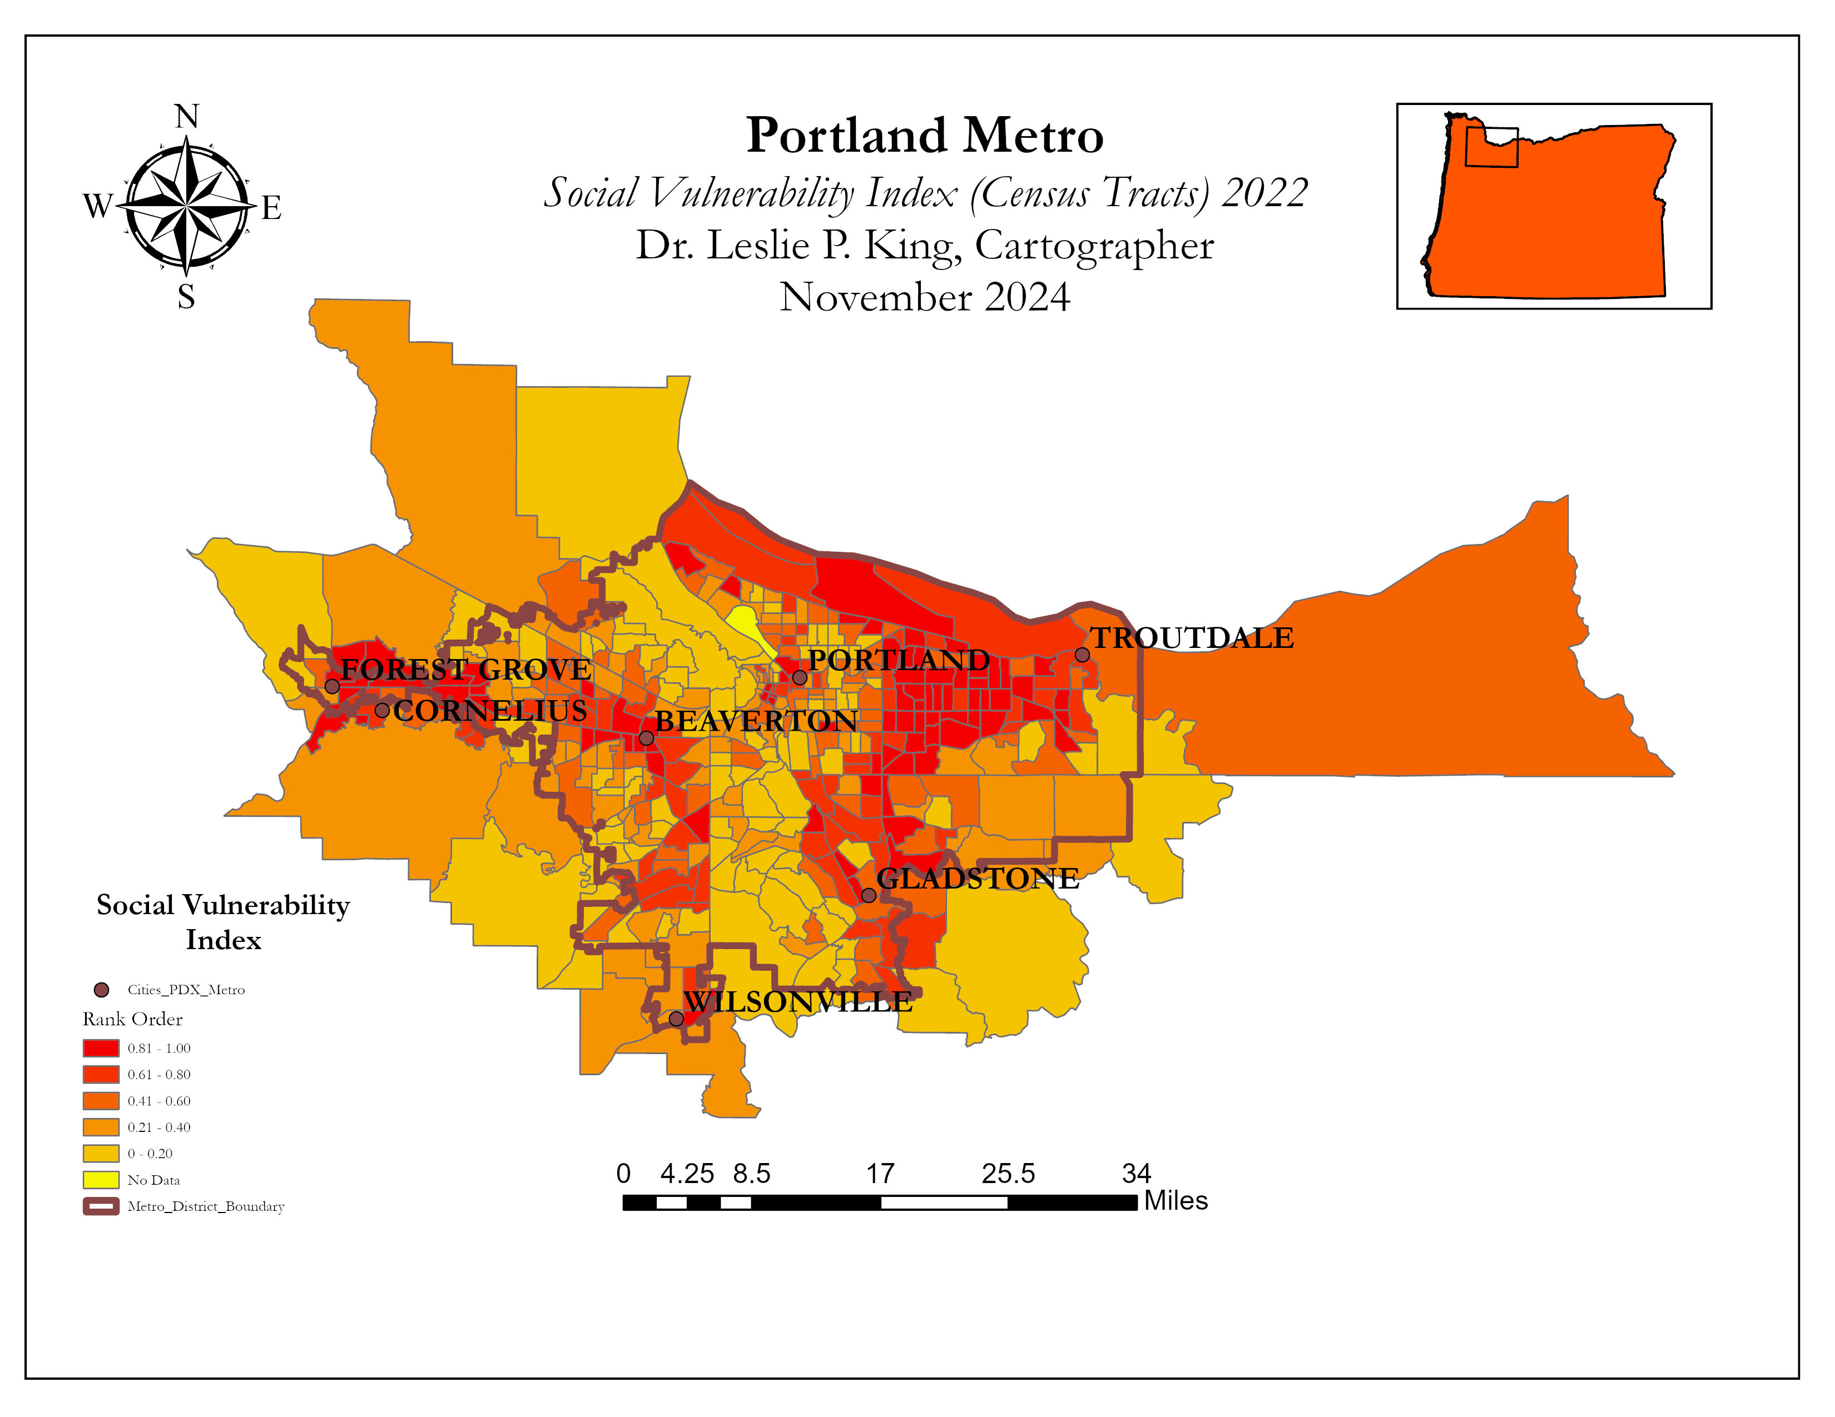

Slide 5
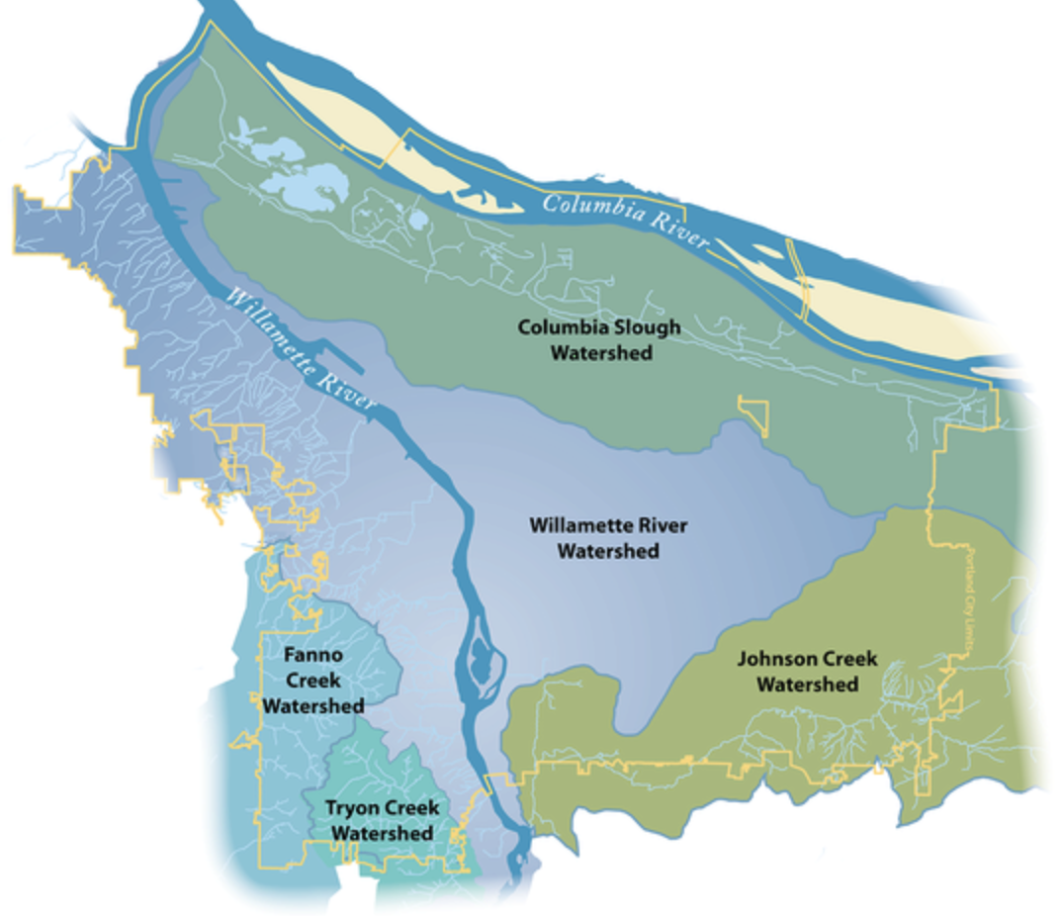

Slide 6
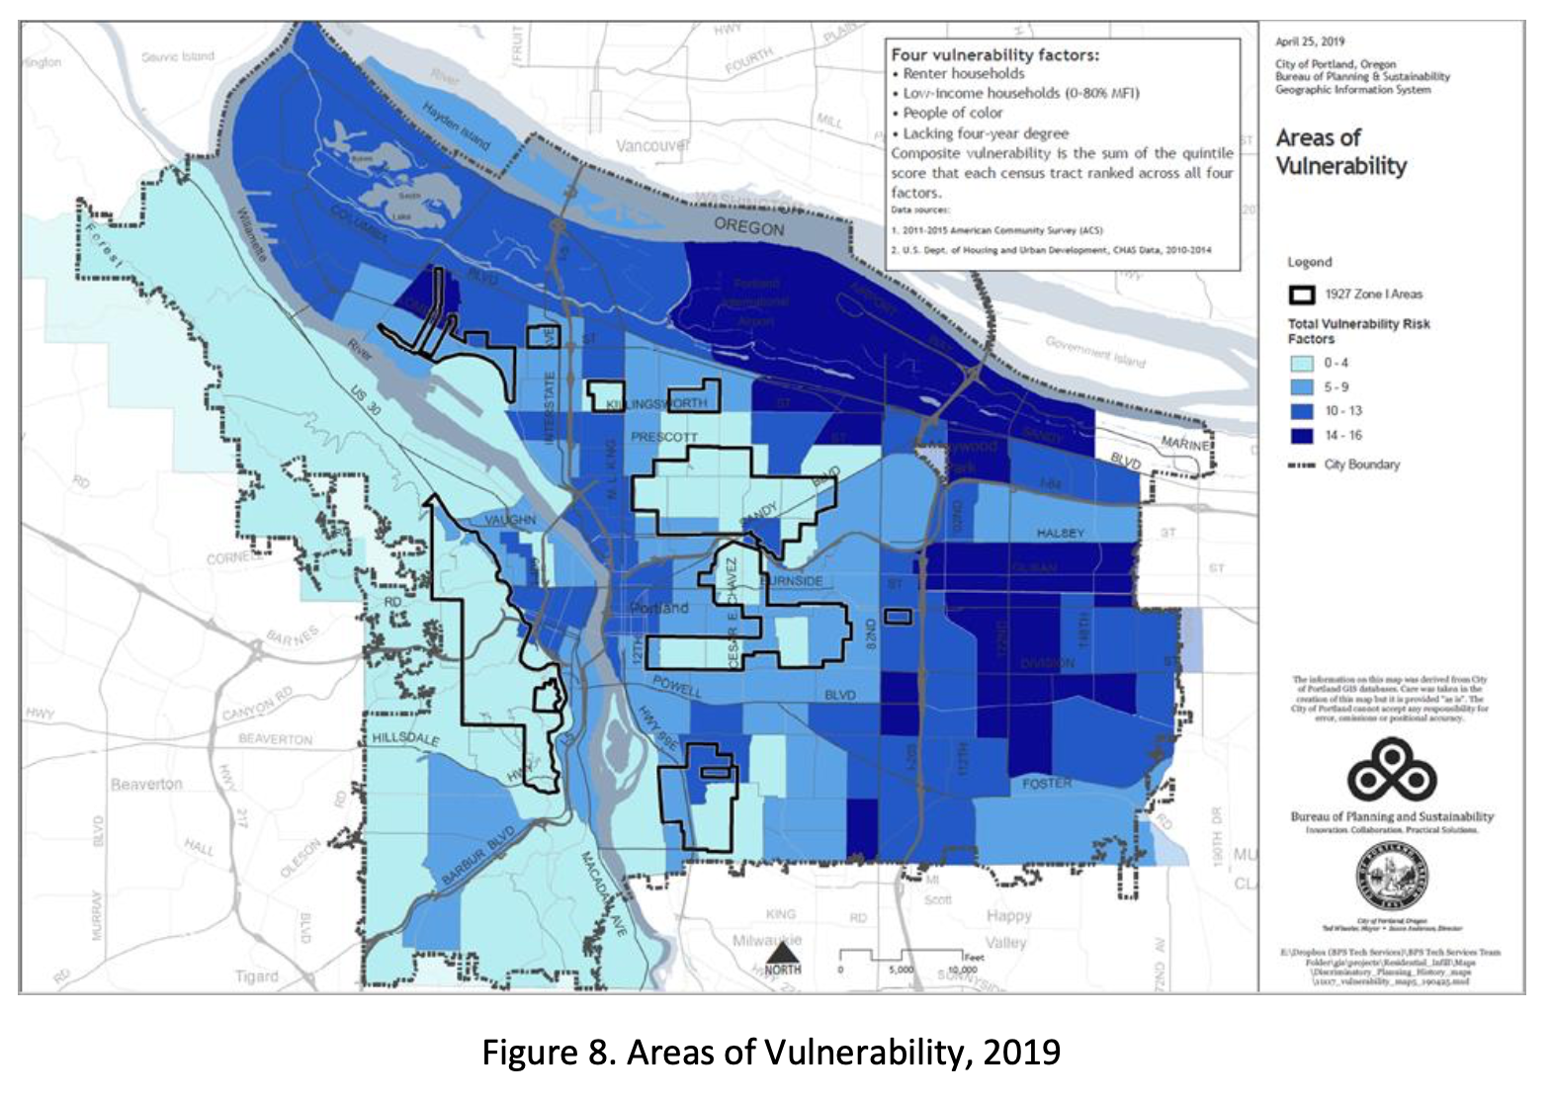

Slide 7
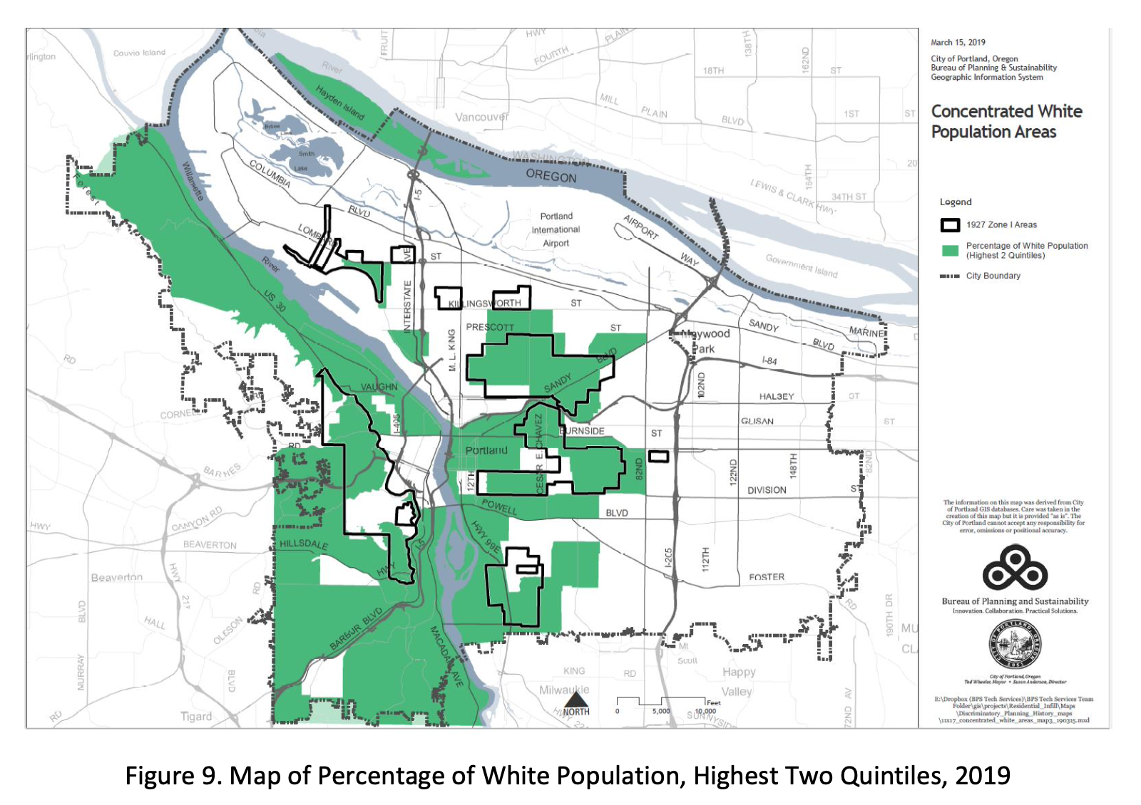

Slide 8
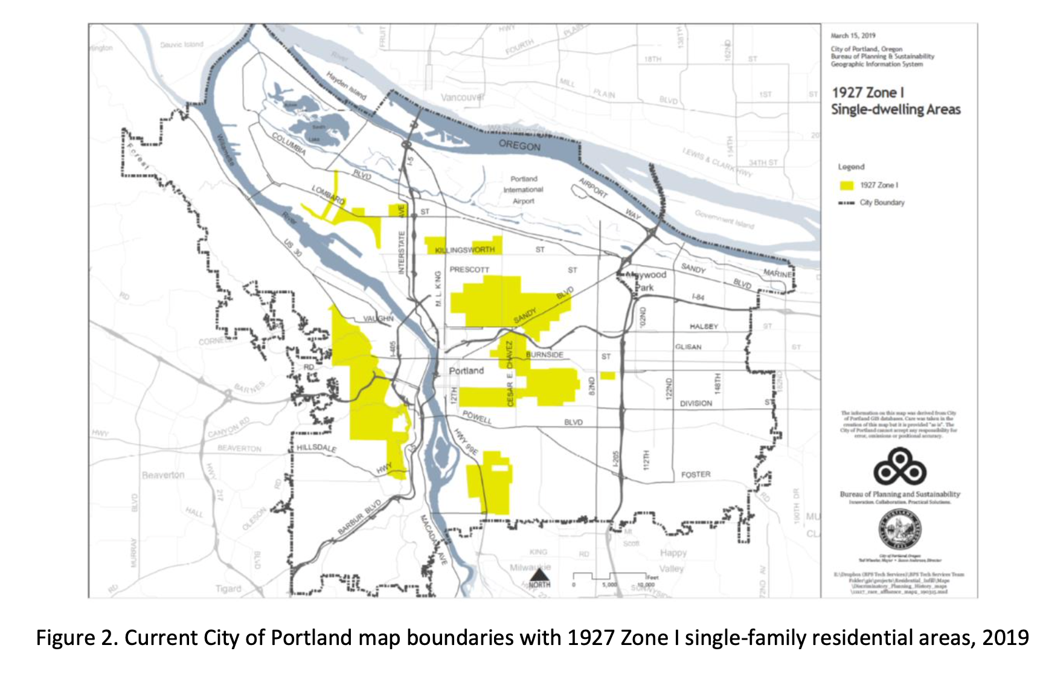

Slide 9
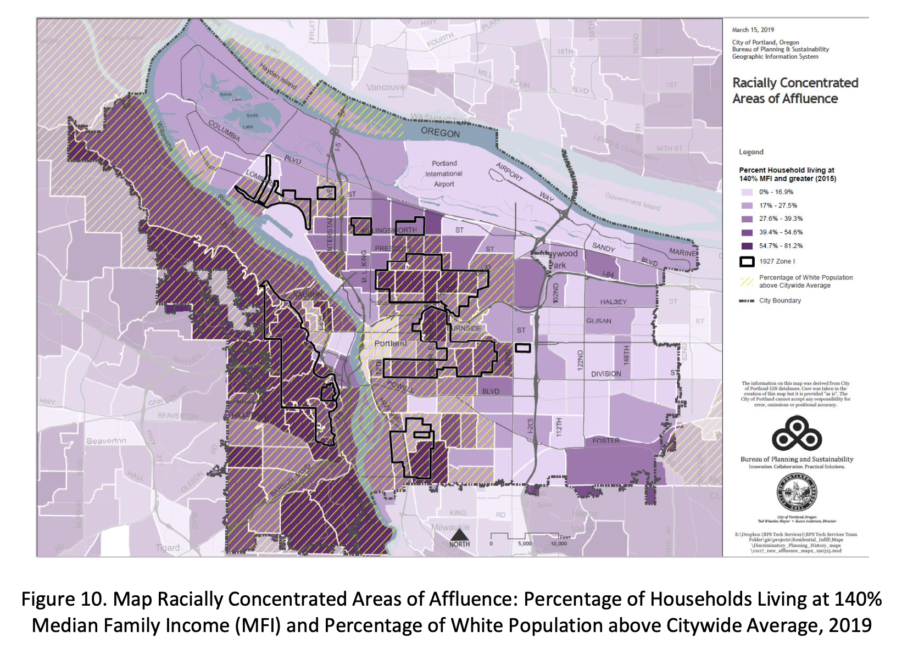

Slide 10
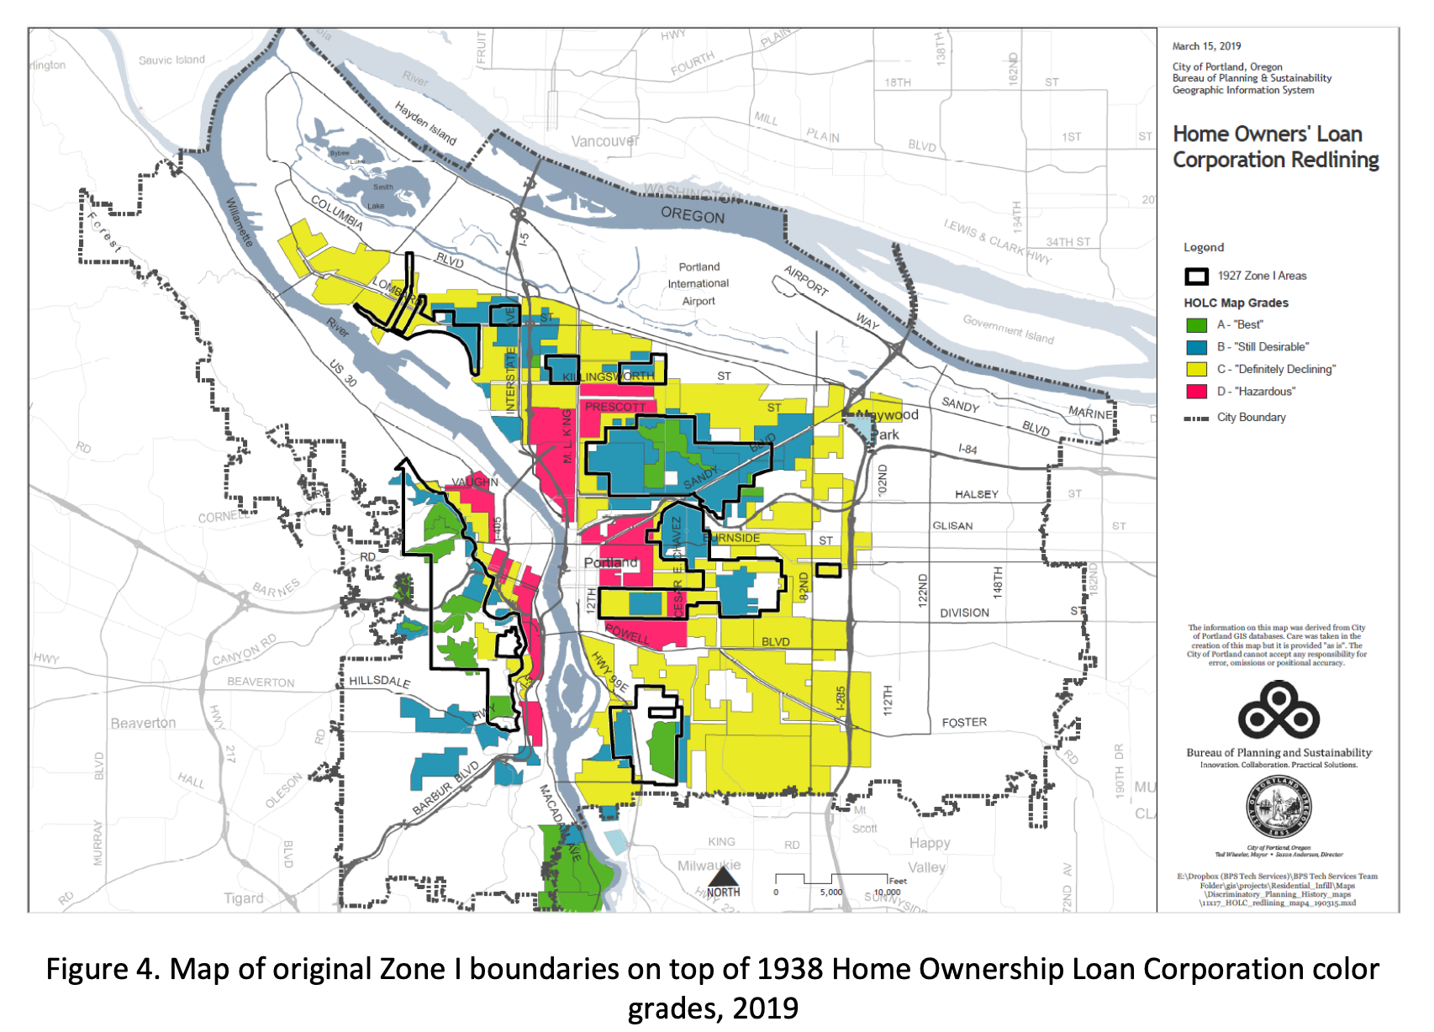

Slide 11
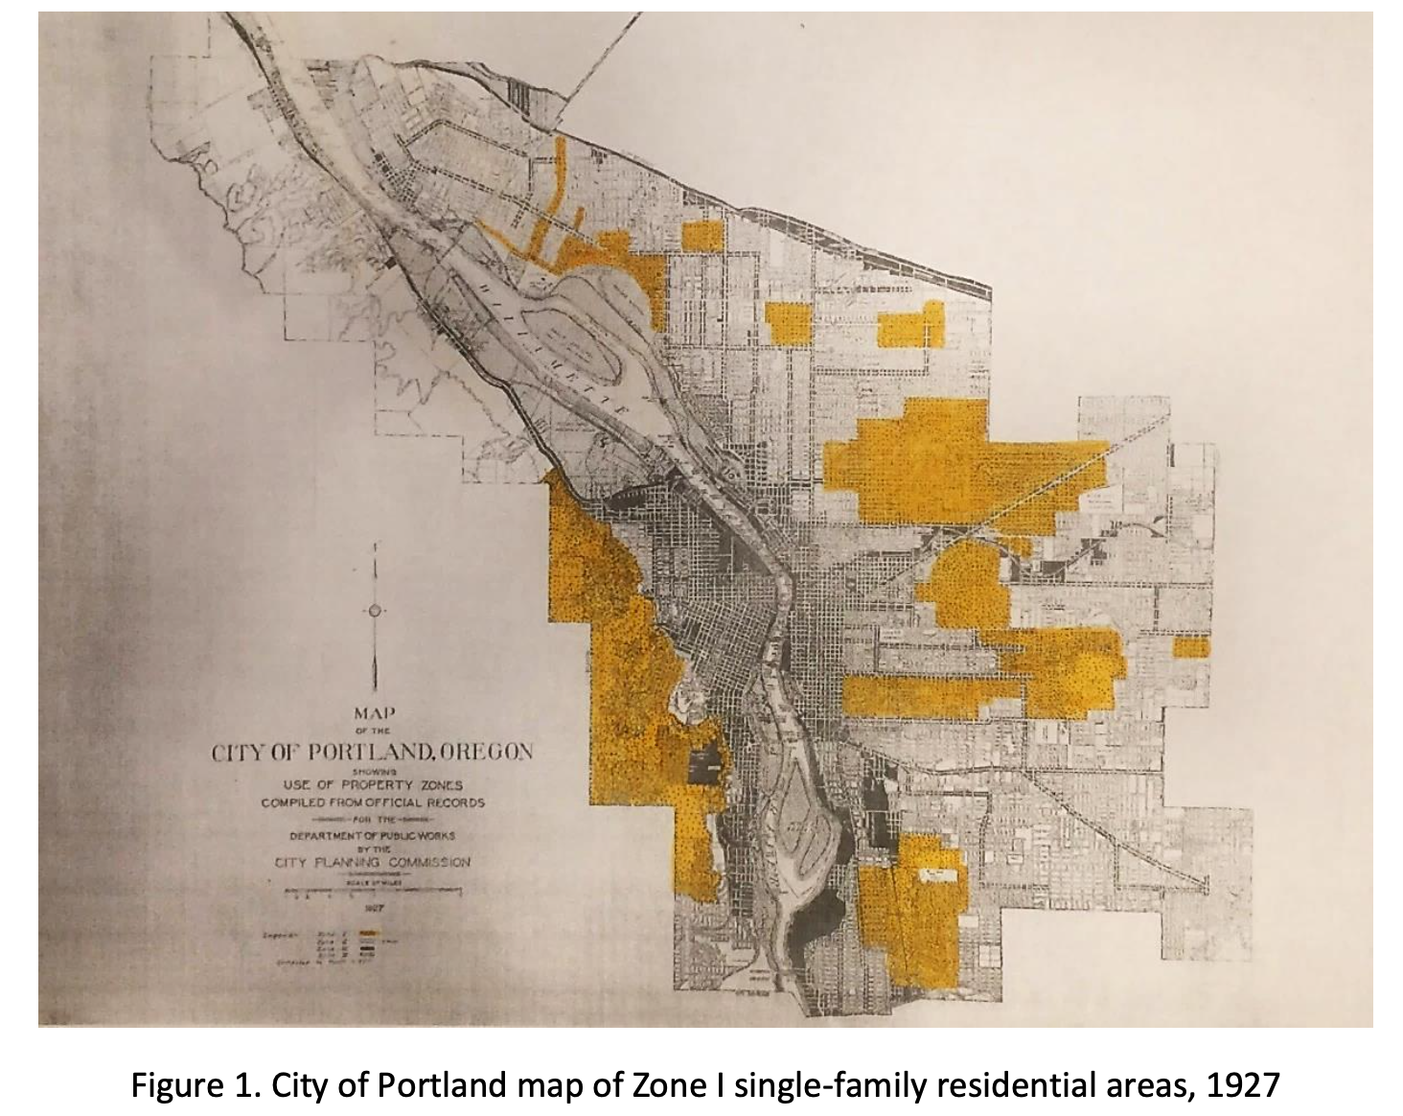

Slide 12
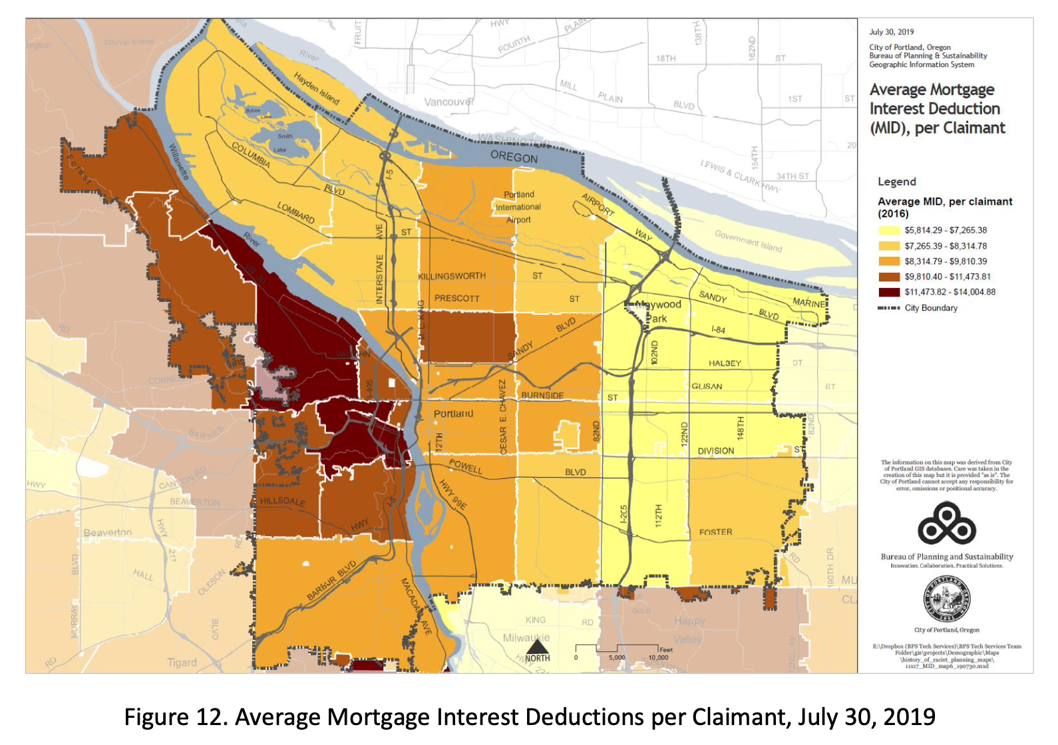

Slide 15
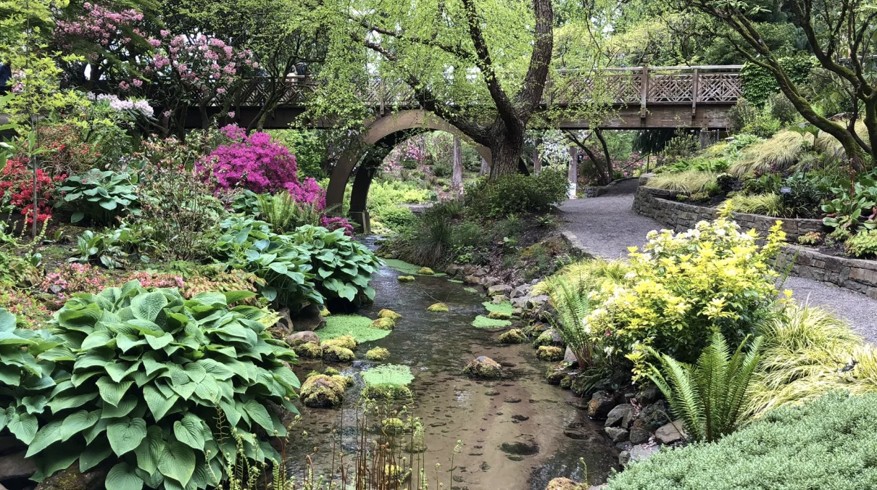

Slide 16
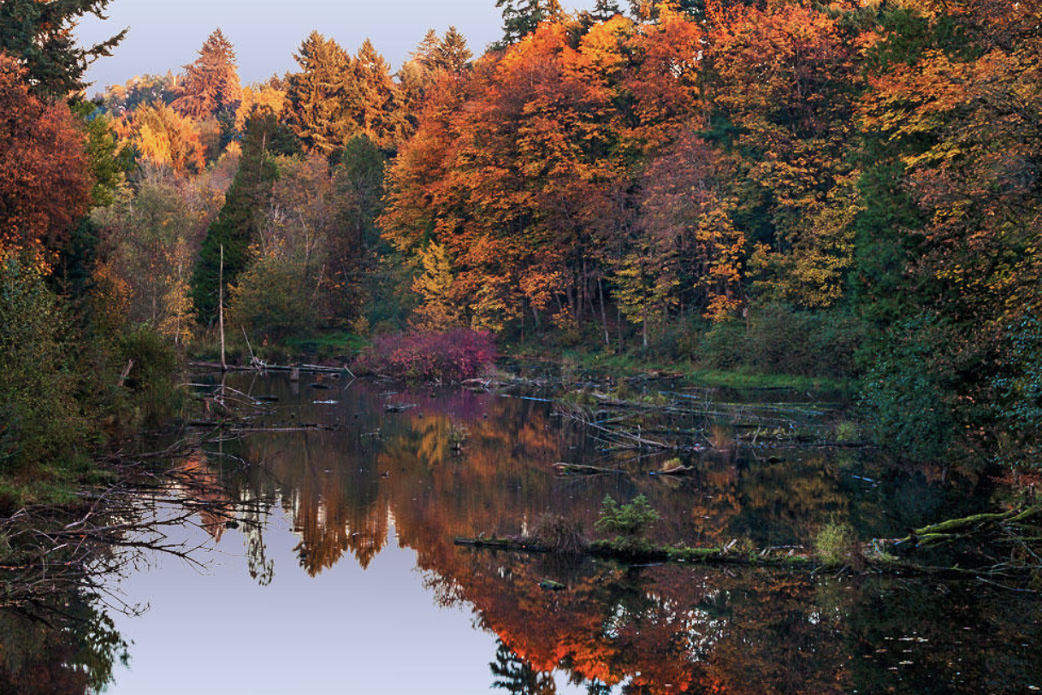

Slide 18
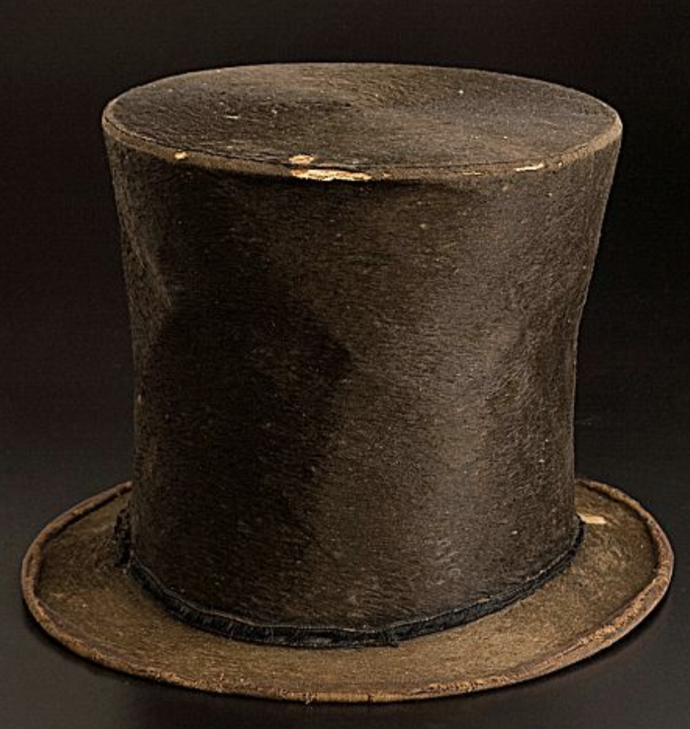
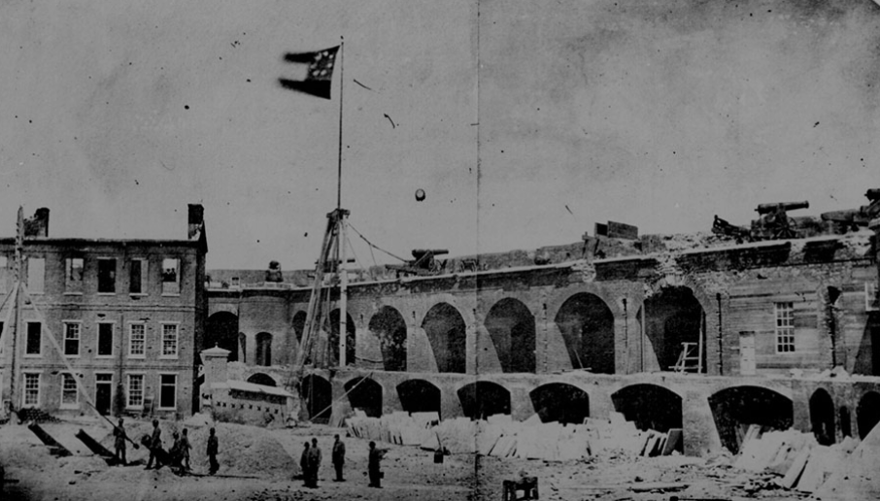
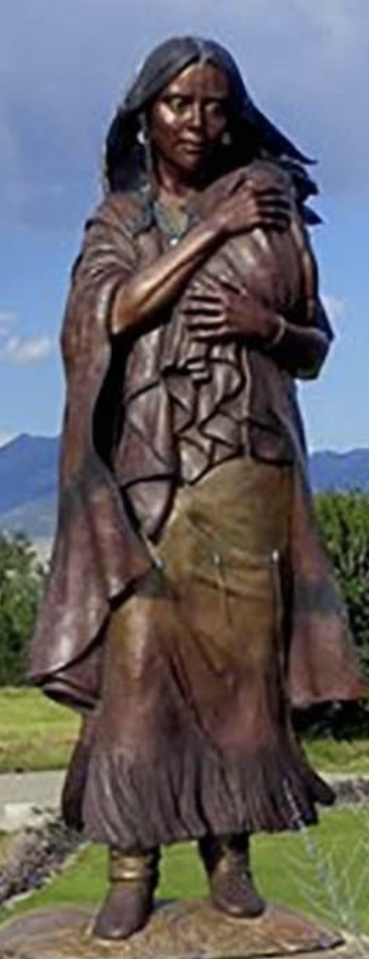
Before Illinois was the “Land of Lincoln”
Before the first shots of The Civil War were fired at Fort Sumpter, SC
Before the Northern Shoshone territory known as ogwa pe-on (River of the West) became Oregon, the 33rd state
There was the Kellogg Dam…
Notes:
Built by Joseph Kellogg, pioneer who made donation land claim (320 acres) straddling what was then called Cold Creek in 1858
Kellogg Dam built in 1858 to power Standard Flour Mill that ceased functioning in 1890s and fell into Willamette River in either 1901 or 1903
Standard Flour Mill, first flour mill of Pac NW. It supplied grain to the California Gold Rush and was renown for its pure, white flour
Kellogg Dam also powered a sawmill and shingle factory. Kellogg Lake was used as log pond.
ODOT built OR-99 highway on top of the the dam in 1930s, effectively acquiring ownership of Kellogg Dam
Fish ladder added in 1954, full barrier to fish passage for nearly 100 years. Note– fish passage laws predate Oregon Statehood

Slide 19
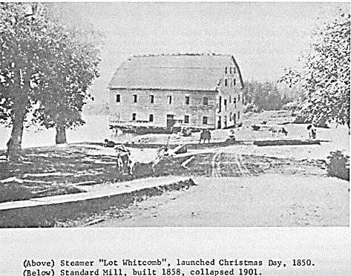
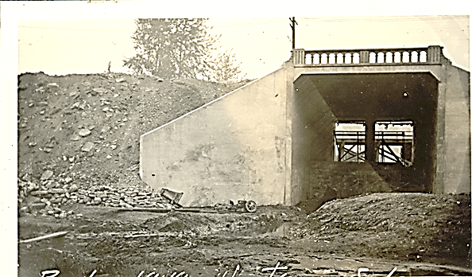
Kellogg Dam/99E Bridge History
Dam/Lake – built 1848
Standard Mill – collapsed 1901
99E bridge – 1934
Fish ladder modified - 2003
Notes:
1858: mill dam in place. 1934: ODOT bridge and fish ladder constructed; modified in 2003.

Slide 20
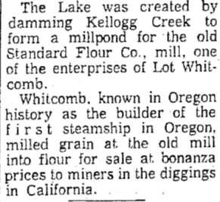
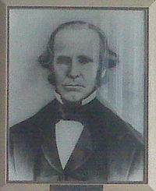
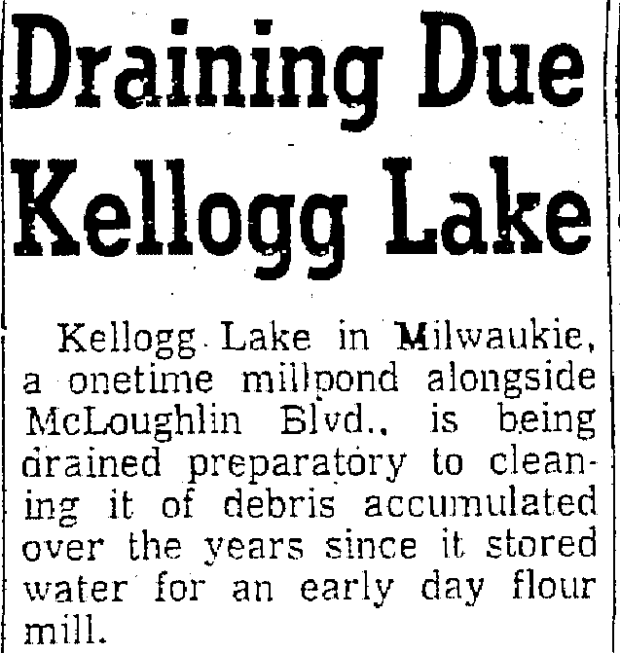
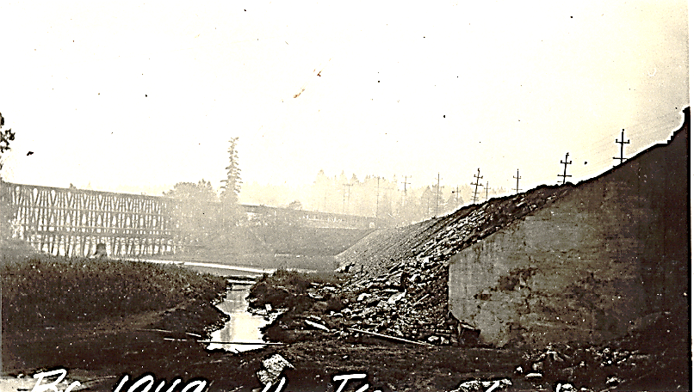







Slide 21
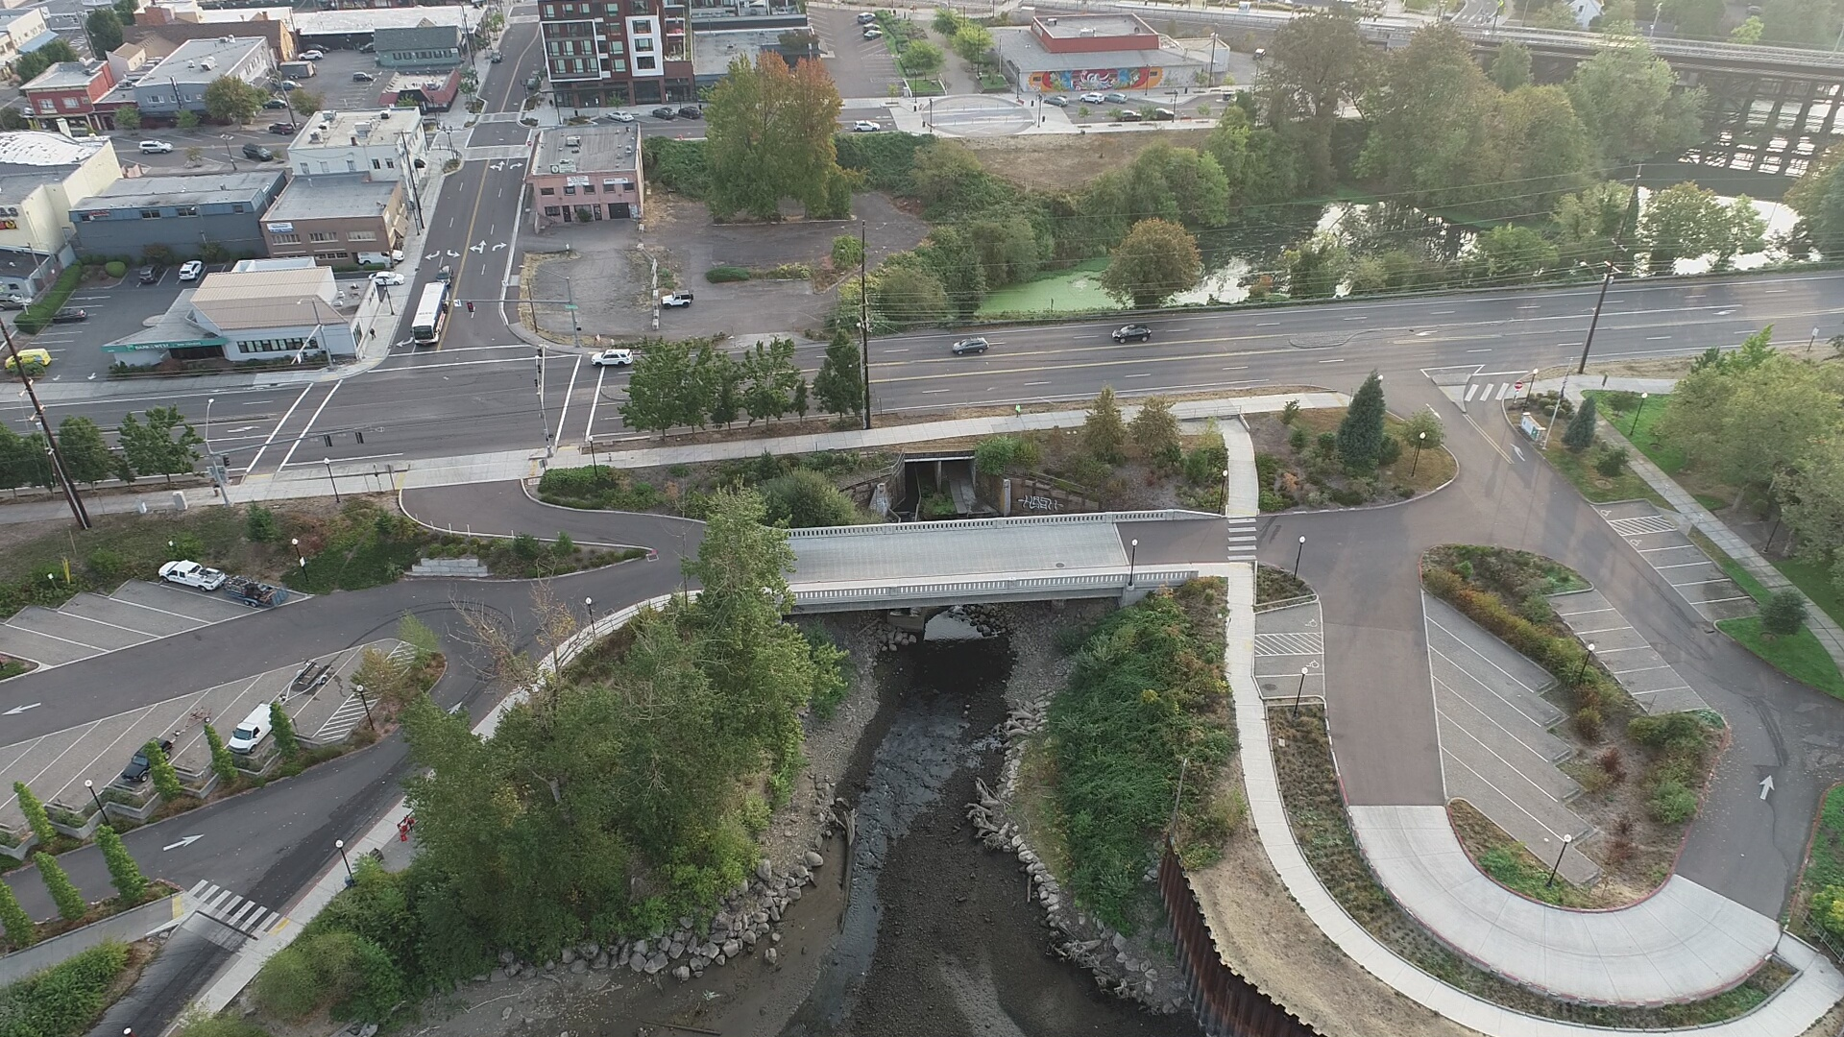
Project Context
Notes:
Washington Street bridge (access to Milwaukie Bay Park/boat ramp) in foreground
Highway 99E with cars crossing – 4 lane state hwy, constructed 1934 on top of old mill dam.
Impoundment (locally referred to as Kellogg lake) - Gravel borrow pit from Kellogg impoundment likely based on as-builts, and data collection

Slide 22
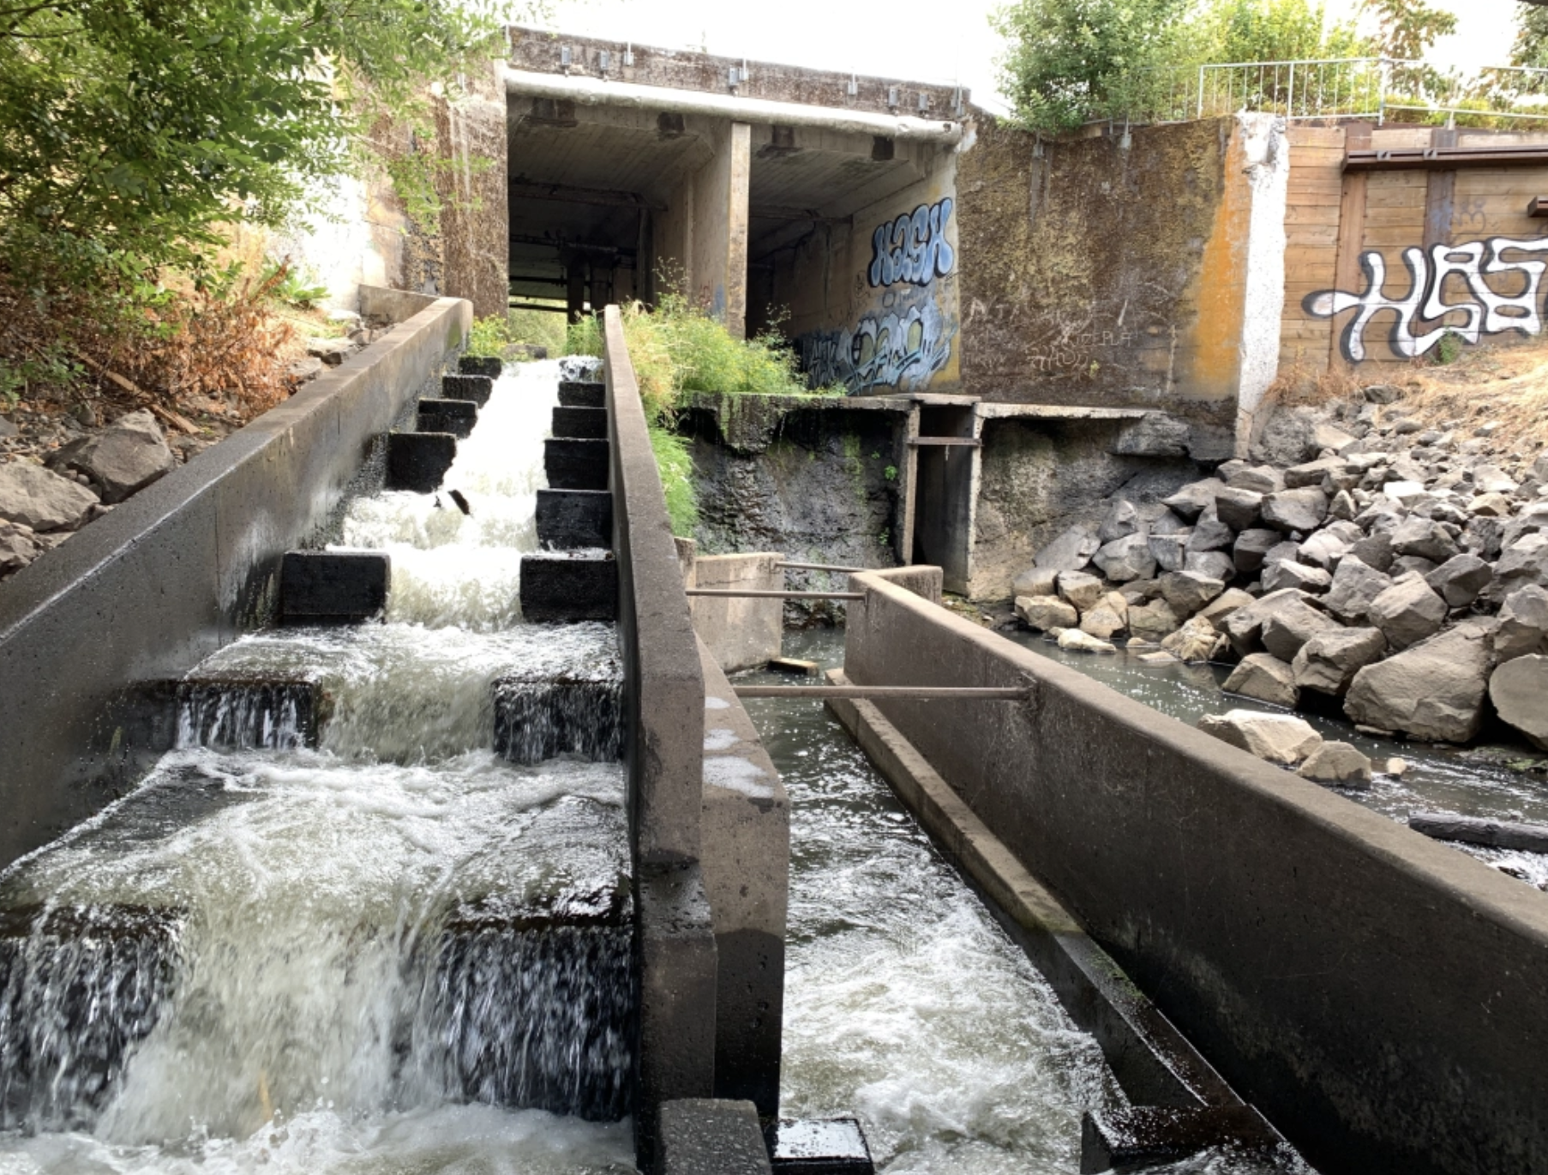
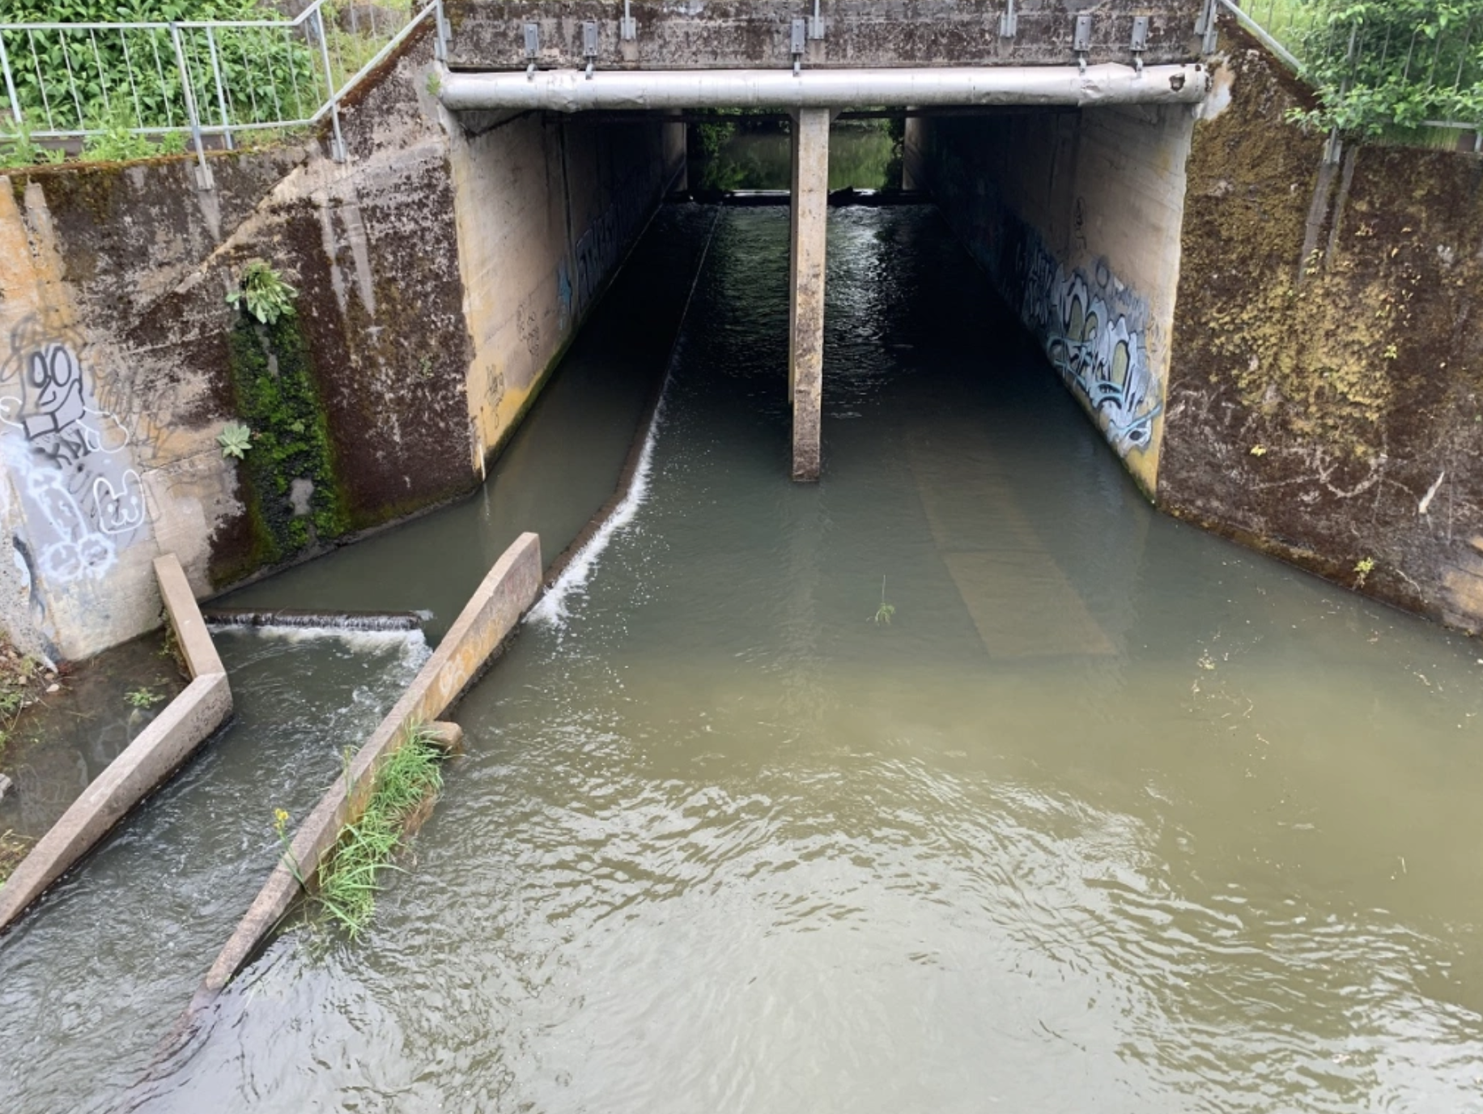

Slide 23
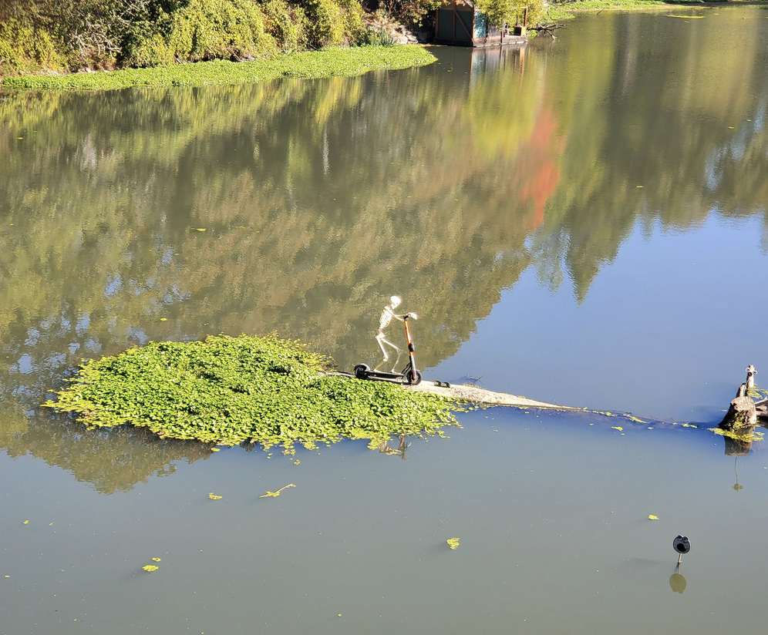
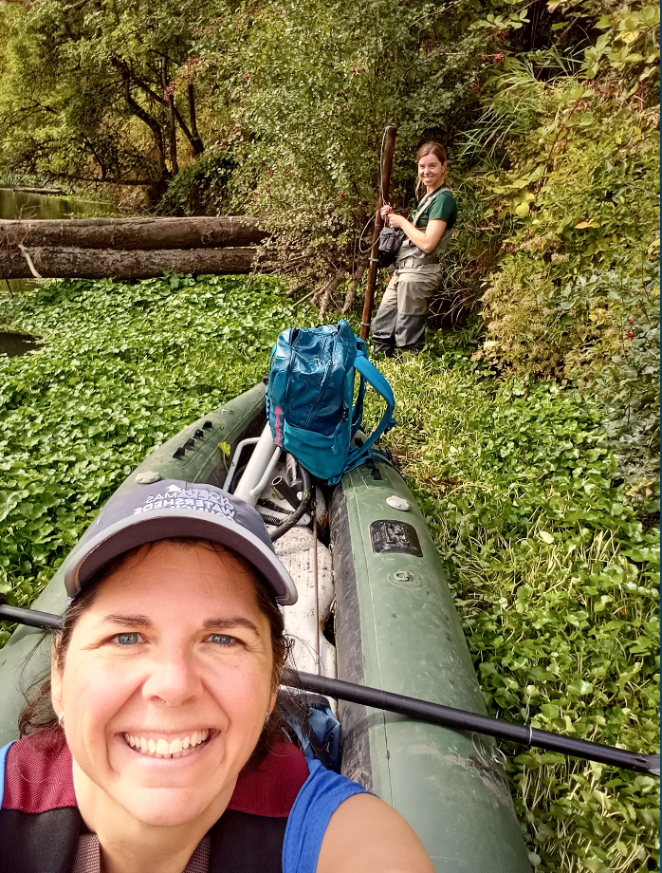

Slide 24
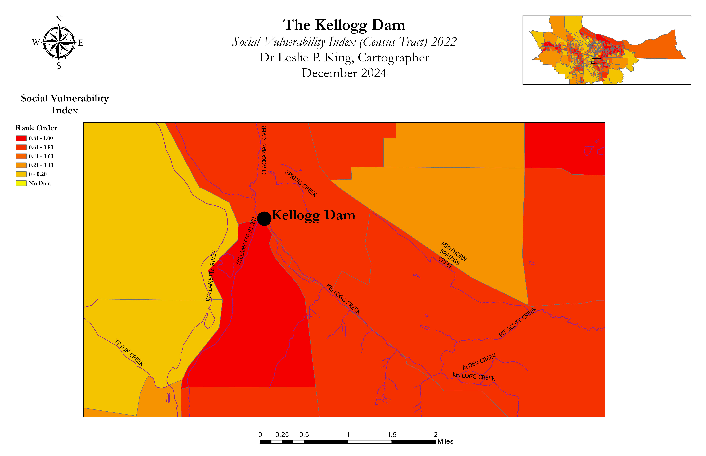
Milwaukie
The Kellogg Dam

Slide 25
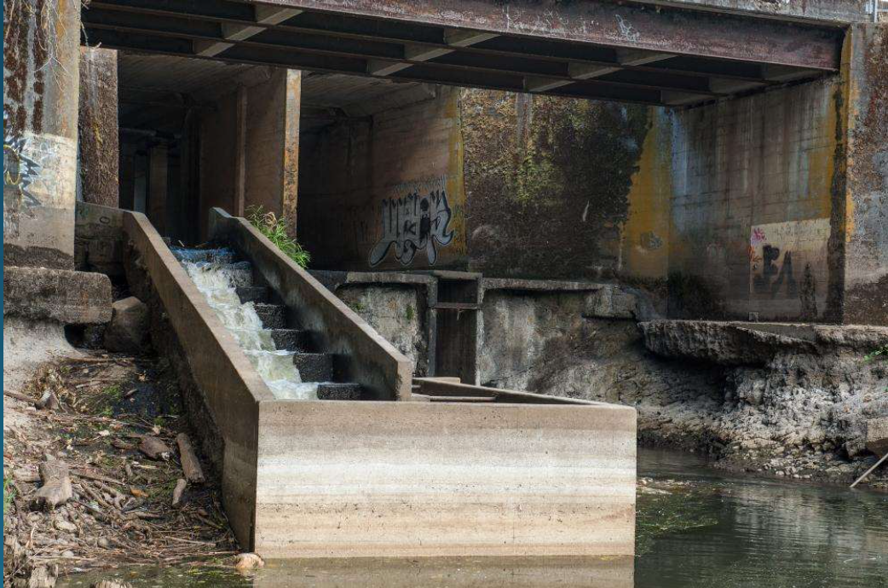
Rather Typical Watershed Speak…
Near total anadromy barrier
Restoration of 14.5 habitat acres
Regional trail connections
Highway bridge improvements
Increased floodway capacity
Climate resiliency

Slide 26
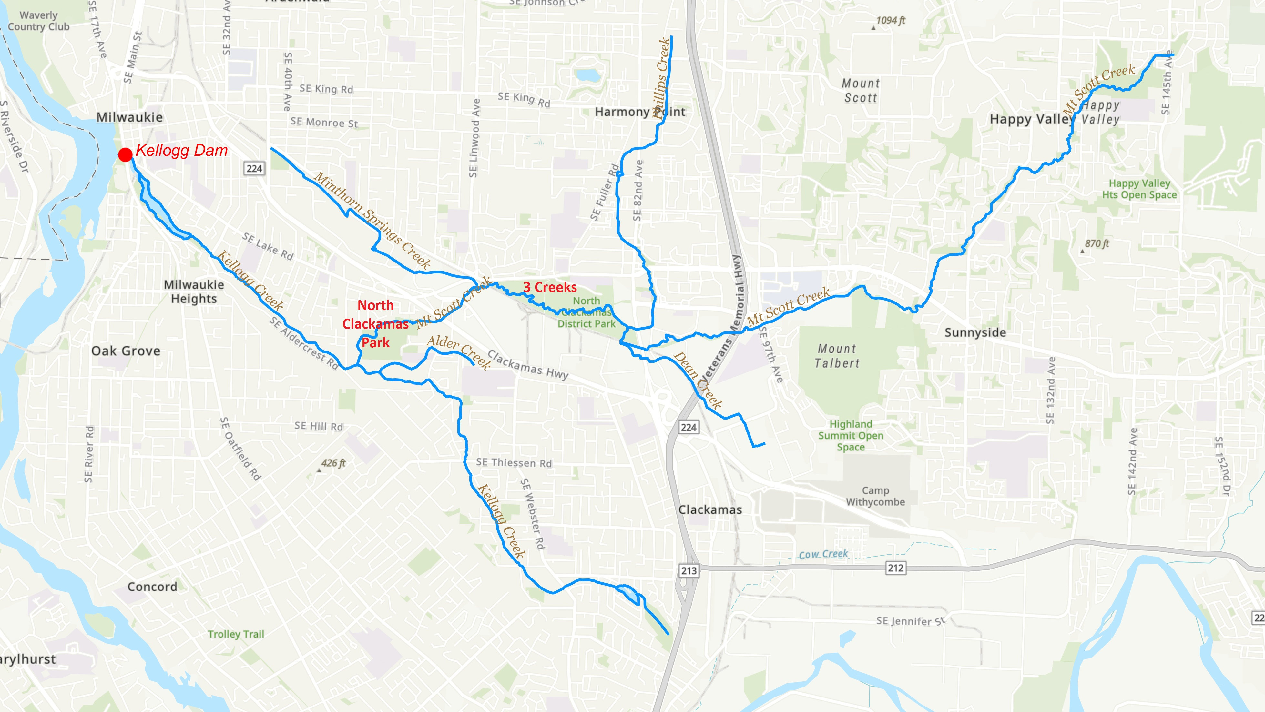

Slide 27
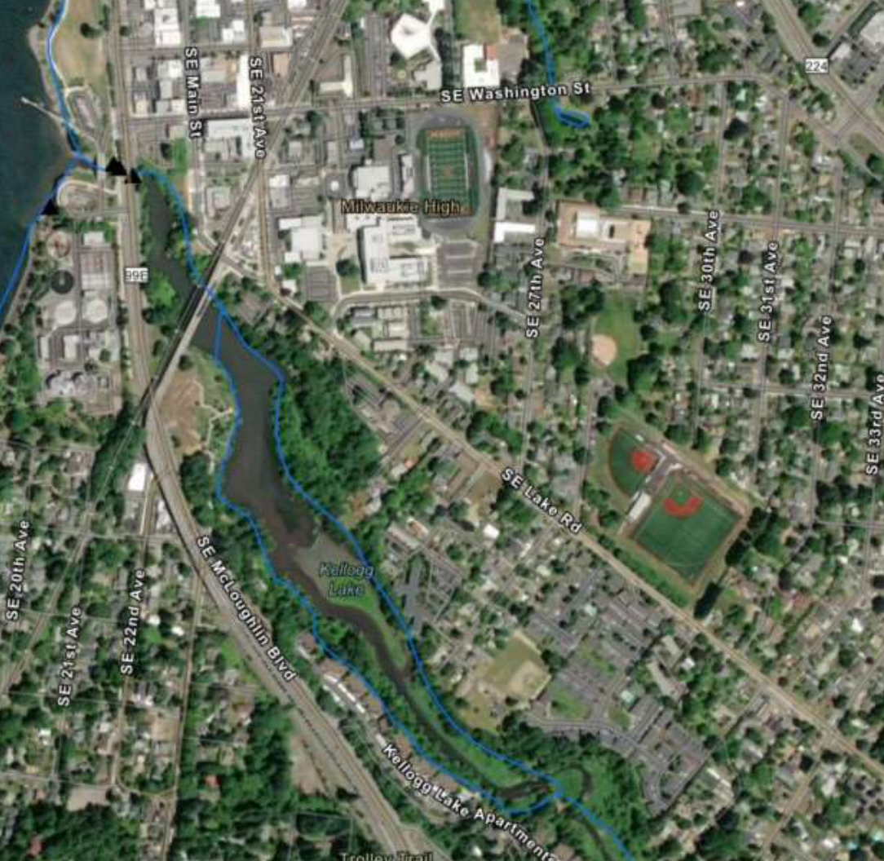
New Social/Environmental Justice Speak…
Strong community support
Equity focus area
Proximity to Milwaukie HS:
  50% BIPOC
  60% Free or Discounted Lunch
  Living laboratory – student monitoring
Workforce development
Community partnerships
Paid underserved community member participation
Notes:
Rowe Middle School (at end of impoundment)

Slide 28

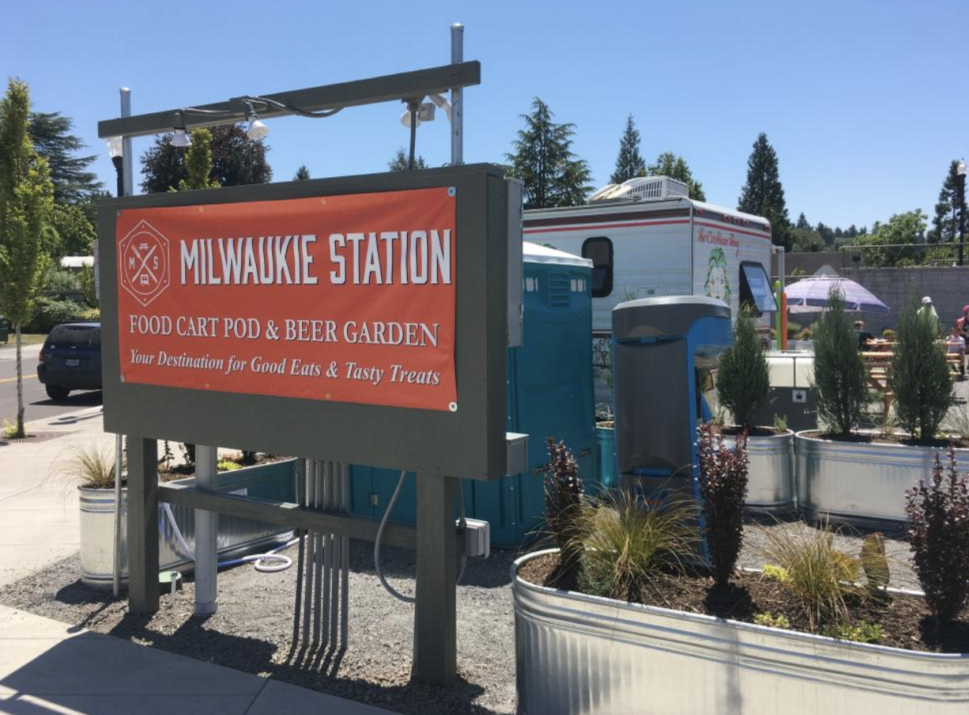

Slide 29
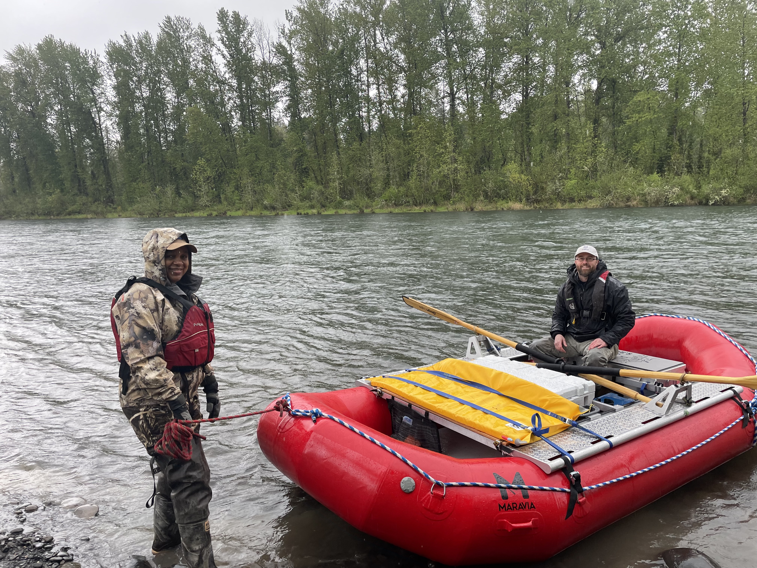
Notes:
Barton or McIver: Clackamas County Parks/Clackamas River w/ Brian from Metro

Slide 30
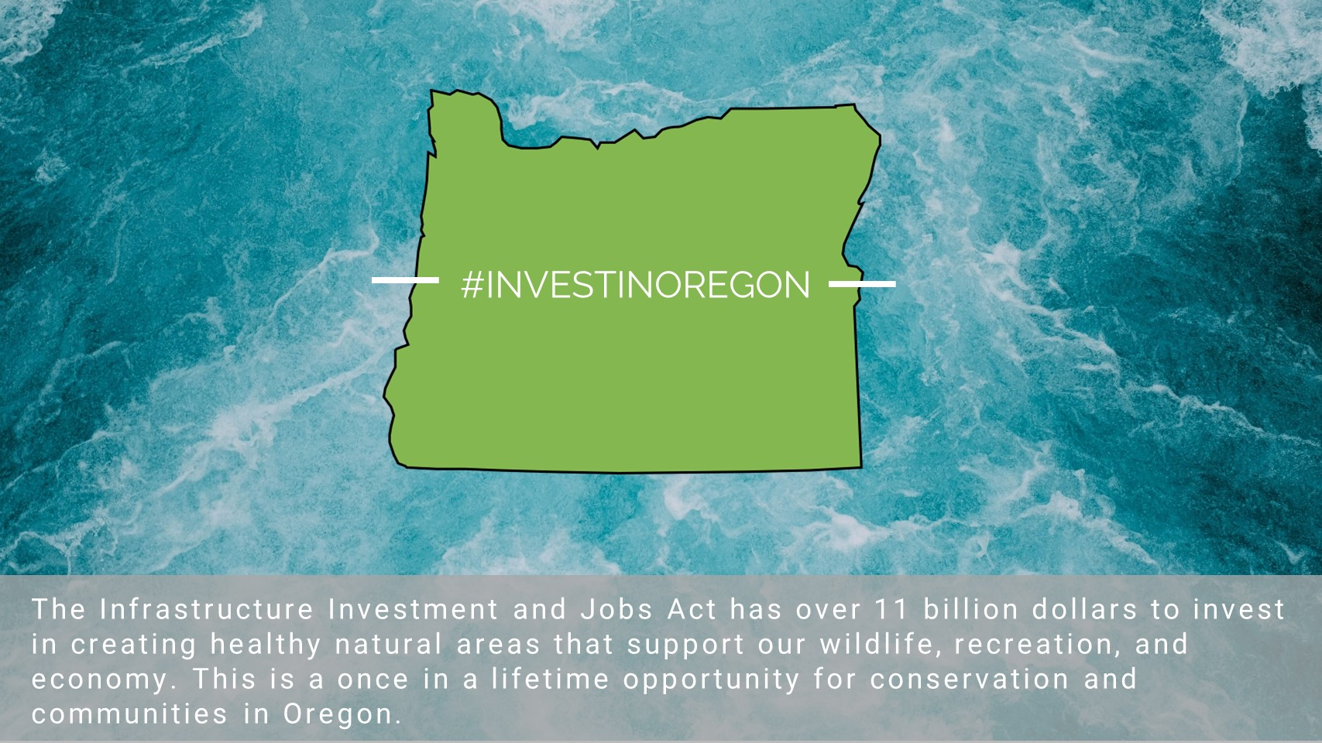
Notes:
Most federal funding programs require 20% match from non-federal sources (private, local/state/regional government)
Critical ingredients for projects to secure funding:
Private and local funding – highly dependent upon community engagement
Project management/development – creating the vision that allows others to see the project is possible and how it will be completed.
Sponsor administrative and organizational capacity to deliver work
Partnerships at scale needed to deliver/complete the project
Telling the story – how well you write the grant application determines score/rank and ultimately if funding is awarded.

Slide 31
Project Funding
Private, Local, State Funding
Federal
  Critical to complete complex multi-benefit projects with diverse benefits
  $100M needed to complete Kellogg Project
Equitable community engagement
Project vision, development, management, delivery resources
Build critical partnerships
Initial Technical site studies and alternatives evaluation
Leveraged NOAA’s largest grant award of $15,000,000

Slide 32
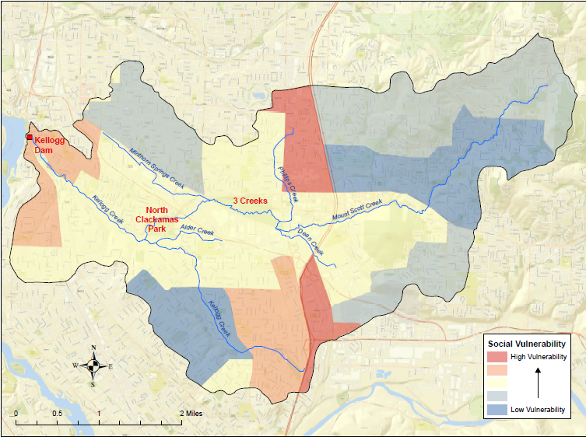
Kellogg Creek Watershed
Justice 40 Initiative
Census Tract 208:
  Kellogg Dam
  Environmental Burden Rank-Impaired Surface Water, Hazardous Site, transportation.
Clackamas Census Tract:
  41005022108
  Low Income Burden
Notes:
Justice 40 is an initiative to deliver at least 40% of the overall benefits from federal investments in climate, infrastructure, and clean energy to disadvantaged communities.

Slide 33
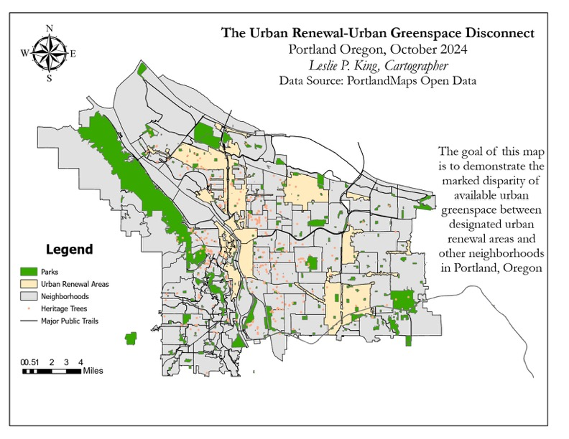
Notes:
My first solo GIS map effort…

Slide 34
