Slide 1
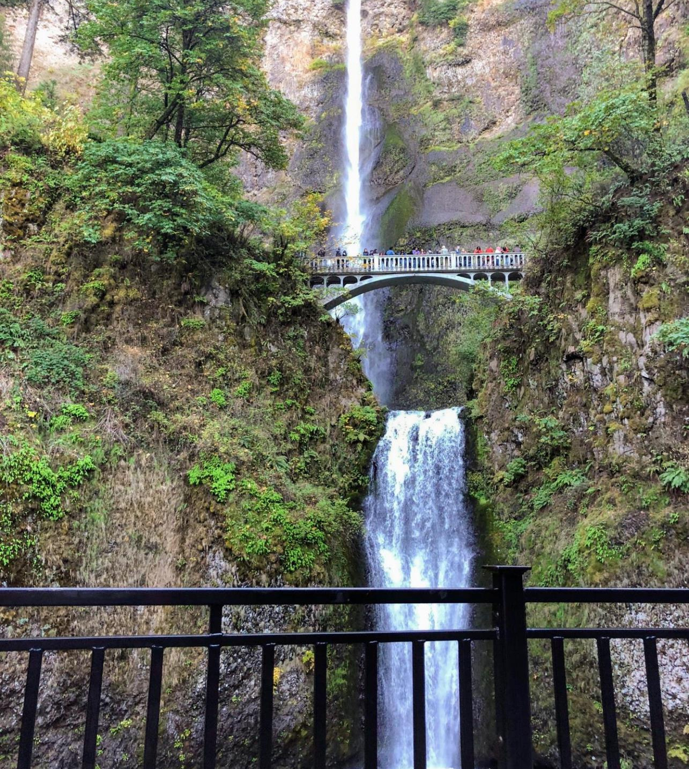
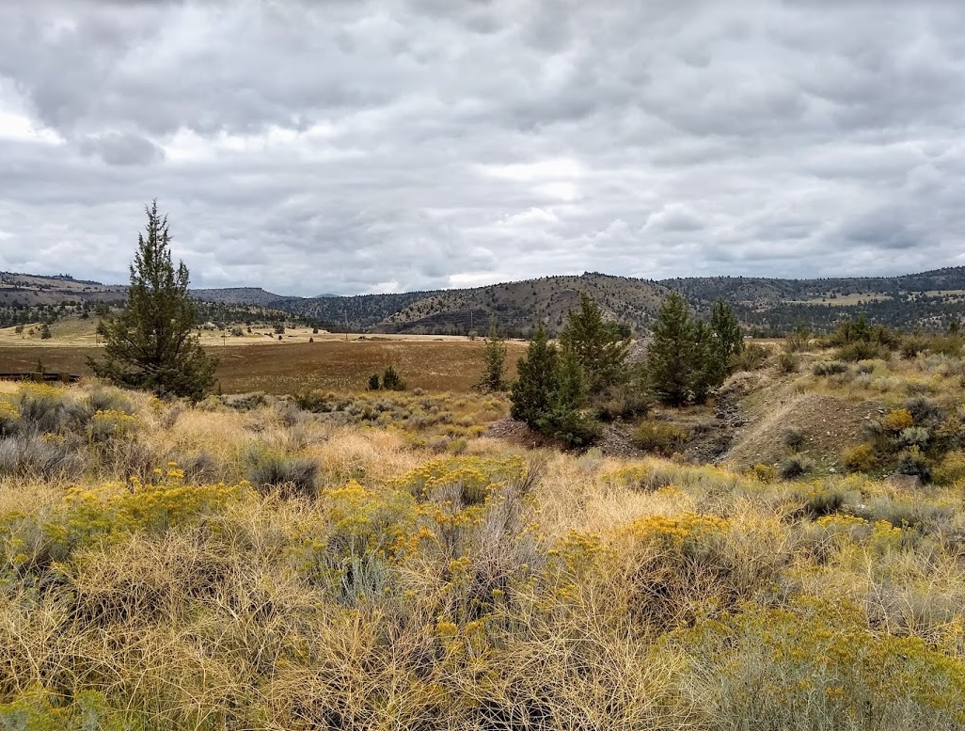
Environmental Justice Theory

Slide 2
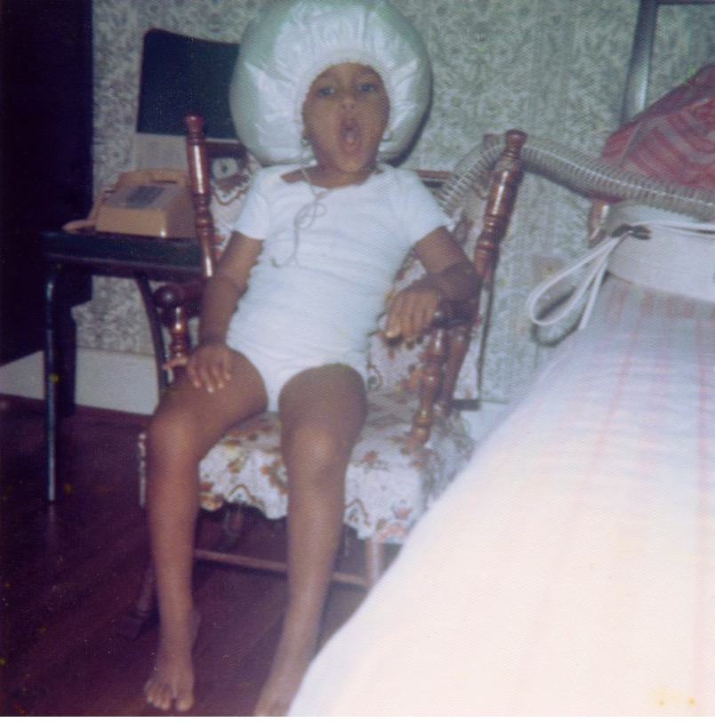
C’est Moi
Straight Outta Virginia
3X Black Ivy
Lived/Worked Six Continents
Certified, Qualified, Pedigreed
Published, Fellowed, Appointed
Decidedly NOT hiding in plain sight…
Notes:
Childhood Bedroom, Ingleside
Norfolk, Virginia USA
(photo taken by my Mother, Althea)

Slide 3
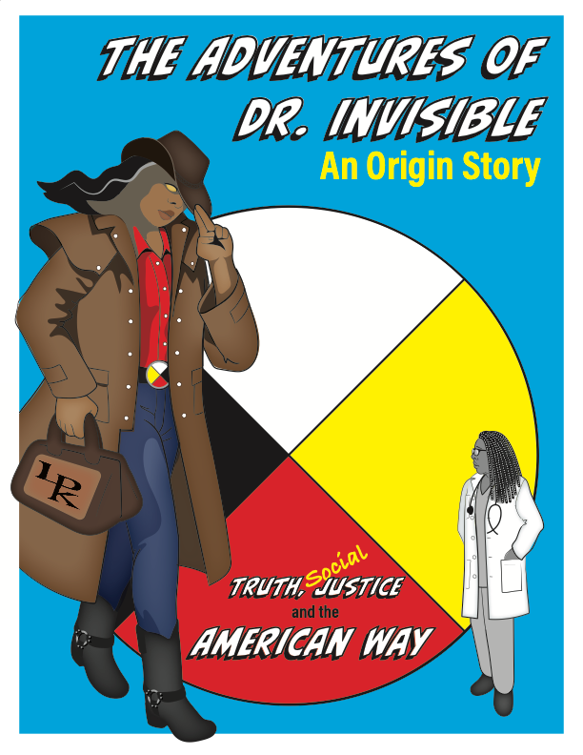
…yet, overlooked and unseen…until now
I am suddenly visible.
It is more than a bit bizarre if not outright tragic to admit that a three-time Black Ivy with a larger-than-life persona has spent her entire life until now as invisible, but is indeed true.
My newly visible status while long overdue is still rather disconcerting. It begs the question of who, exactly, has been being seen for the past five decades?
Notes:
OpEd, 2022
Basis for Dr Invisible Comic

Slide 4
Environmental Justice Definition
Environmental Protection Agency (EPA)
The fair treatment and meaningful involvement of all people regardless of race, color, national origin, or income with respect to the development, implementation, and enforcement of environmental laws, regulations, and policies. Fair treatment means that no population, due to policy or economic disempowerment, is forced to bear a disproportionate share of the negative human health or environmental impacts of pollution or environmental consequences resulting from industrial, municipal, and commercial operations or the execution of federal, state, local and tribal programs and policies.

Slide 5
Environmental Justice Definition
(Simplified)
Once more…with editing
The fair treatment and meaningful involvement of all people regardless of race, color, national origin, or income with respect to the development, implementation, and enforcement of environmental laws, regulations, and policies

Slide 6
Environmental Racism
Definition
Any environmental policy, practice, or directive that differentially affects or disadvantages (whether intended or unintended) individuals, groups, or communities based on race or color
Notes:
Pulido (2016b) argues that environmental racism is a product of racial capitalism achieved by first producing social difference in order to extract value and then operationalizing nonwhite devaluation. Pulido (2016b) describes differential value as “the production of recognized differences that result in distinct kind of values… [which] become critical in the accumulation of surplus — both profits and power” (p. 4).

Slide 7
Facts:
>50% residents who live <2 miles from toxic waste facilities are POC
53% of people living within 3 miles of the worst polluting coal plants are POC
Communities below the poverty line have a 35% higher burden of particulate matter emissions compared to the overall population (54% for Black residents)
Black homeowners received $8,000 less in grant aid after Katrina

Slide 8
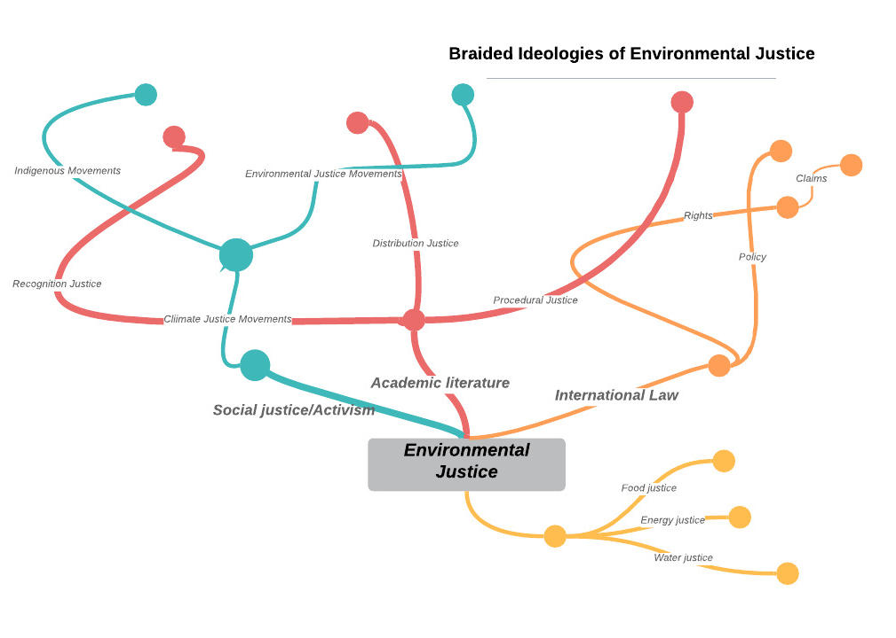

Slide 9
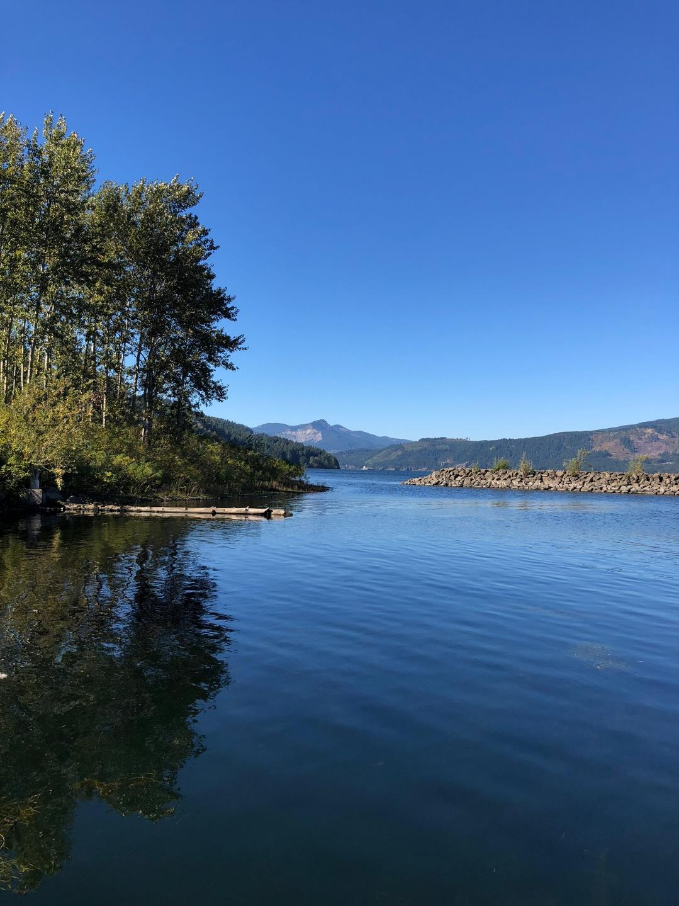
Distribution: Who has access?
(Research/Academia)
Procedural: Who is at the table?
(Government/Policy)
Recognition: Who sets the table?
(Activist/Advocacy)

Slide 10
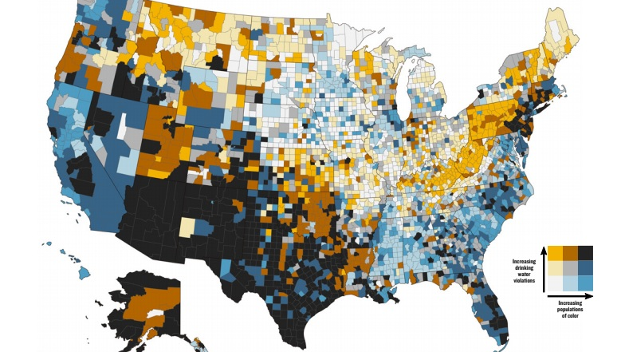
DISTRIBUTION JUSTICE
Credit: Kristi Pullen Fedinick, NRDC (2019). Used with permission.

Slide 11
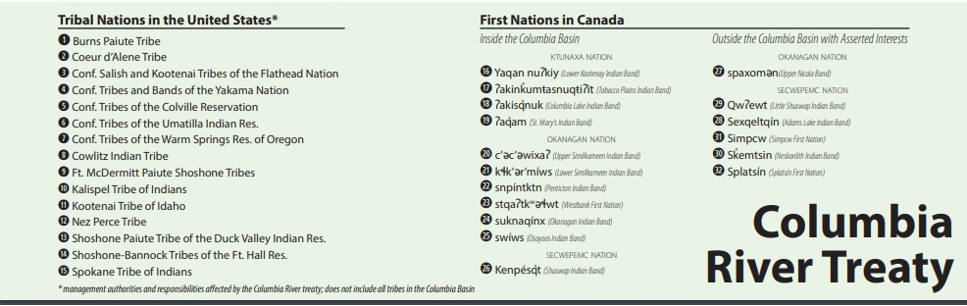
PROCEDURAL JUSTICE

Slide 12
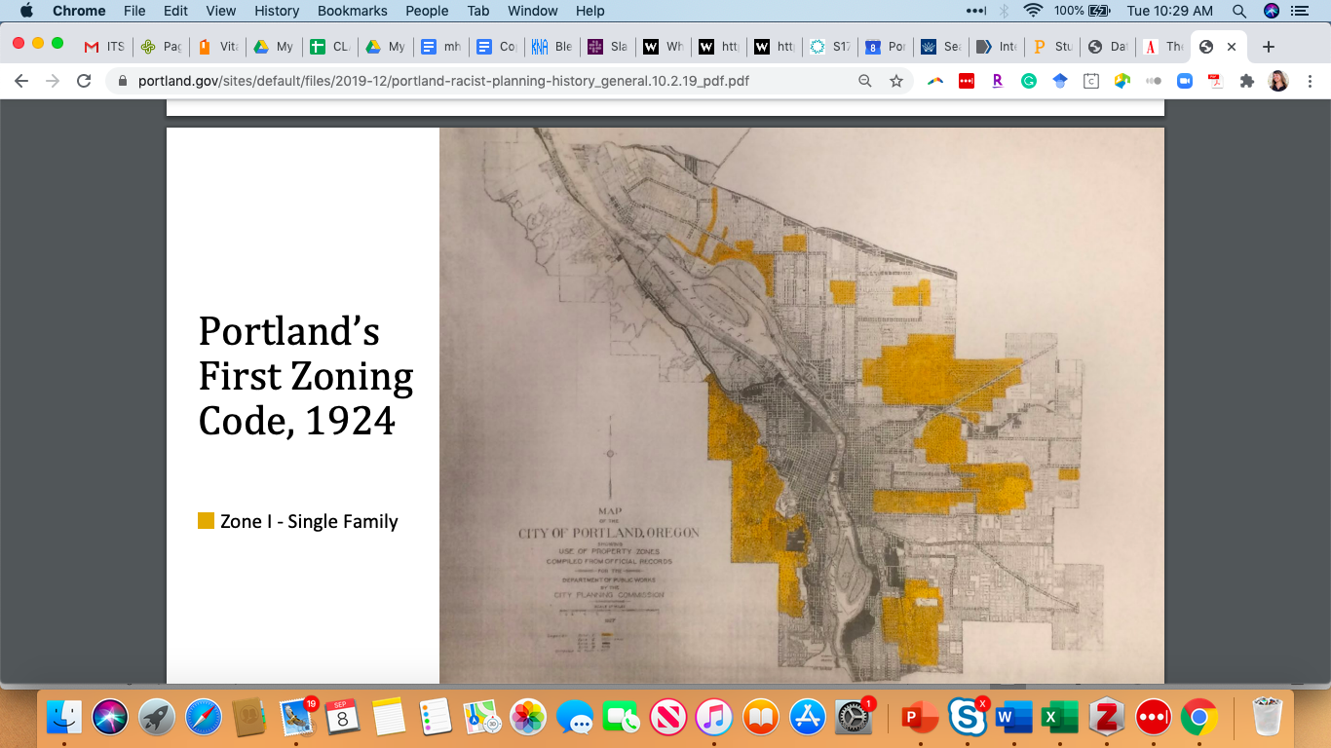
RECOGNITION JUSTICE
Recognition of intergenerational wealth and health
Recognition that data collection and modeling sometimes produce inequity
https://www.portland.gov/bps/history-racist-planning-portland

Slide 13
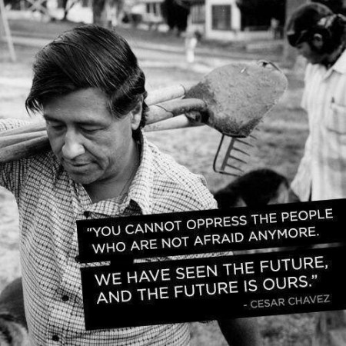
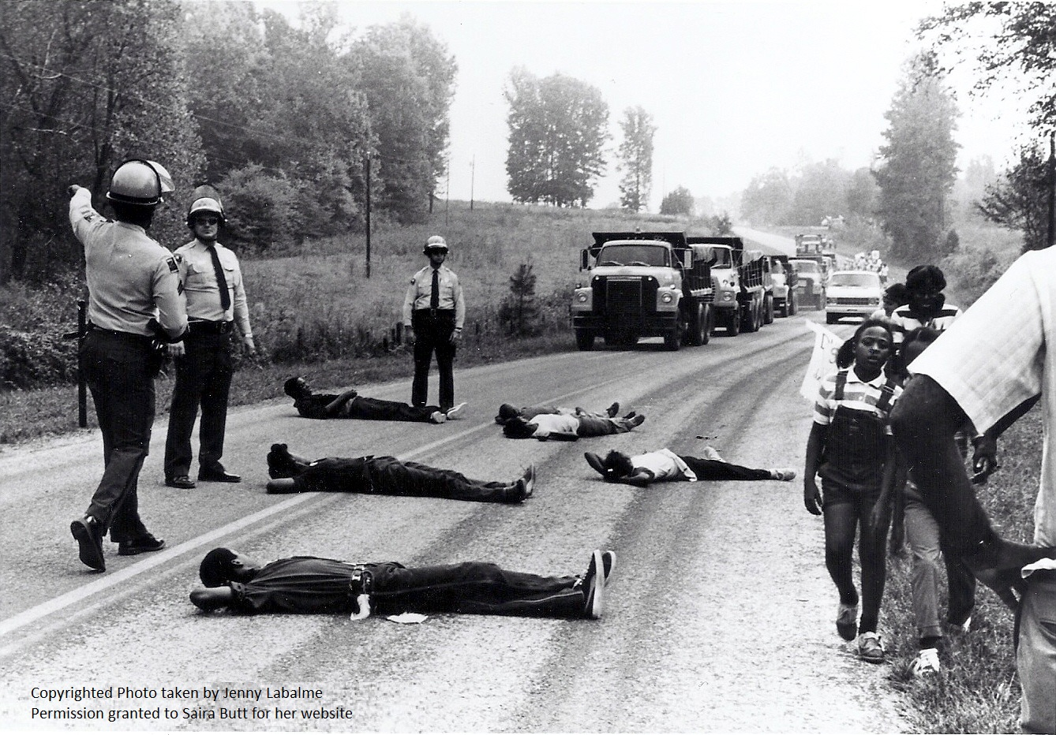
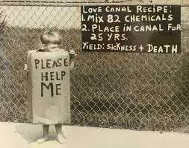
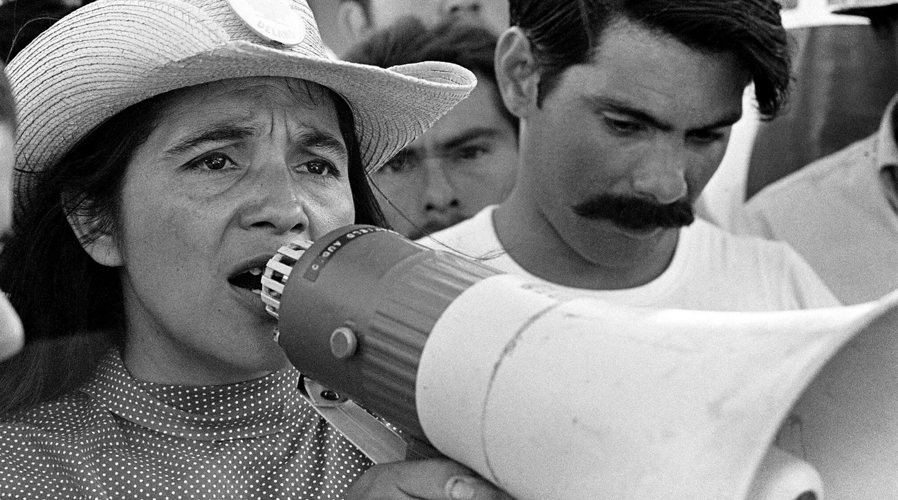
Seminal Environmental Movements

Slide 14
https://www.youtube.com/watch?v=REHiLryR1oE

Slide 15
United Farmworkers (San Joaquin Valley, CA)
1943 US patent DDT
1951-1966: 136 deaths caused by pesticides (laws protected growers)
1962 Rachel Carson, Silent Spring
1970 California banned DDT
1962 César Chávez & Dolores Huerta create United Farmworkers Union
1964 Braceros program to bring in low wage foreign labor during Vietnam War
  Mexican, Filipino paid below minimum wage
1965 Nationwide grape strike, lasted 6 years
1969 San Joaquin Valley, California
  1,400 sustained pesticide poisoning
  ½ disabled, ½ farmworkers
1970 Fieldworkers won the right to unionize
  Sí, Se Puede

Slide 17
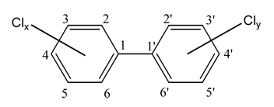
Afton, NC (Warren County) Landfill
June 1979 State officials selected Warren County as disposal site
“There is not one shred of evidence that race has at any time been a motivating factor for any decision taken by any official—state, federal or local—in this long saga” (Afton. District Court Judge W. Earl Britt as quoted in Labalme, 1987).

Slide 18
Polychlorinated Biphenyl (PCB)
Risks:
Skin Conditions
Thymus Gland Abnormalities
Liver Damage
Immune Deficiencies
Reproductive System Defects
  Decreased birth weight
  Congenital motor skill defects
  Short term memory loss
Nervous System Defects
Increased risk of cancer
  non-Hodgkins lymphoma
Findings:
Increased rate of miscarriages and birth defects
Increased rate of congenital abnormalities
Breast milk contaminated with dumped PCBs

Slide 19
Toxic Waste Disposal
1976: PCB manufacturing banned by Toxic Substance Control Act of 1976
1976: Resource Conservation and Recovery Act (RCRA) guides disposal
1978: Robert J Burns & Sons and Ward PCB Transformer Co. deliberately dripped 31,000 gal of PCB-contaminated oil along 240 miles of highway to circumvent EPA recycling regulations and save money
Legal Result:
  Burns and Ward tried and convicted
  Served short prison sentence plus $570,000 settlement/fine
Environmental Result:
  Soil– direct contamination of 60,000 tons
  Water– delayed contamination due to four-year clean up delay

Slide 20
Afton, NC (Warren County) Landfill
Themes:
EPA Toxic Substances Control Act permitted Warren County landfill as “dry-tomb” waste landfill, defined as open dump with liners between contaminated and uncontaminated
Later learned that state scientists misrepresented soil sample testing at the site. Site flawed because of soil permeability and short distance from groundwater
Hurricane rains eroded site and accumulated water before capping
Governor Hunt pledged to detoxify once tech became available
Final clean-up completion 2004 (~$18 million)
No reparations for residents
Patterns/Outcomes:
1982: Warren 1st county to have a majority of Black members on the Board of County Commissioners, coined the term “environmental racism.” Landfill site still approved (by state) despite facts and six weeks of protests, 550 arrests
1983 US General Accounting Office report concludes race correlates with hazardous waste sites across Southeast US. Warren County, NC:
  Population: 16,232
  60% Black (22% Statewide)
  Ranked 97th of 100 counties in per capita income
  Residents 2/3 of per capita income of the rest of the state
1987 Commission for Racial Justice’s Toxic Wastes and Race in the United States, convened by Rev. Ben Chavis

Slide 21
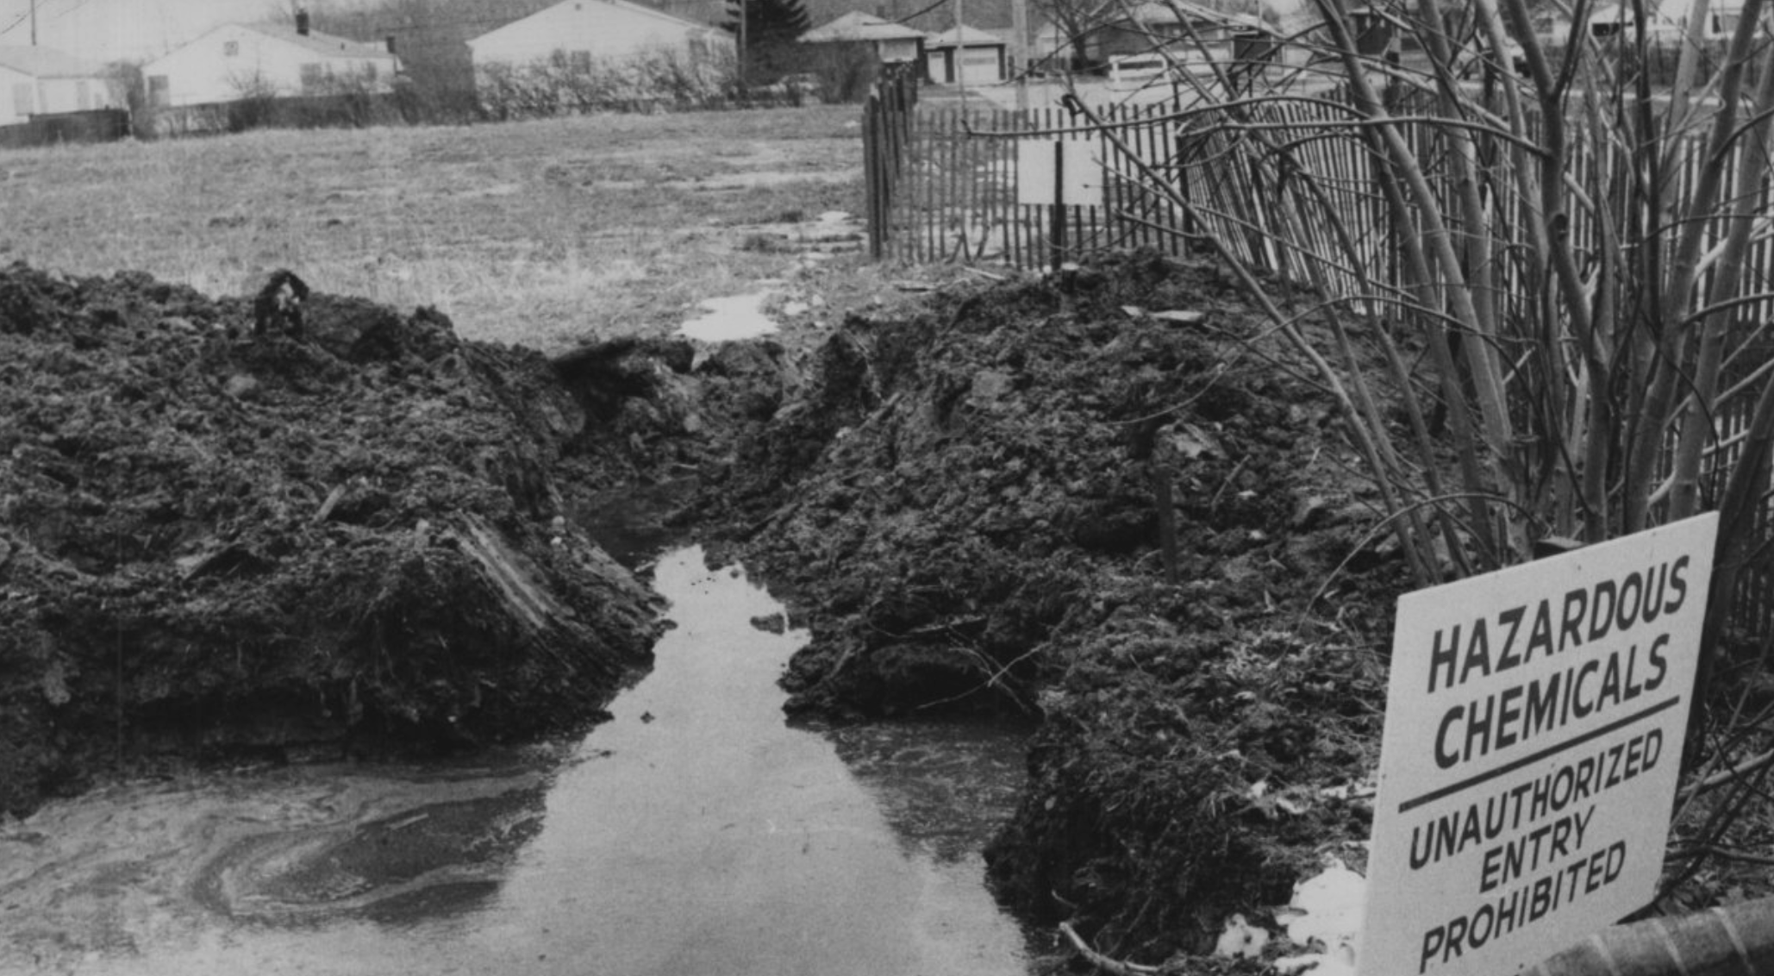
https://www.youtube.com/watch?v=Kjobz14i8kM

Slide 22
Love Canal (Niagara Falls, NY)
Themes:
1940s-1950s Hooker Chemical Company created 40 acre landfill. Hooker company attorney advised the land was not suitable for construction where underground facilities would be necessary due to chemical waste.
Sold to working class school district:
  800 private houses, 240 low income apartments
Black fluid in the canal, odors, leakages in yards
1977 storm raised water table, flooded basements
High rates of leukemia, birth defects, genetic damage
1978 protests led by a lawyer named Lois Gibbs (proto Erin Brockovich)
Patterns/Outcomes:
Comprehensive Environmental Response, Compensation, and Liability Act (CERCLA)
  "Superfund” Act
  Tax on chemical and petroleum industries
  Federal authority
  National Priorities List (clean up priority)
1994 Federal District Court ruled Hooker was negligent but not reckless
Final clean up 2004

Slide 23

Whisky Tango Foxtrot?!?

Slide 24
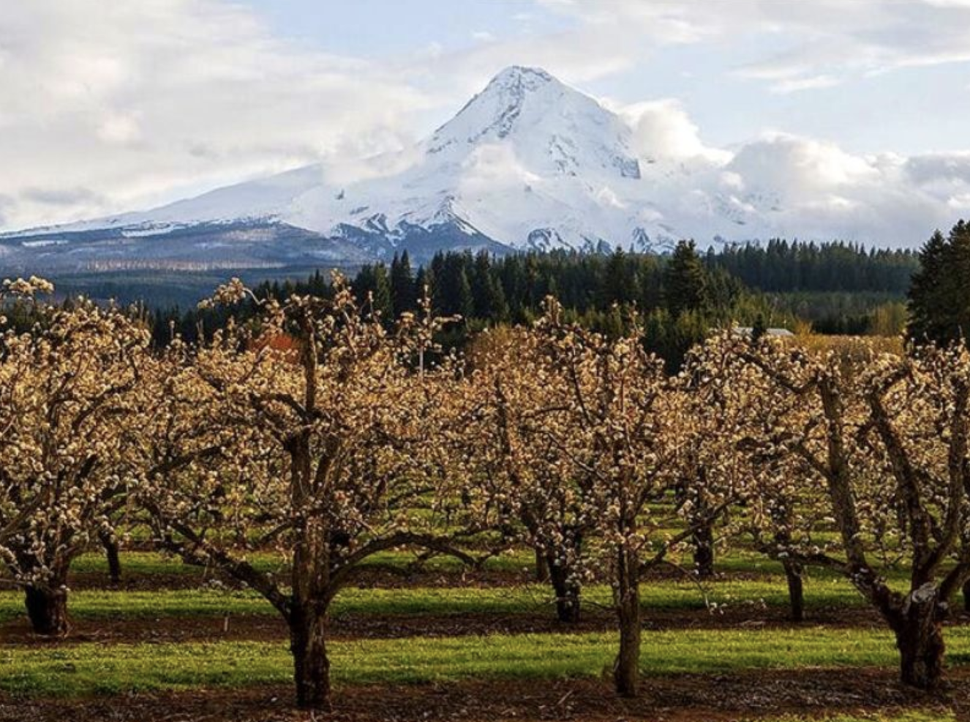
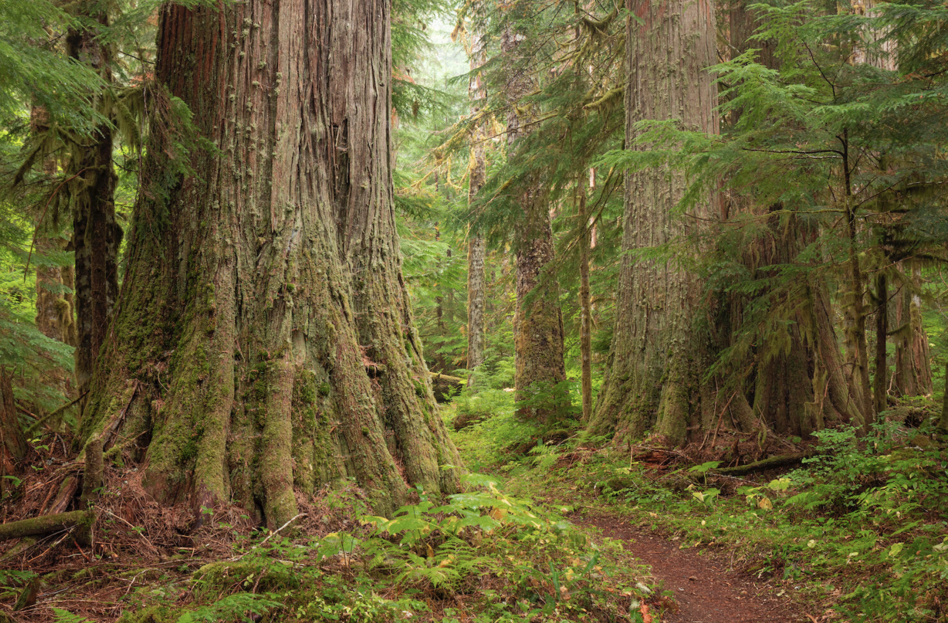
Typical Magnificent PNW Flora & Scenery

Slide 25

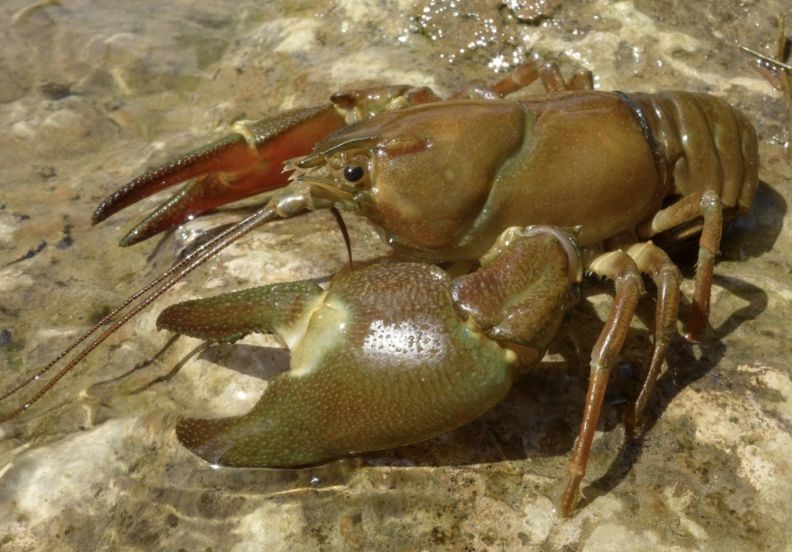





Typical Magnificent PNW Fauna

Slide 26


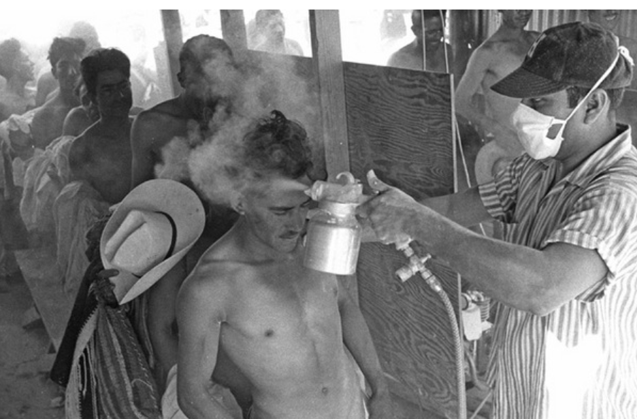
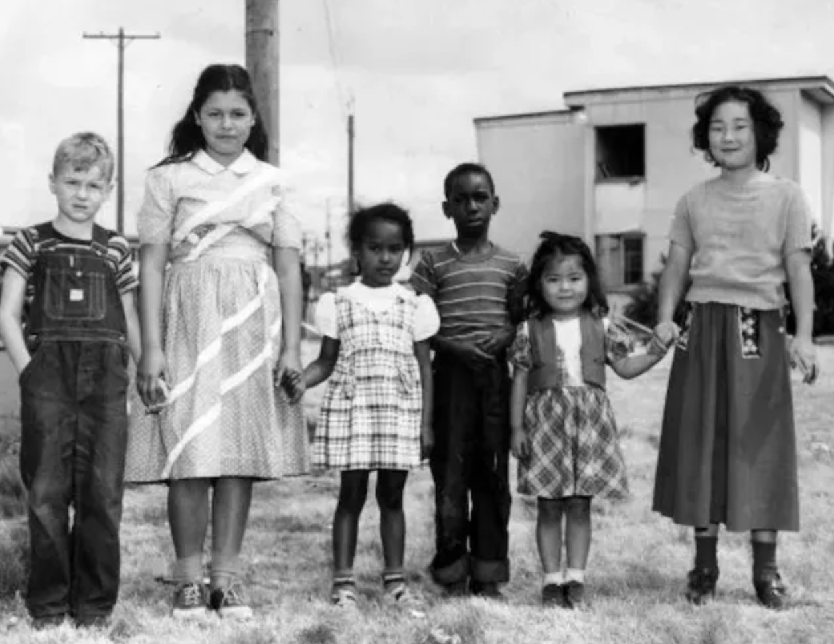
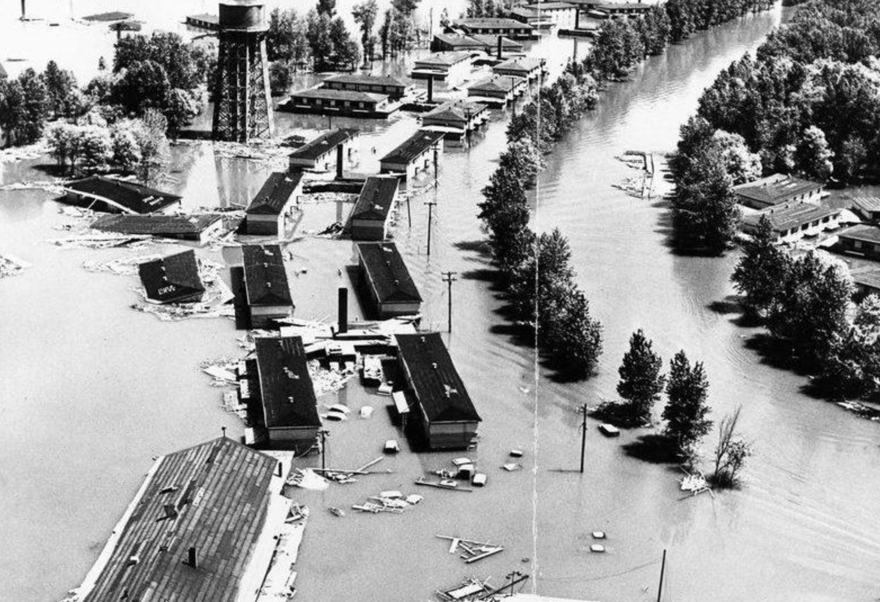
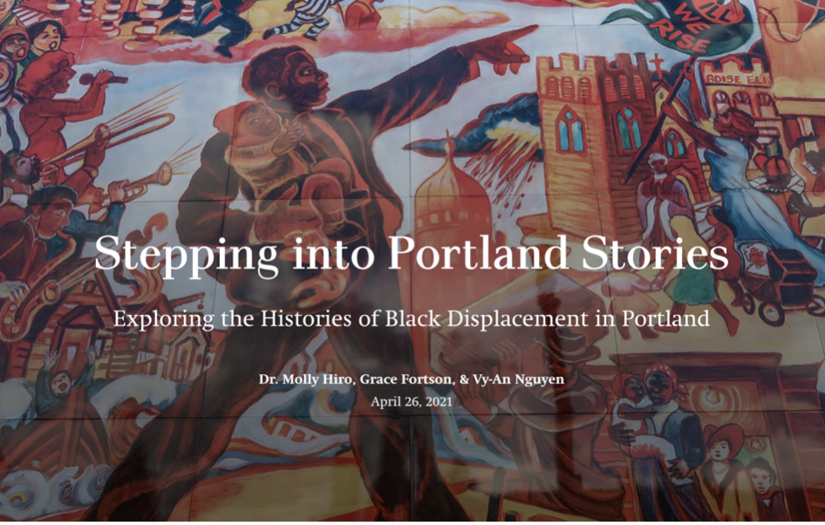
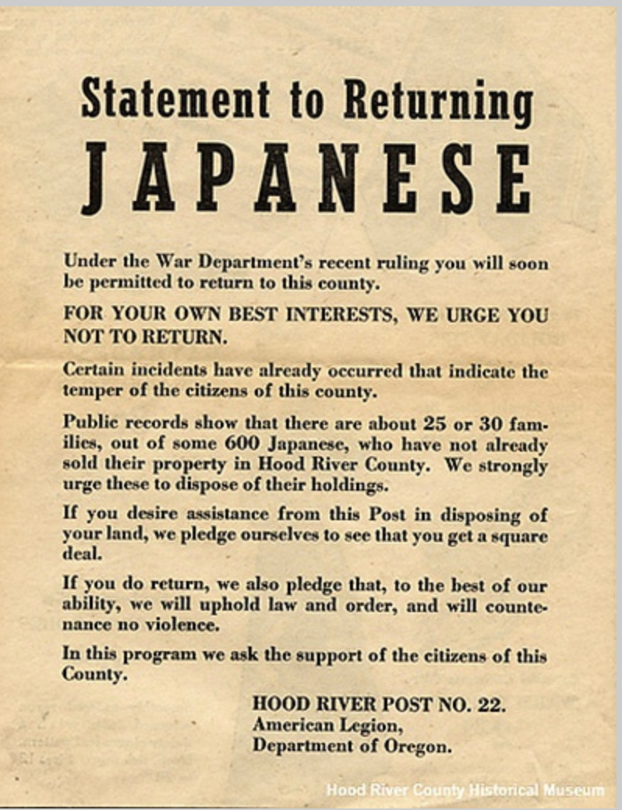
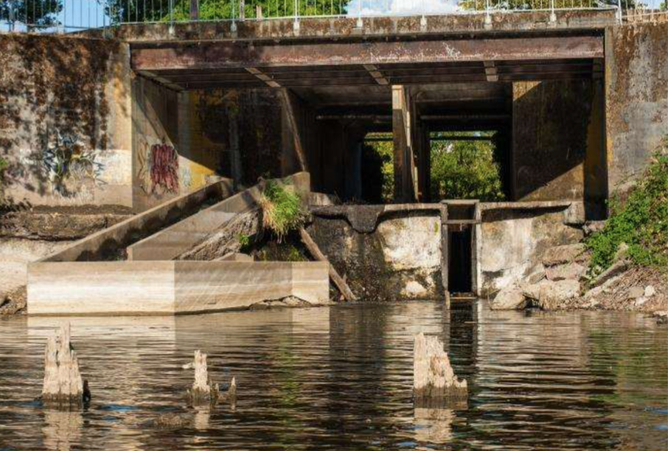
Typical Environmental Justice Focus

Slide 27
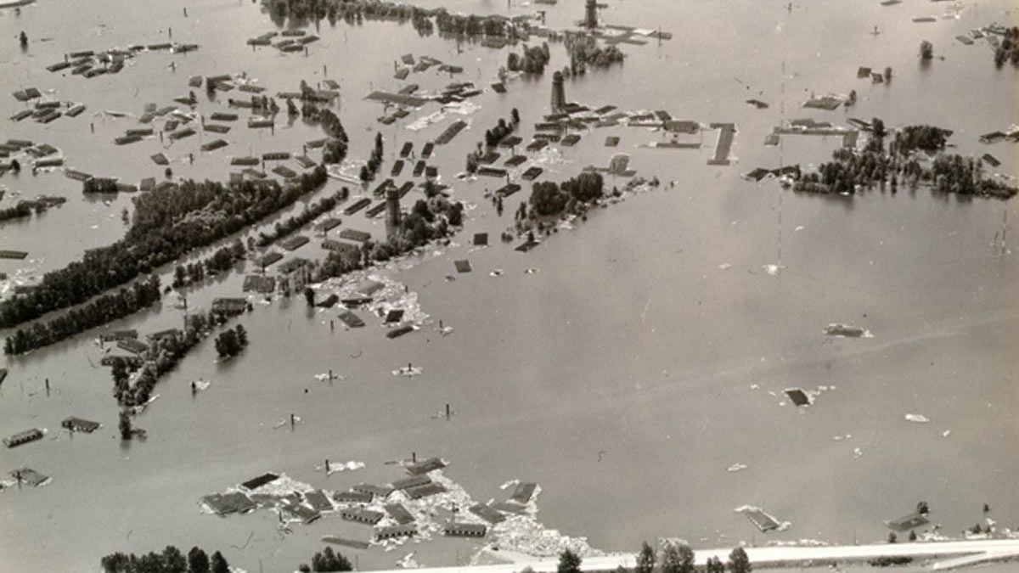
Notes:
Vanport Flood, 1948

Slide 28
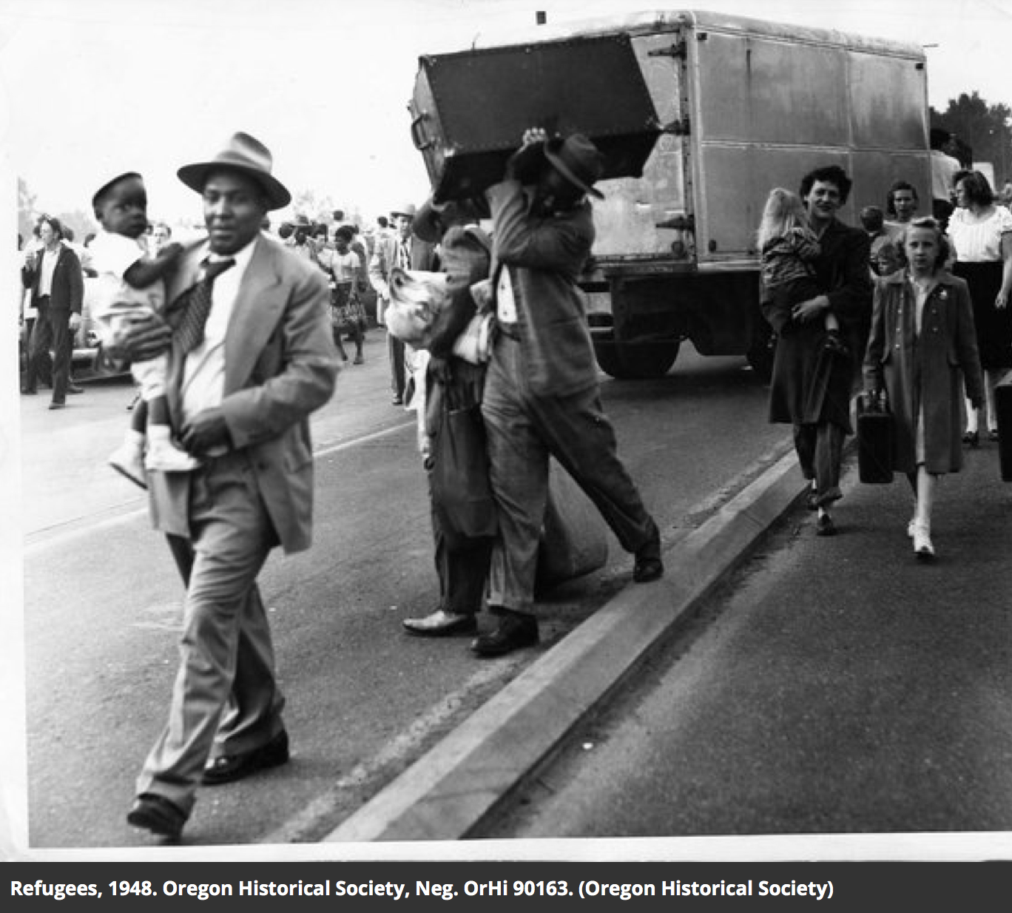
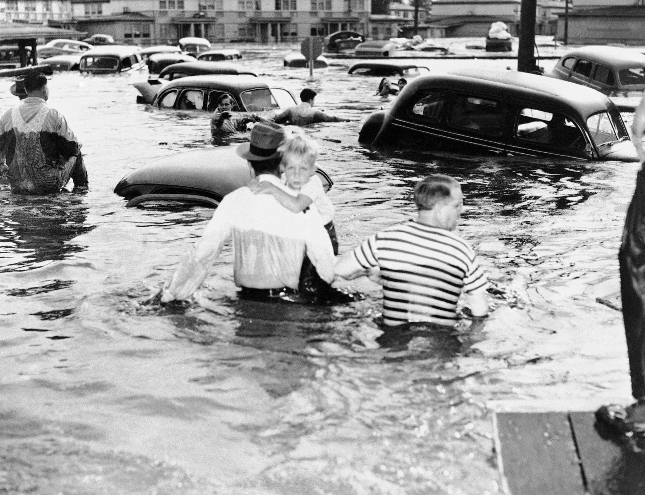
Notes:
Vanport Flood, 1948

Slide 29
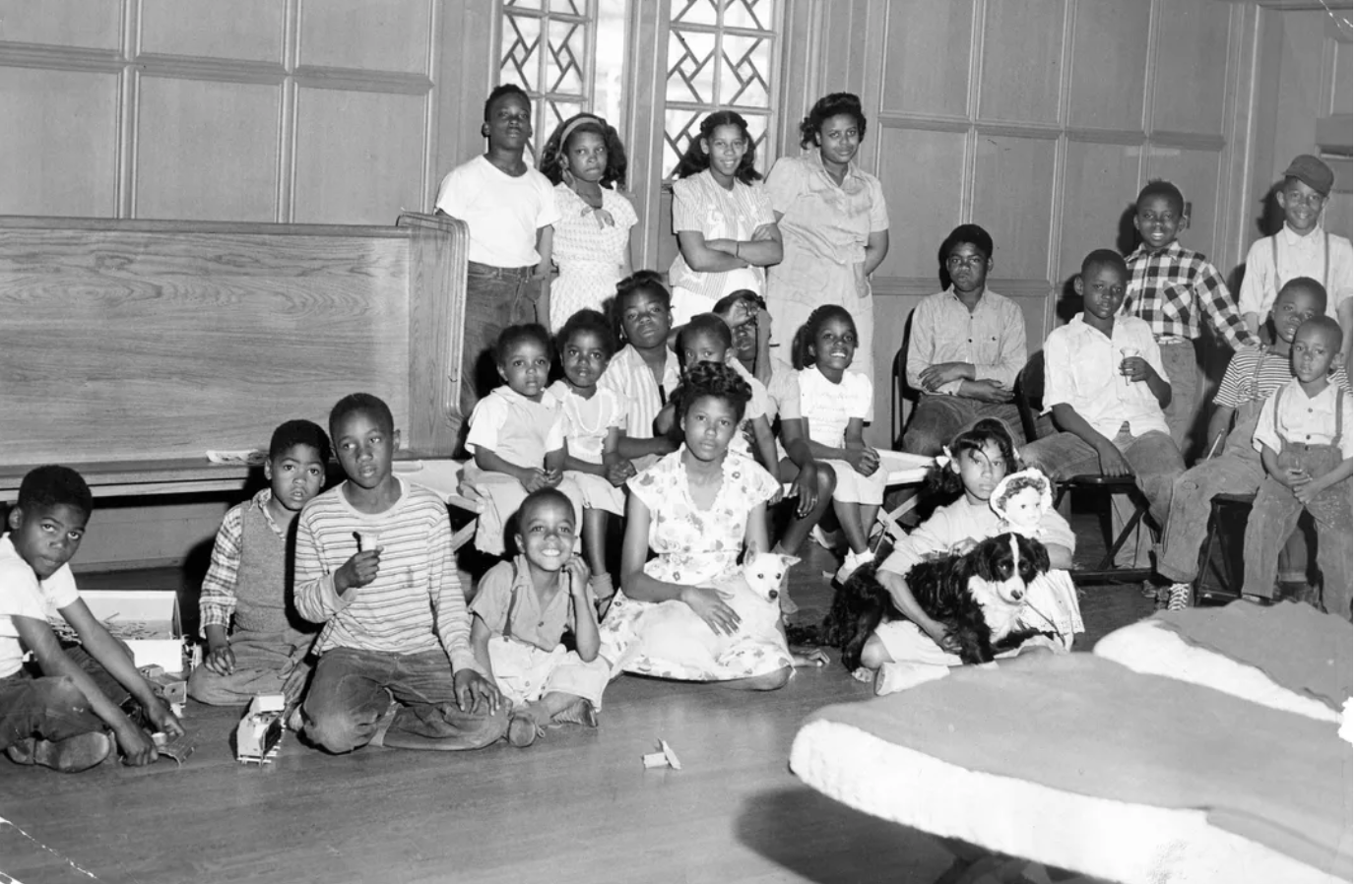
Notes:
Black Vanport Flood survivors take refuge at local Episcopal Church– briefly…

Slide 30
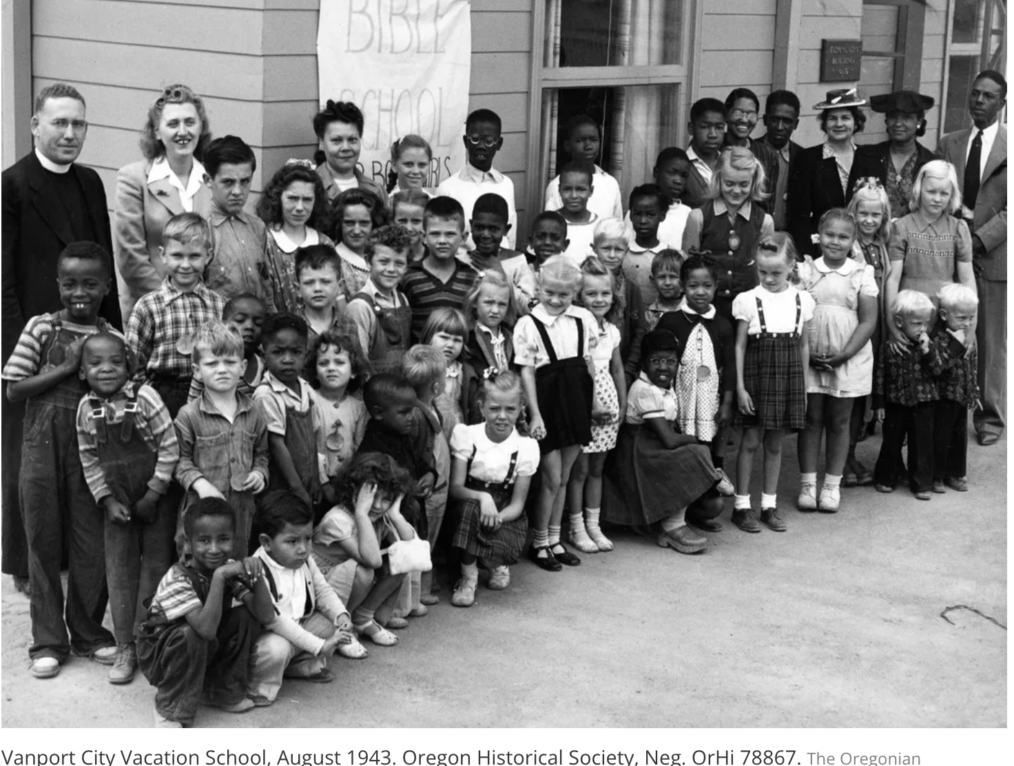

Slide 31
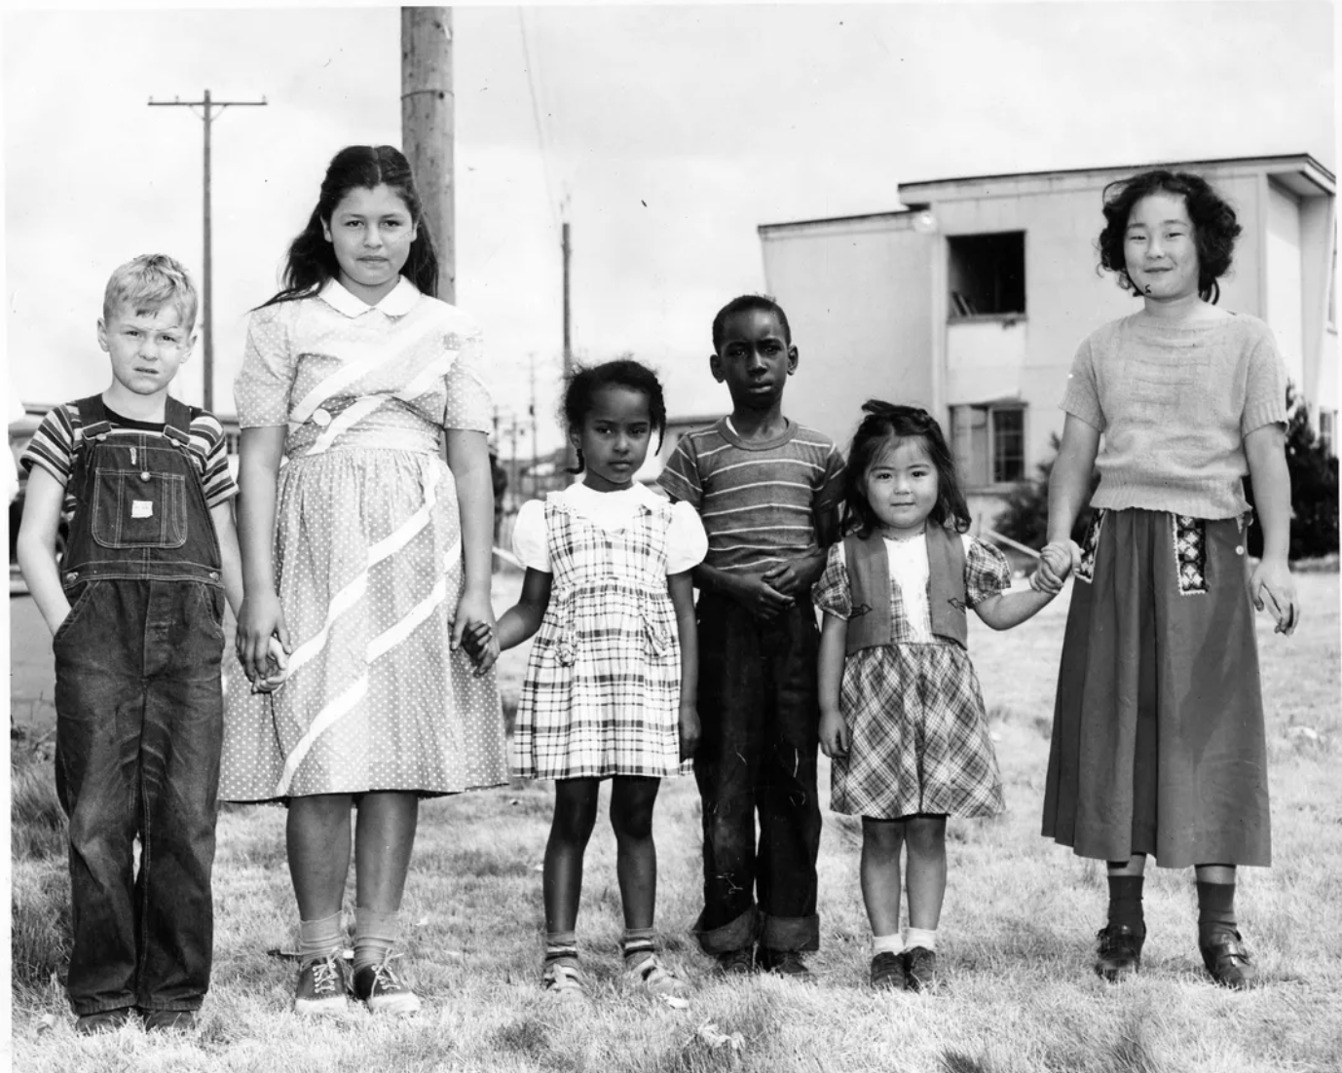

Slide 32
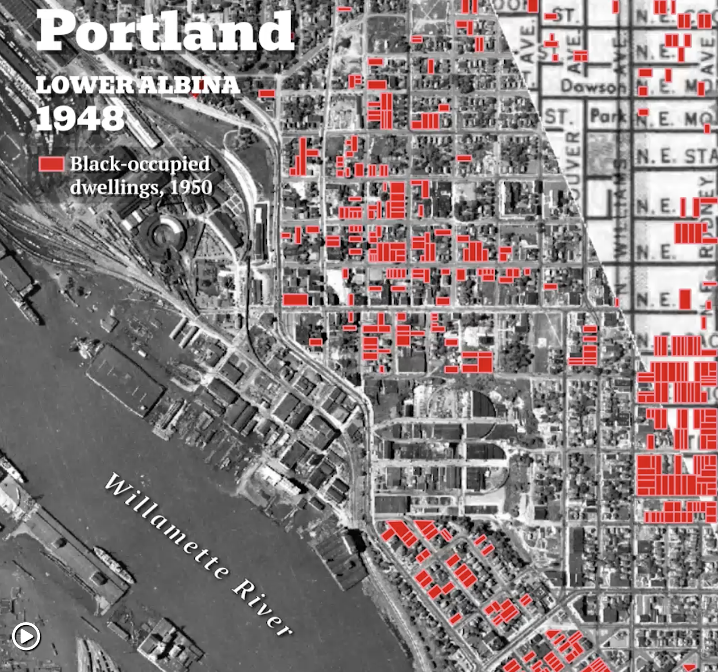

Slide 33
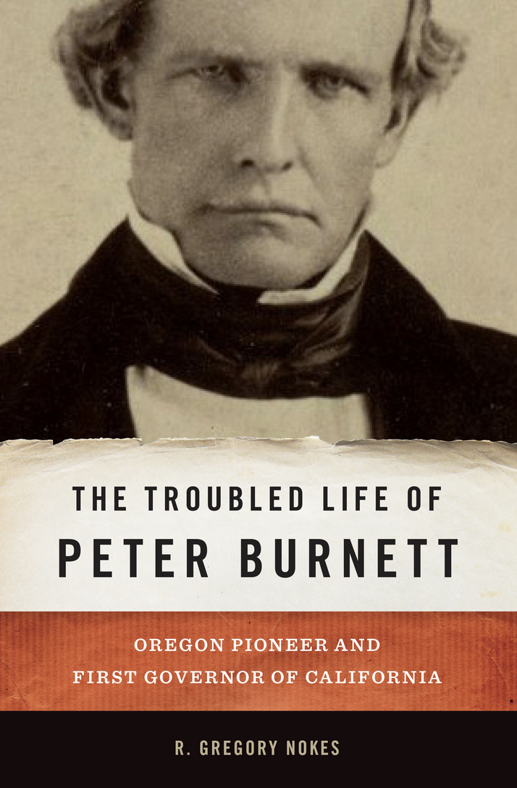
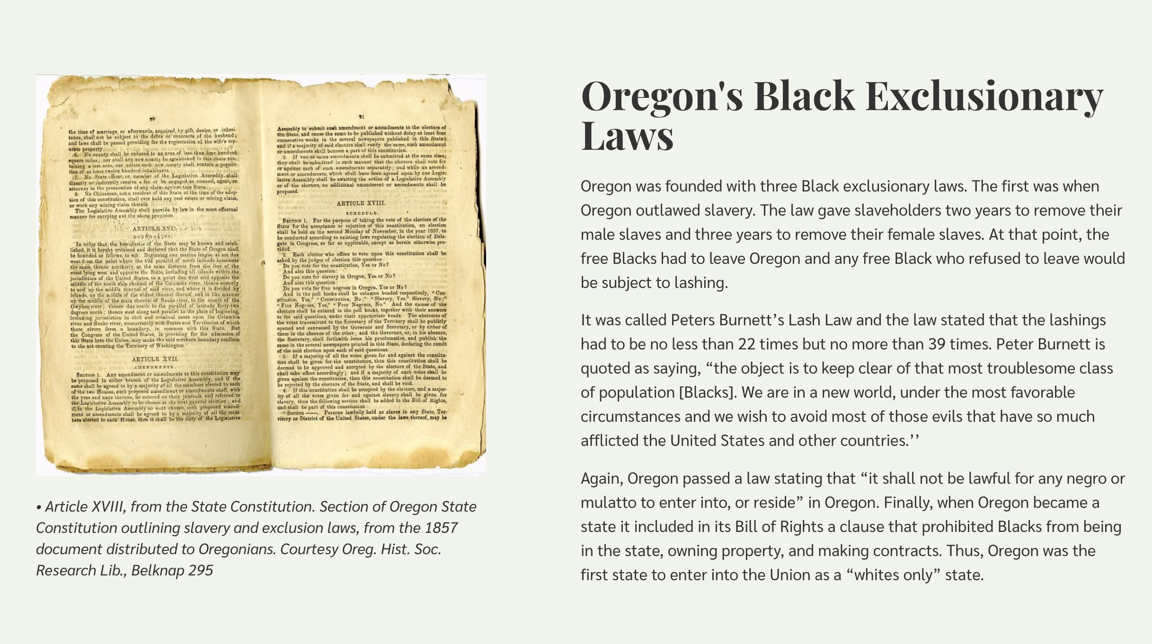

Slide 34
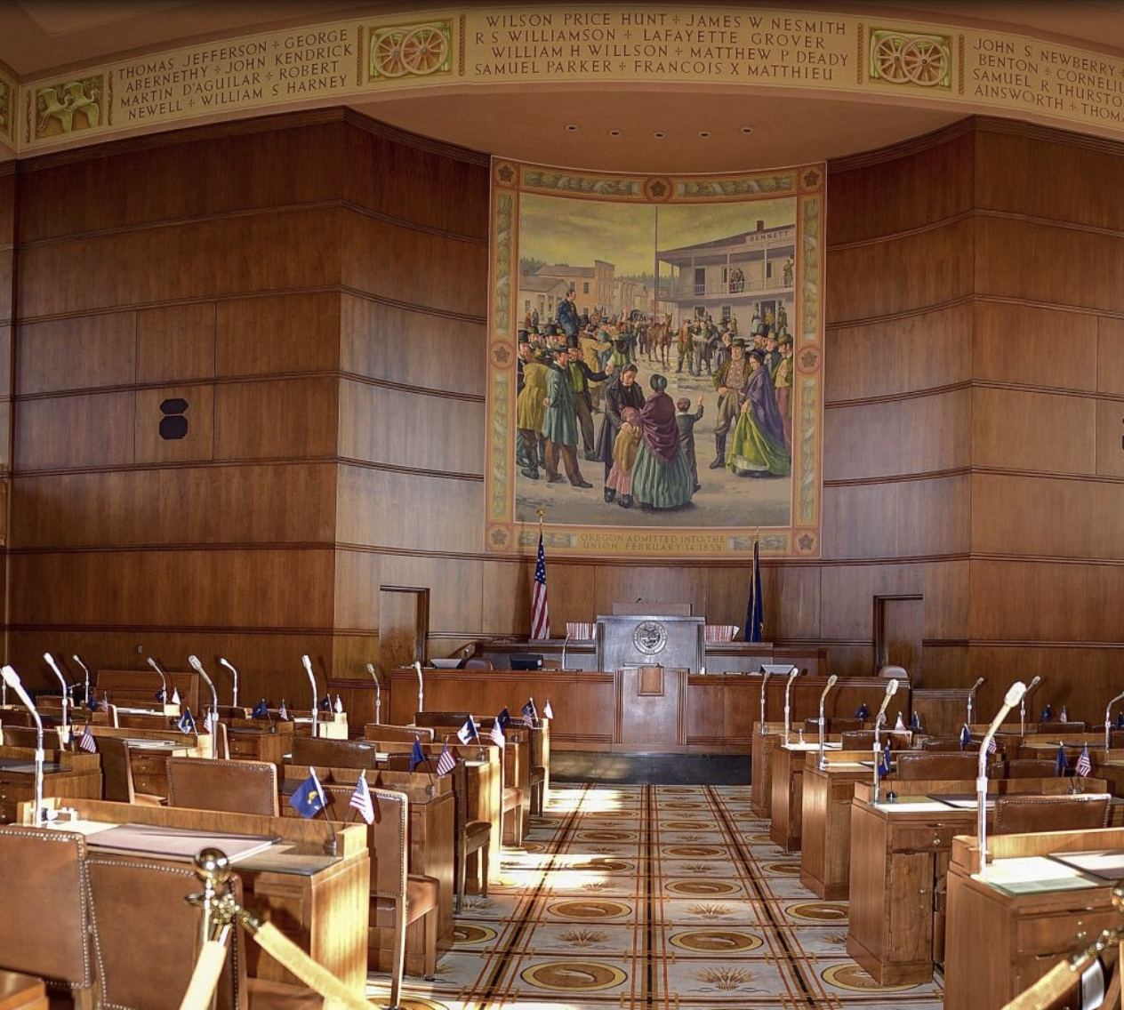

Slide 35
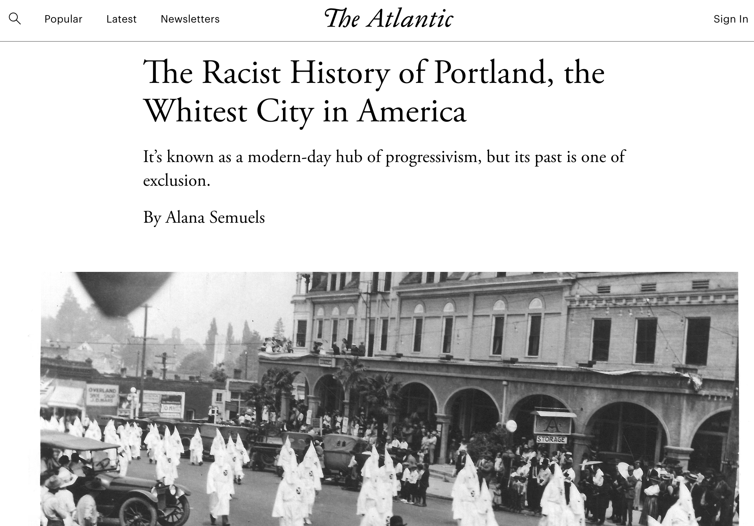

Slide 36


Slide 37


Slide 38
