Slide 1
We have the Data and Science, It’s Time to Act
Tony Grover
Fish and Wildlife Director
Northwest Power & Conservation Council
17 June 2016

Slide 2
What We Know

Slide 3
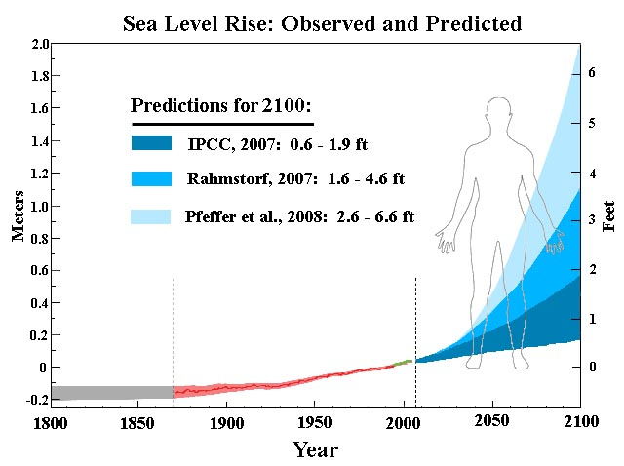
The Facts
We have it on the best authority that climate change and sea level rise are real, and almost certainly accelerating.

Slide 4
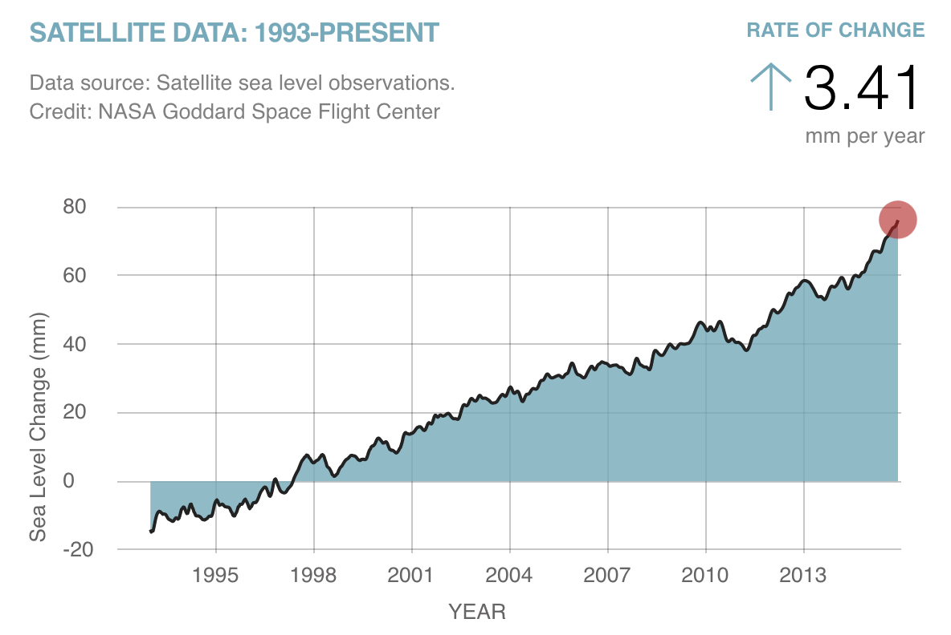
NOAA: “Sea level has been steadily rising at a rate of 0.04 to 0.1 inches per year since 1900.” Since 1993 the rise has been ~ 0.13 inches per year.

Slide 5
What We Are Doing

Slide 6
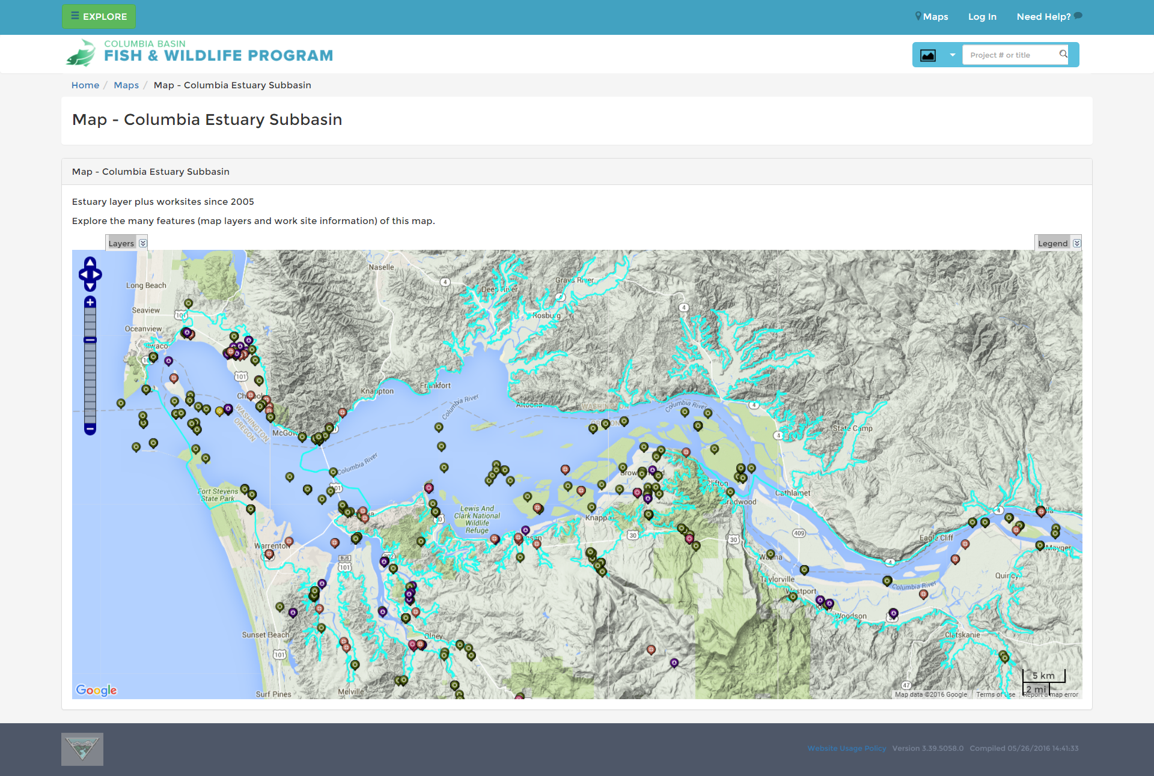
CBFish Screenshot of
BPA Funded activities

Slide 7
So What ?

Slide 8
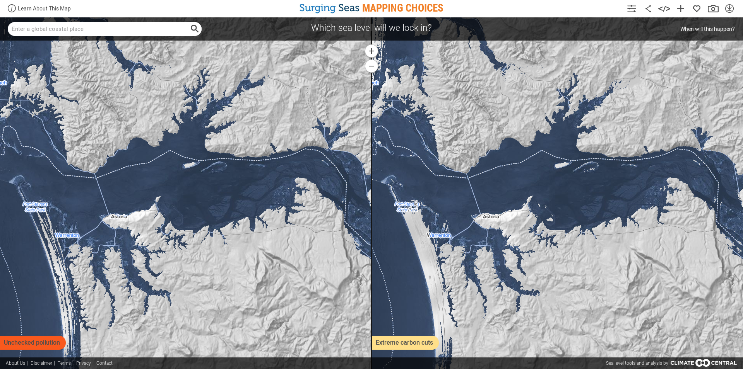
A couple of sea level rise scenarios

Slide 9
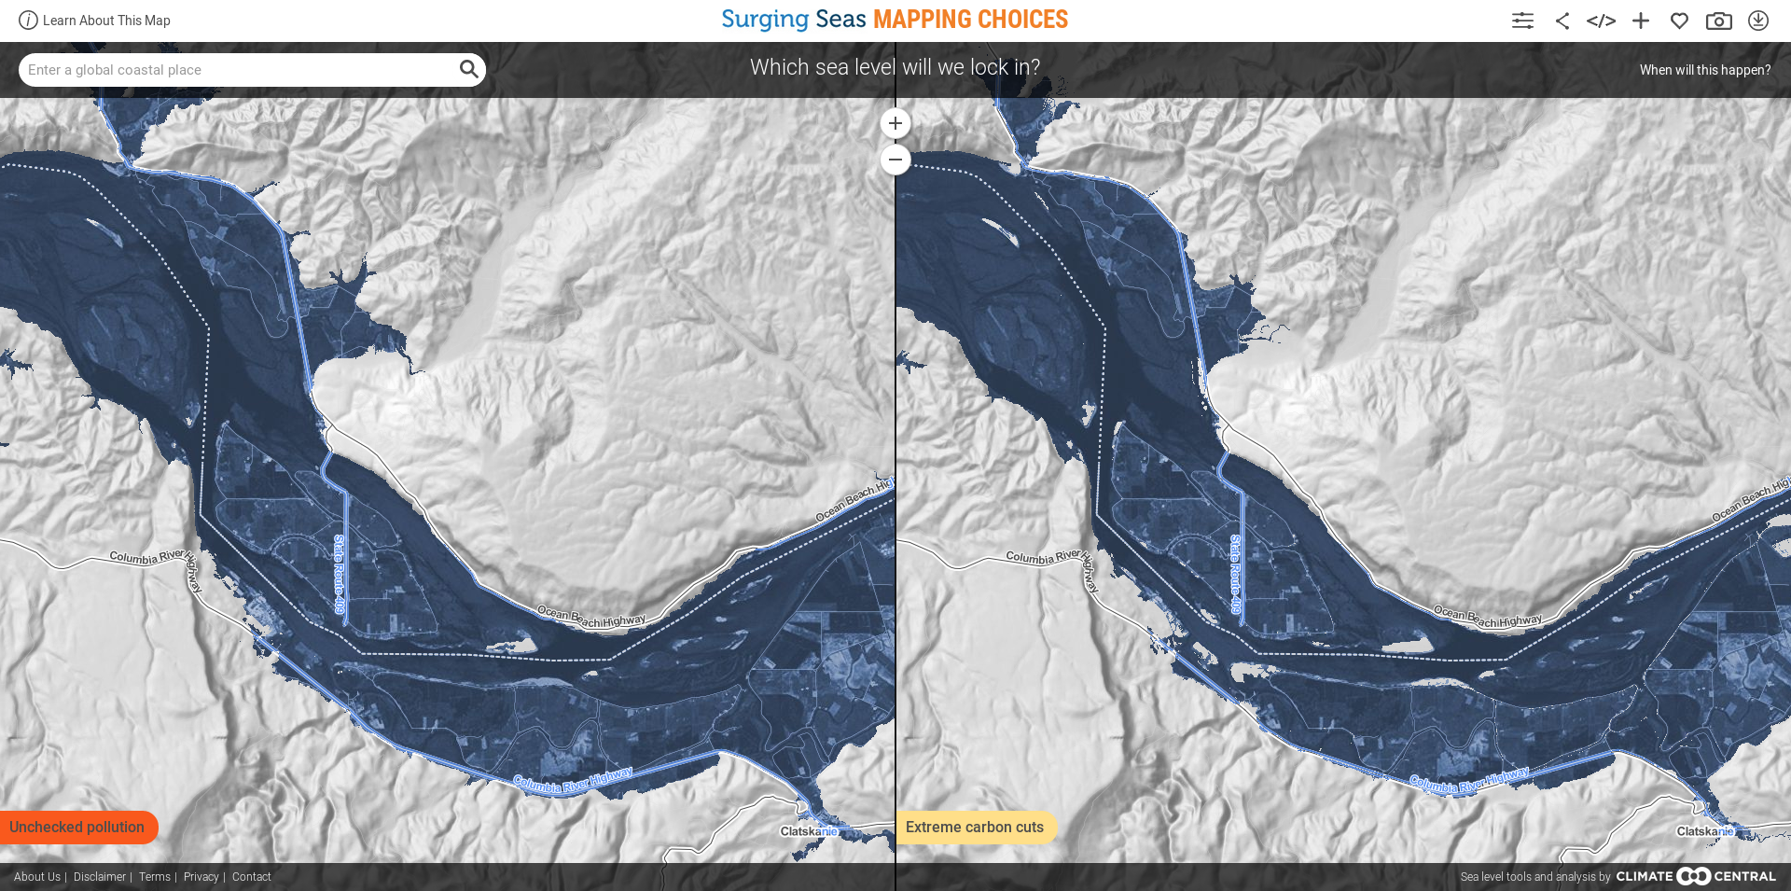
… moving up river…

Slide 10
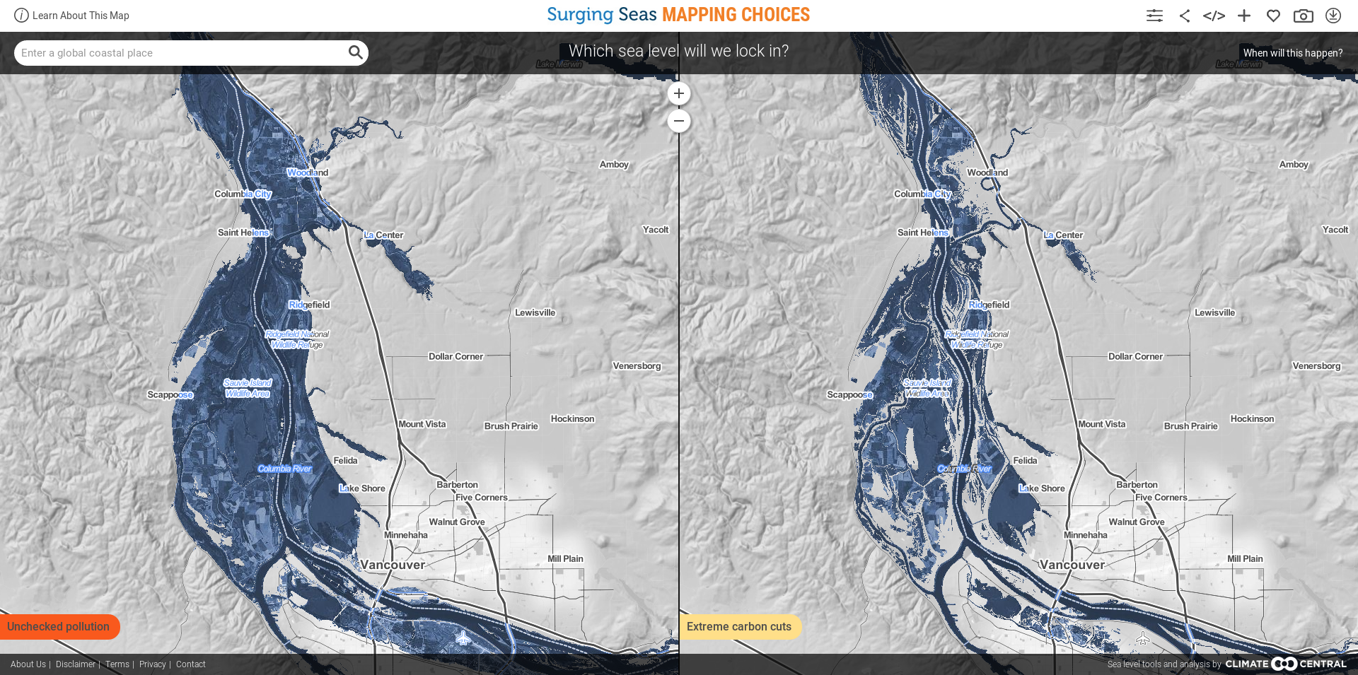
… to Sauvie Island …

Slide 11
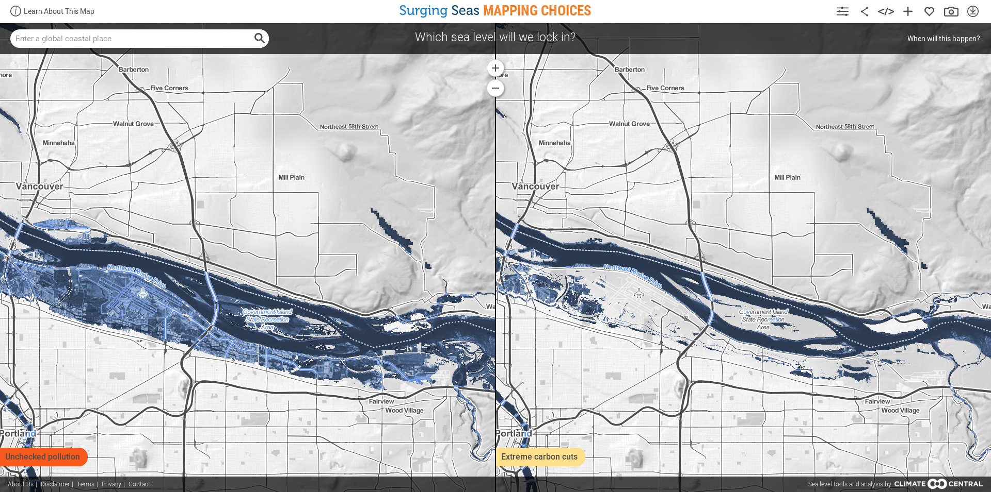
… and to Portland.

Slide 12
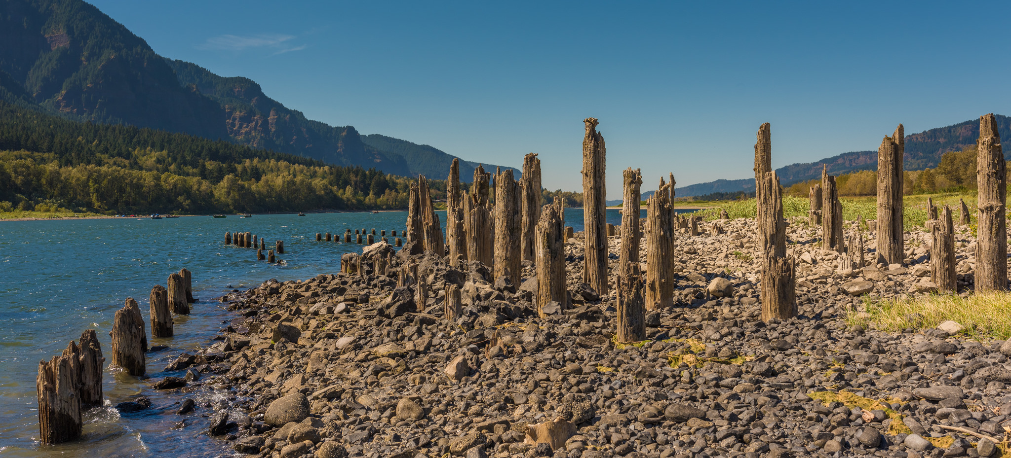
The Problem – Human Nature
Folly: “self destructive act carried out despite the availability of a recognized and feasible alternative.” – Barbara Tuchman, The March of Folly, 1984
Example: 150 years ago it was widely understood that operation of fish wheels, such as this ruin on Ives Island, resulted in catastrophic declines in salmon fisheries. Laws were passed in 1878 to stop over-harvest. They were ignored and un-enforced.

Slide 13
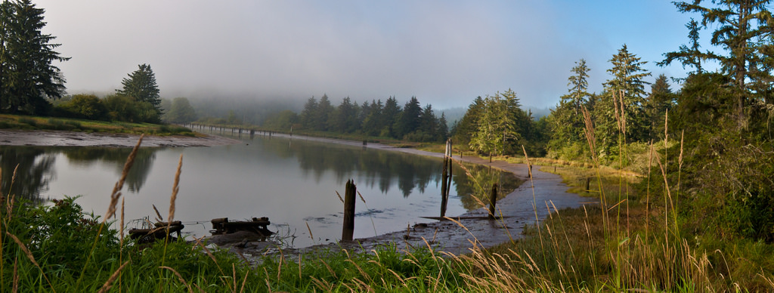
A Modern Example and an Opportunity
2003-011-00 - Columbia River Estuary Habitat Restoration ~ $25,624,696 since 2004

Slide 14
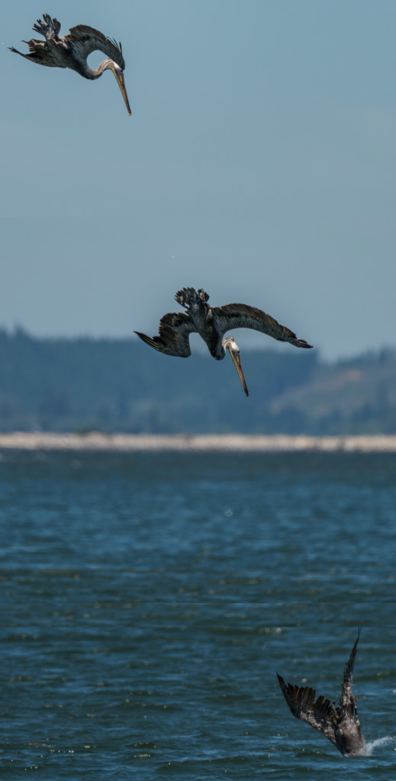
Human Nature
Mental standstill (lock-in) – ‘we see the problem and have identified a solution.’
Signs of failure – ‘it is harder than we thought, but we will persevere.’
Refusal to admit error, egoism – ‘of course it is not a mistake, in fact, we will double down on our commitment.’

Slide 15
We can do better.
We can pause to integrate climate change and sea level rise into our planning.
We can accept the uncertain nature of climate change predictions into our planning.

Slide 16
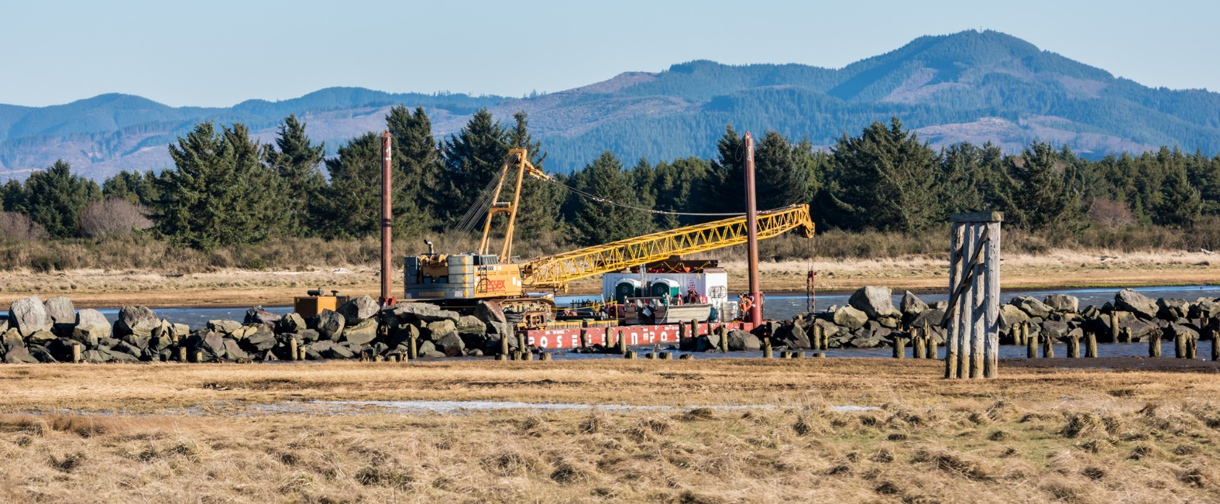
What to do ?
Develop new criteria that prioritizes habitat actions with near term and long term benefits – even if those benefits are inexact and will change over time. (i.e. wetlands that become tidal marshes and eventually become submerged shallow water habitat.)
Do not implement actions that do not have a clear succession of near to long term benefits under a range of sea level rise scenarios.

