Slide 1
Climate Change Impacts in the Tribal Cultural Landscape
Michael Karnosh, Ceded Lands Program Manager
Confederated Tribes of Grand Ronde
June 17, 2016

Slide 2
Presentation Outline
What is a Tribal Cultural Landscape?
Why is the Columbia River Estuary a Tribal Cultural Landscape?
What are the impacts of climate change on this Tribal Cultural Landscape?
Questions

Slide 3
Tribal Cultural Landscapes (TCLs)
U.S. Dept. of Interior, Bureau of Ocean Energy Management (BOEM)
In partnership with NOAA, Makah Tribe, Yurok Tribe, Confederated Tribes of Grand Ronde
Published this Guidance Document in 2015

Slide 4
So what are TCLs?
Tribal Cultural Landscape: Any place in which a relationship, past or present, exists between a spatial area, resource, and an associated group of indigenous people whose cultural practices, beliefs, or identity connects them to that place. A tribal cultural landscape is determined by and known to a culturally related group of indigenous people with relationships to that place.
Differs from Traditional Cultural Property (TCP) in that TCLs are defined as significant by indigenous communities, whereas TCPs are designated in the limited context of eligibility for listing in the National Register of Historic Places

Slide 5
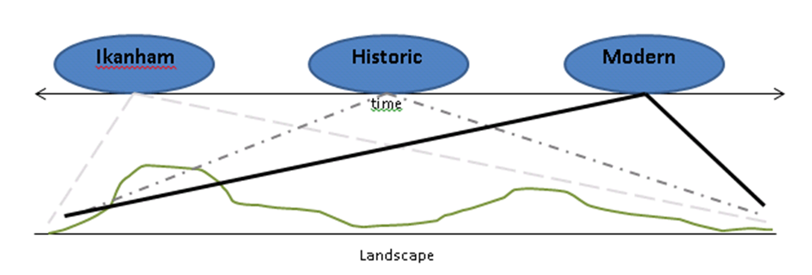
Why do TCLs matter?
They are the constant bases of culture, not just in modern times, but also going back to the Historic and Ikanham (myth time before the Creation) Eras
As cultural resources their protection may be required by treaties, NEPA, NHPA Section 106, AIRFA, etc.
Notes:
A place can have value as (1) where according to oral tradition something significant happened before/during the Creation, (2) where people did/do traditional ceremony, (3) where food and other traditional materials were/are gathered, or (4) where something historically significant happened (e.g. treaty signing), or all of these simultaneously.

Slide 6
The Columbia River Estuary
Defined as the tidally-influenced reaches of the Columbia and its tributaries
The primary trade highway in the PNW, lined with villages and resource sites
Directly connected to Coast, Puget Sound, Klamath, and Inland Northwest (WA/OR/ID/MT) – indirect connections go further
At least five major language families were used, in addition to the Chinuk Wawa trade language
Notes:
The Estuary may be thought of as the “Old Silk Road” of the PNW, connecting widely varying cultures and trade goods.

Slide 7
The Estuary is a TCL
Traditional Food and Fiber materials / gathering sites
Pictured: Wapato

Slide 8
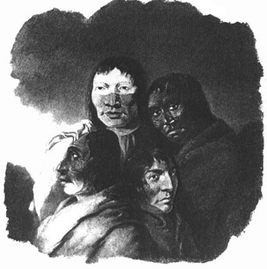
The Estuary is a TCL
Villages, Treaty areas (ratified and unratified) and other places of historical significance
Pictured: Four Chinookan men encountered near the Clackamas/Willamette confluence, painted by Paul Kane c. 1847

Slide 9
The Estuary is a TCL
Ikanham (Myth age) places used in describing the creation of the world
Pictured: Rooster Rock
Interactive Story Map illustrating the ikanham of South Wind (N. OR/S. WA coasts, plus LCR) can be found at http://arcg.is/1VivLSQ

Slide 10
The Estuary is a TCL
Traditional fishing sites
Pictured: Fishing scaffold “below the Cascades” painted by Paul Kane. Beacon Rock can be seen in the background.

Slide 11
Cultural Landscapes (TCLs)

Slide 12
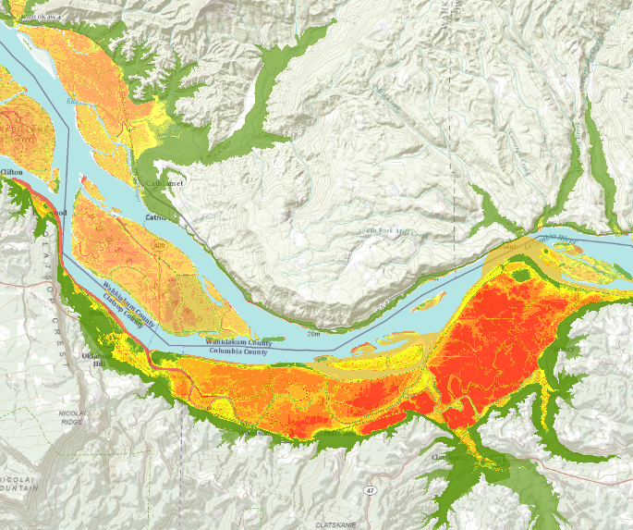
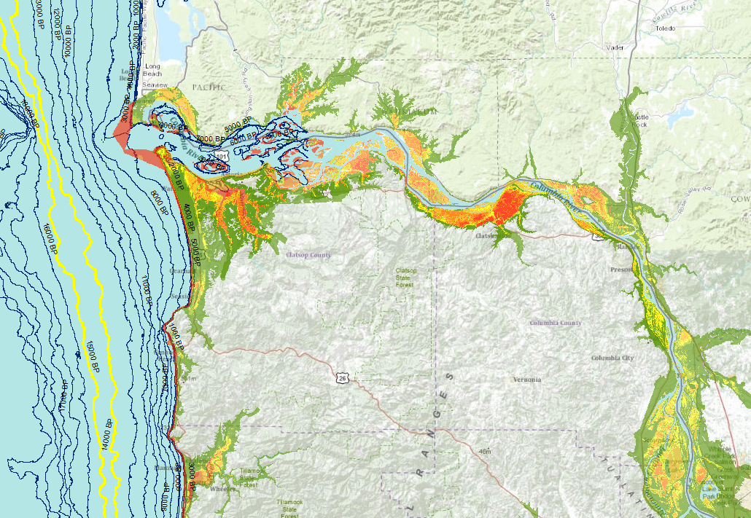
Climate Change & Sea Level Rise
Climate Change & Sea Level Rise
Landscape Changes
Site Impacts
Gathering Practices
Landscape Changes
Site Impacts
Gathering Practices

Slide 13
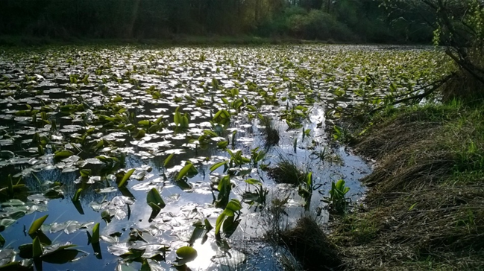
Cultural Resource Impacts
Increased Wave Energy
Storm Intensity
Severity of Erosion
Resource Inundation

Slide 14
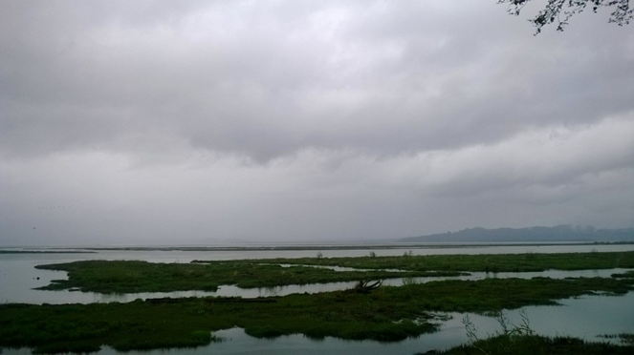
Prioritization & Triage of Resources
Archaeological Sites
Gathering Resources
Hunting & Fishing Resources
Metals, chemicals, toxins
Already in system
Potential increase from new sources

Slide 15
Potential Impacts to the Estuary TCL
What We Can Count On
Climate Change
Increased Population / Development Pressure
Increased Pressure to Protect Infrastructure and Production
Acceleration of Processes / Activities that have Already Taken a Toll on TCL
What We Don’t Know (yet)
Exact Scope and Degree of Impact
Exact Extent of All Cultural Resources
Which Mitigation Measures will Prove Successful

Slide 16
What We Can Do
Take opportunities to learn: Research, survey and monitor natural / cultural resources; “cross train” with experts in other disciplines/TEK
Prioritize and triage resources, as mentioned previously
Investigate potential prevention and mitigation tools
Awareness: Educate the public on what is out there and why it is important
Adapt our activity / management / protection regimes to change as our “new normal” changes

Slide 17
hayu-masi (Many Thanks)
Tribal Lands Dept.
Lands@grandronde.org
503-879-2383
Tribal Historic Preservation Dept.
thpo@grandronde.org
503-879-1630

